Slide 1
Overview of Type 1 Diabetes – Management and Regimens
Dr Julia Platts
Consultant in Cardiff and Vale UHB
National Clinical Lead for Diabetes in Wales

Slide 2

Declarations
I have received honoraria for speaker fees and advisory boards from Medtronic, Dexcom, Abbott, Insulet, Lilly, Astra Zeneca, Sanofi

Slide 3
Type 1 Diabetes
Type 1 diabetes affects
  370,000 adults in the UK
  30,000 children in the UK (1 in 1000 children)
Rising incidence and prevalence
A person with type 1 diabetes aged 20 will lose 12 years life*
Generally, a decline in complications with improving control over time
Cohort of people (upto 140,000) who struggle with disordered eating and have some of the worst outcomes
* Wise BMJ 2015;350:h59

Slide 4
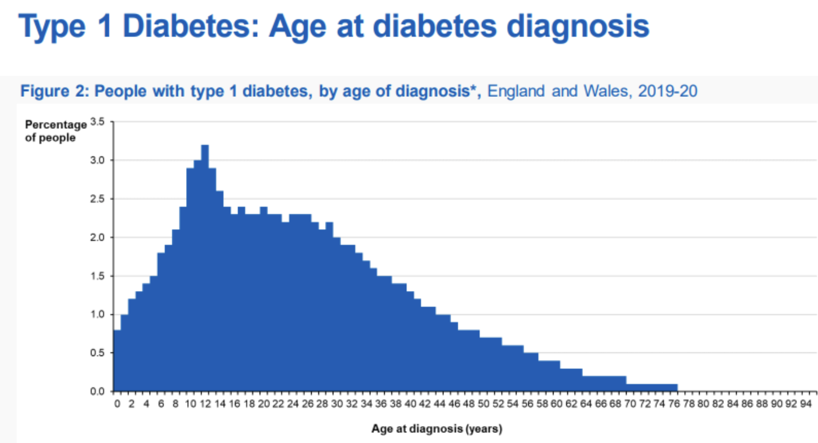

Slide 5

Complication rate 20 years post diagnosis
Severe hypoglycaemia per year
7.5% *
Retinopathy
38% *
Nephropathy
14% *
Neuropathy
8% *
CAD 3.% *
Autonomic dysfunction
20% **
Disordered eating in type 1 diabetes
30% ***
*J Clin Med 2022 Feb; 11(4): 1039
**Diabetes Care 2003 May;26(5):1553-79.
*** Diabetes Care. 2008; 31:415-419

Slide 6
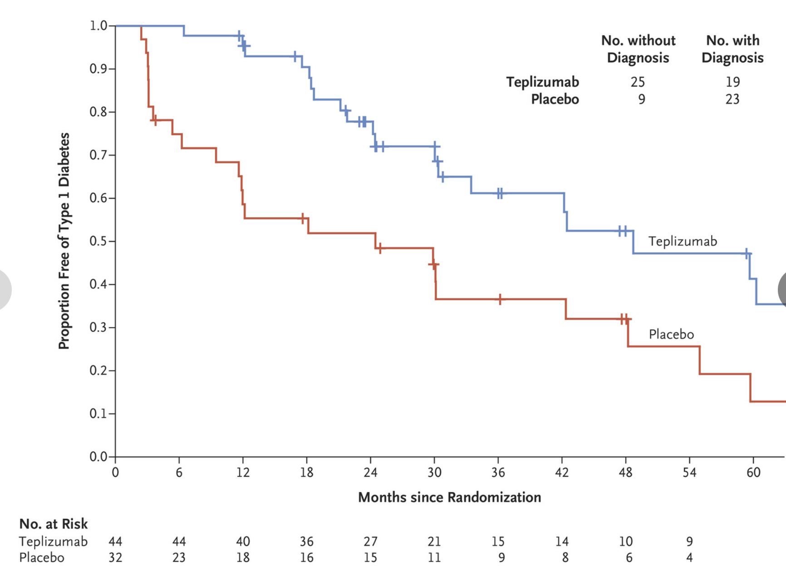
Delaying inset of type 1 diabetes: Immunotherapy
Trials of teplizumab in individuals with stage 2 type
1 diabetes (dysglycaemia and antibody positive) delayed
the onset of clinical (stage 3) type 1 diabetes by a median of 2 years*
Licensed by FDA
Being considered by NICE
ELSA study testing 3 to 13 year olds
T1DRA 18 to 70 year olds
*N Engl J Med 2019;381:603-613

Slide 7
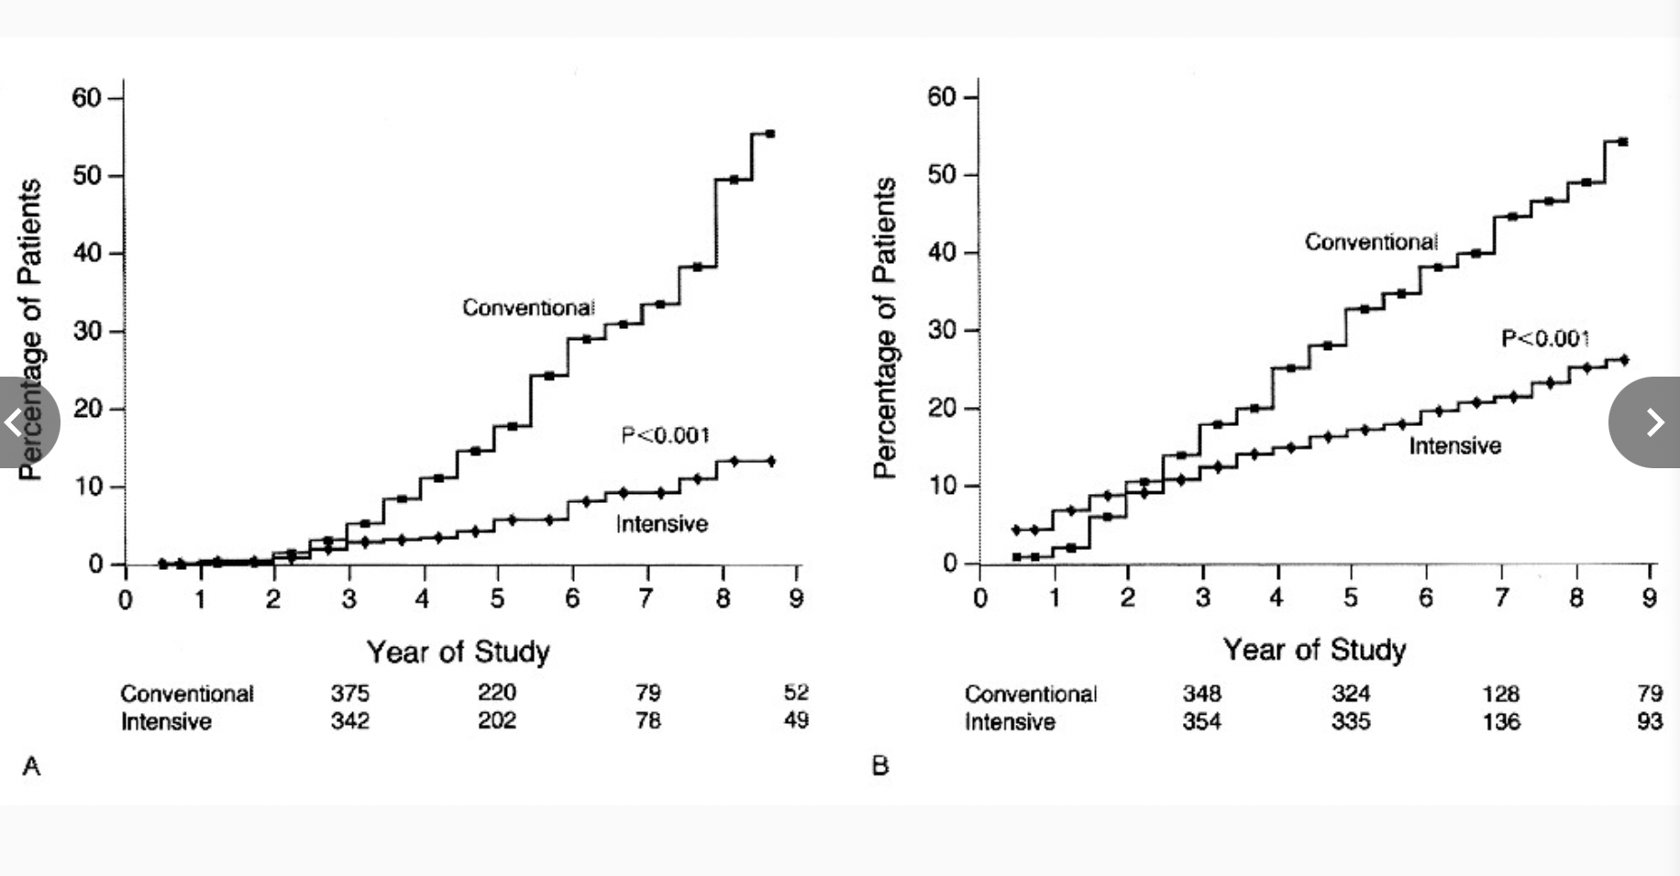
Early good control – Modern Treatment founded on DCCT
DCCT trial* compared intensive (pumps and MDI) and conventional treatment (1 to 2 injections) in type 1 diabetes diagnosed <5 years
Marked improvement in complications
EDIC study ** shows 30% reduction of CVD at 30 years in the intensive group
EDIC study *** shows enduring protection against microvascular complications
*N Engl J Med 1993;329:977-986
**Diabetes Care 2016;39(5):686–693
***Diabetes Care 2014;37(1):17–23

Slide 8
Treatment Targets: HbA1c < 58 mmol/mol in Wales and England
NDA 2021/22 www.nhsdigital.org

Slide 9
Treatment Targets: HbA1c < 58 mmol/mol – adults in Wales and England
A lot of missed opportunities in
Wales and England!
NDA 2021/22 www.nhsdigital.org

Slide 10
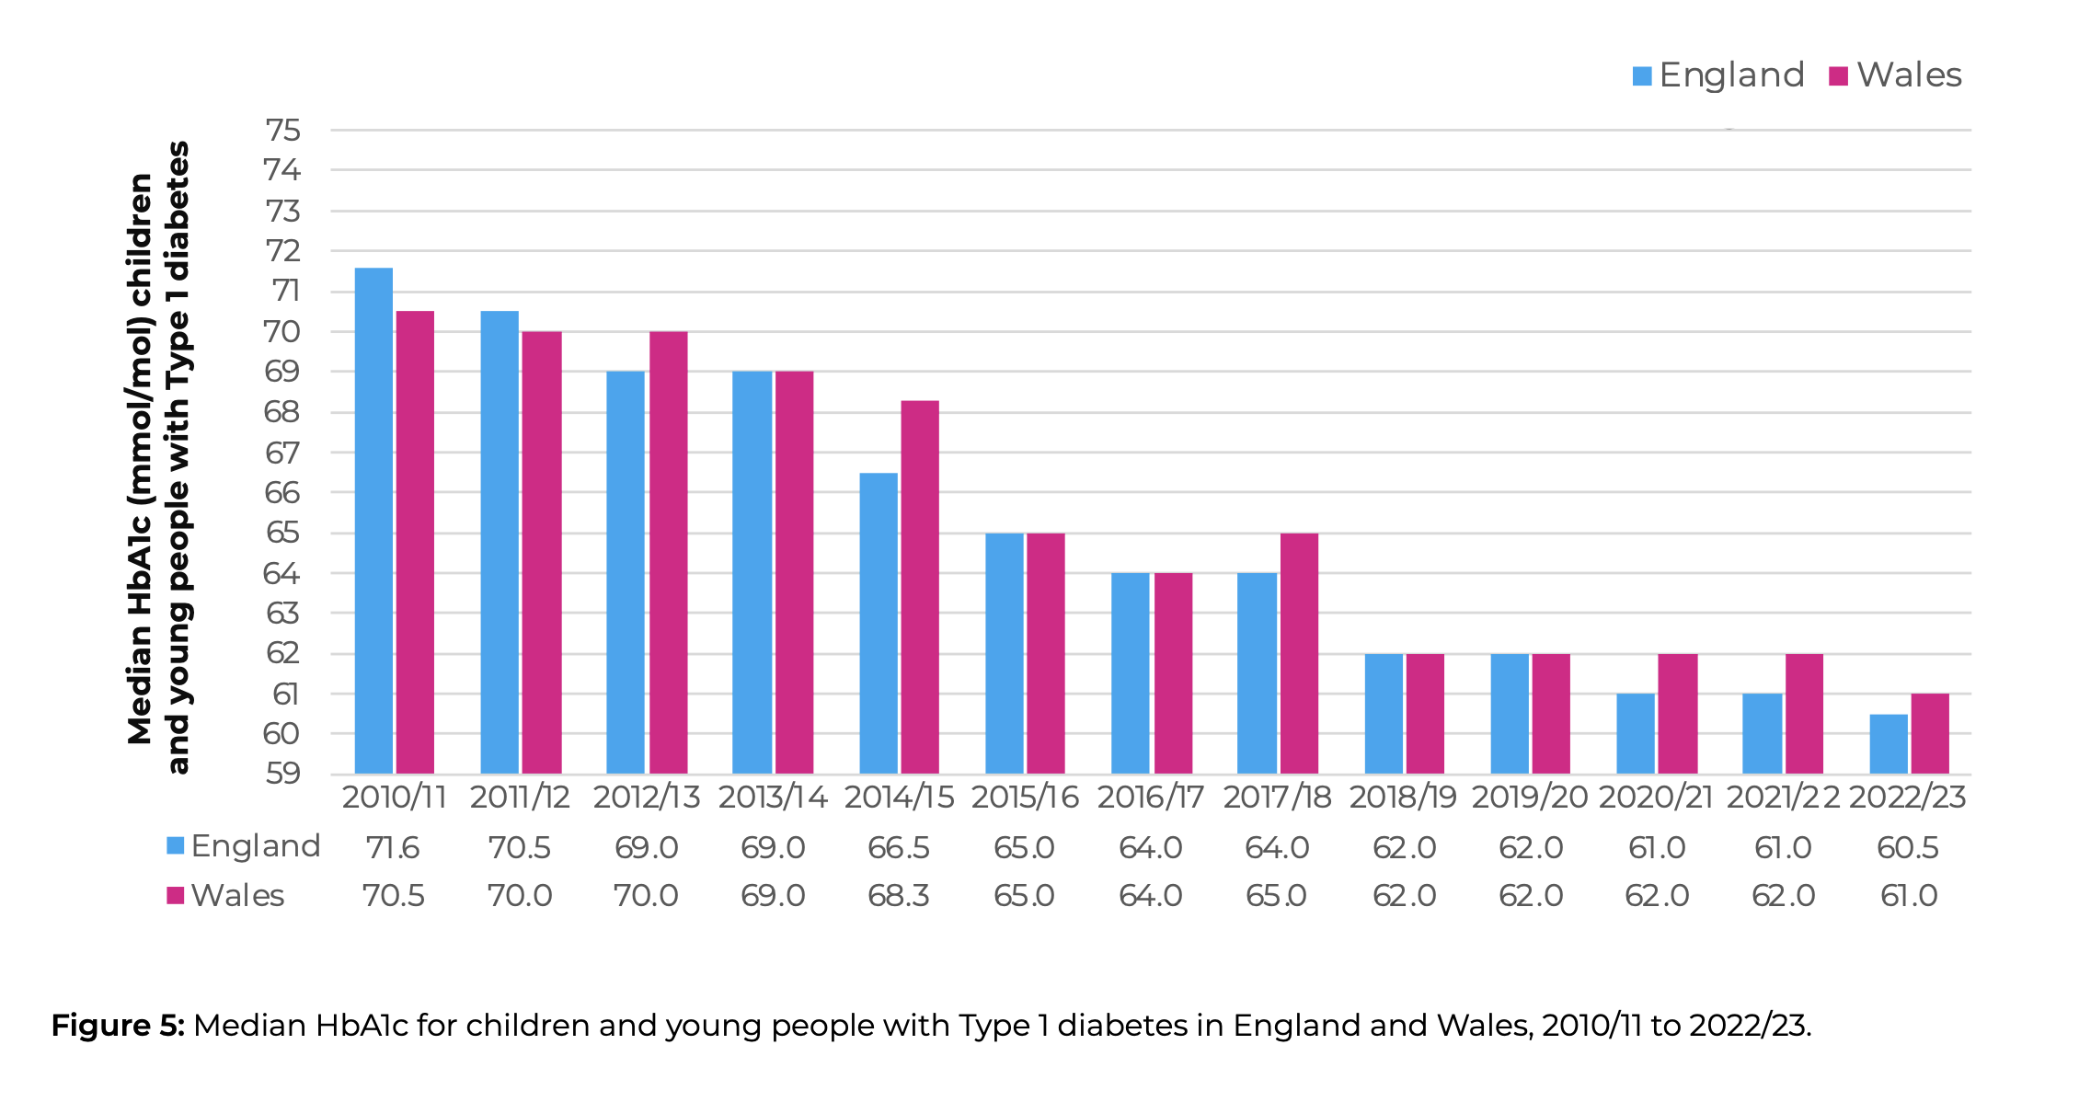
Median HbA1c in England and Wales

Slide 11
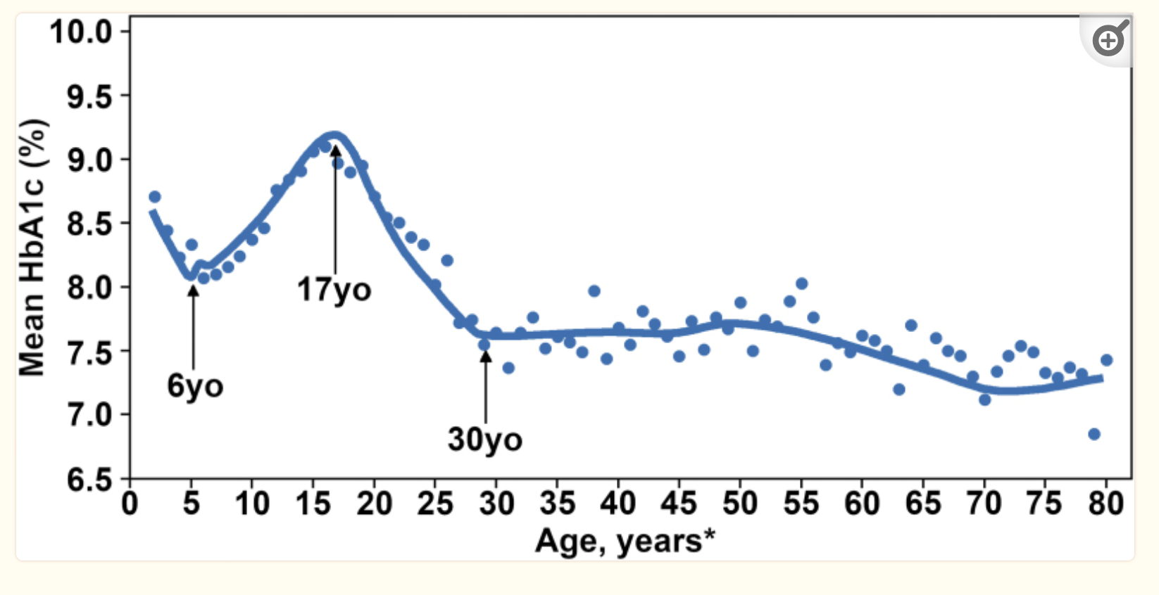
Treatment target achievement is affected by age:
Diabetes Technol Ther. September 2020; 22(9): 645–650

Slide 12
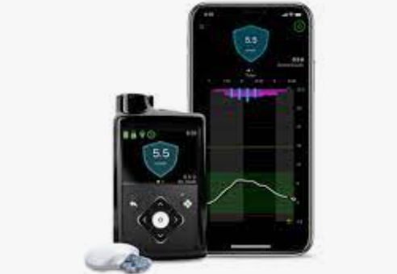
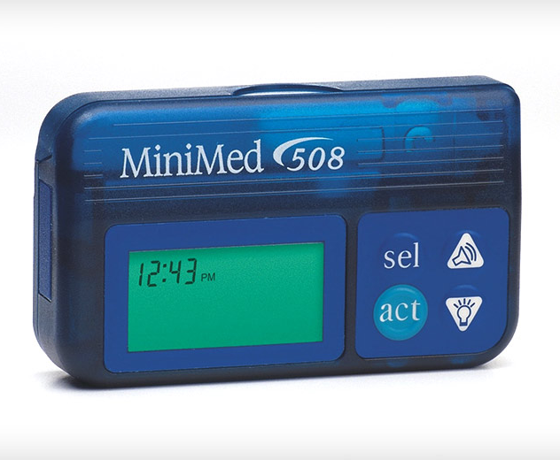
Treatment Evolution over last 20 years
  MDI
  Standalone pumps (reliable since 2000’s)
  Sensor augmented pump therapy (early 2000’s)
  Predicted low glucose suspend (2015 ish)
  DIY closed loops
  Hybrid closed loops (2019)

Slide 13
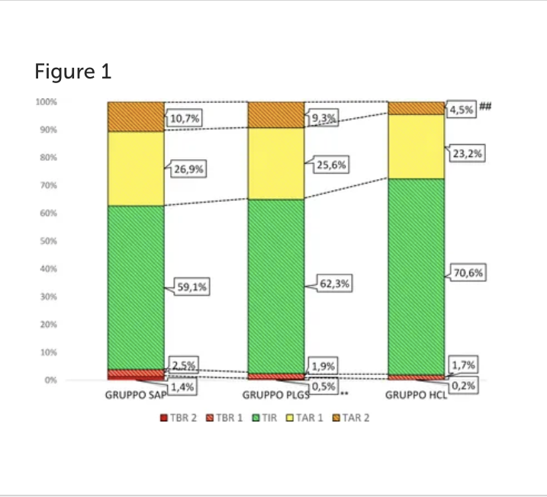
Evolution and Increased TIR
Lunati et al.A Single-Center Cohort Study. Front. Endocrinol. 13:816599. doi: 10.3389/fendo.2022.816599

Slide 14

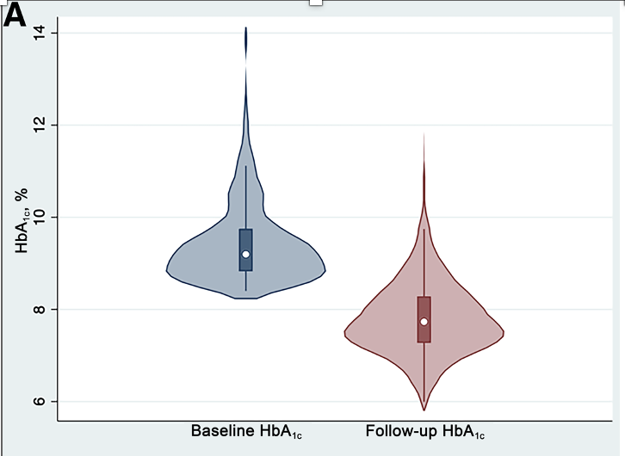
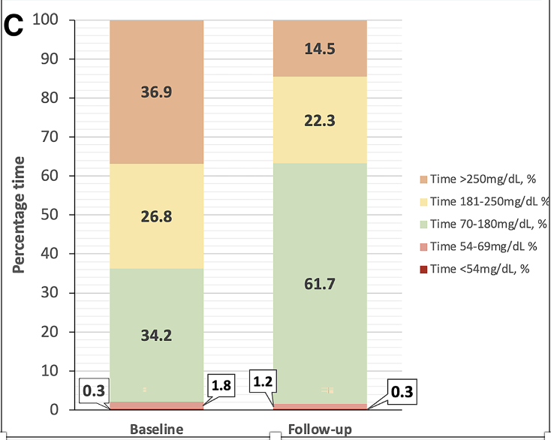
From: Hybrid Closed-Loop Therapy in Adults With Type 1 Diabetes
and Above-Target HbA_{1c}: A Real-world Observational Study
Diabetes Care.
2023;46(10):1831-1838. doi:10.2337/dc23-0635
Figure Legend:
A: Violin plot demonstrating HbA_{1c} at baseline and follow-up (P < 0.0001). B: Scatter plot showing individual patient data for HbA_{1c} at baseline, with the line representing the threshold for no change in HbA_{1c}. C: Stacked bar chart demonstrating TIR at baseline and follow-up. Data are for individuals with complete sensor data only (n = 380).
Date of Download: 6/15/2024
Copyright © 2024 American Diabetes Association. All rights reserved.

Slide 15
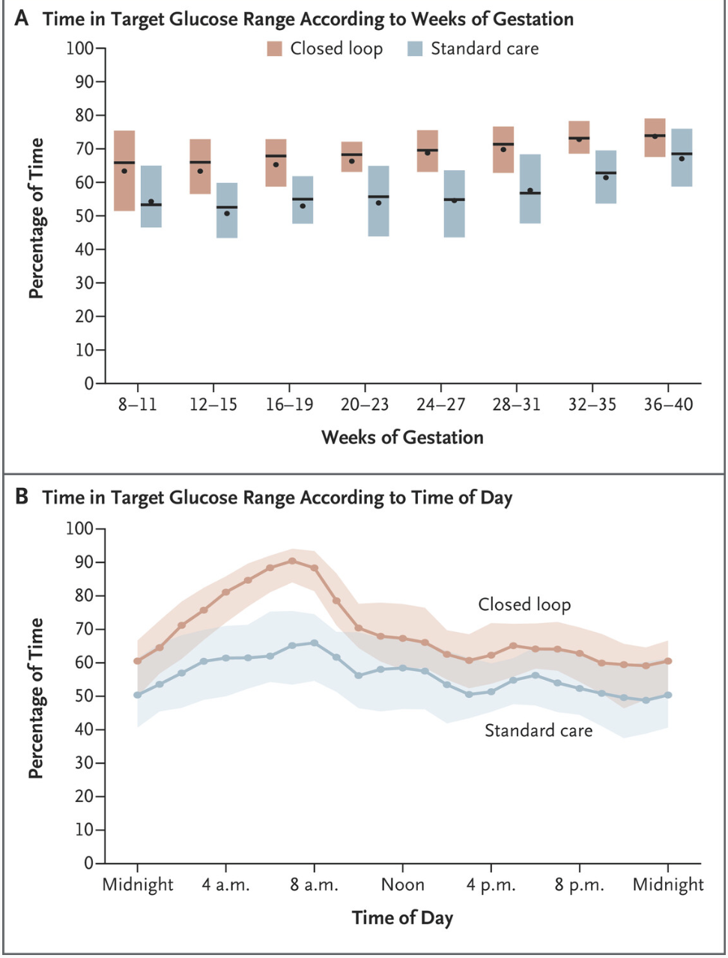
Pregnancy on HCL
Significant benefits to HCL
therapy in pregnancy
1 in 2 pregnancies with
diabetes have a complication
Continual change in insulin
Requirements
AiDAPT studyN Engl J Med 2023;389:1566-1578
Greater TIR
Less maternal weight gain
Low LGA

Slide 16
NPID data 2021 - 2022
Pregnancy outcomes improved in those with type 1 diabetes.
Fewer serious adverse pregnancy outcomes (congenital anomalies, stillbirths and neonatal deaths) compared to the previous seven years (5.9% 2014 to 2020 vs 5.1% in 2022).
Increasing use of CGMS has been the major change:
  Serious adverse outcomes (4.4% on CGM vs 6.2% not on CGM)
  fewer preterm births (39.5% on CGM vs 43.9% not on CGM)
  fewer large birthweight babies (45.6% on CGM vs 53.5% not on CGM )
  fewer neonatal care unit admissions (44.8% on CGM vs 48.5% not on CGM)
No improvement in type 2 diabetes

Slide 17
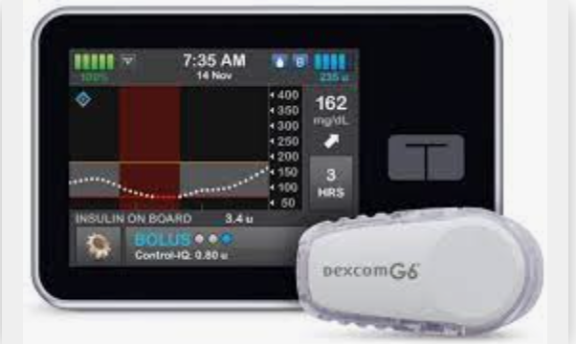
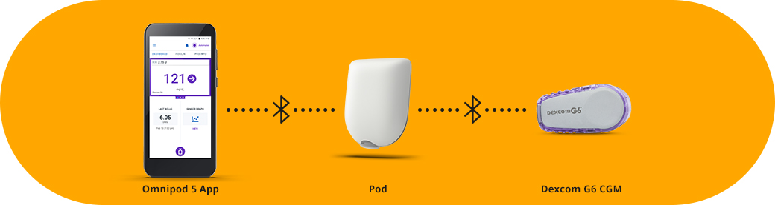
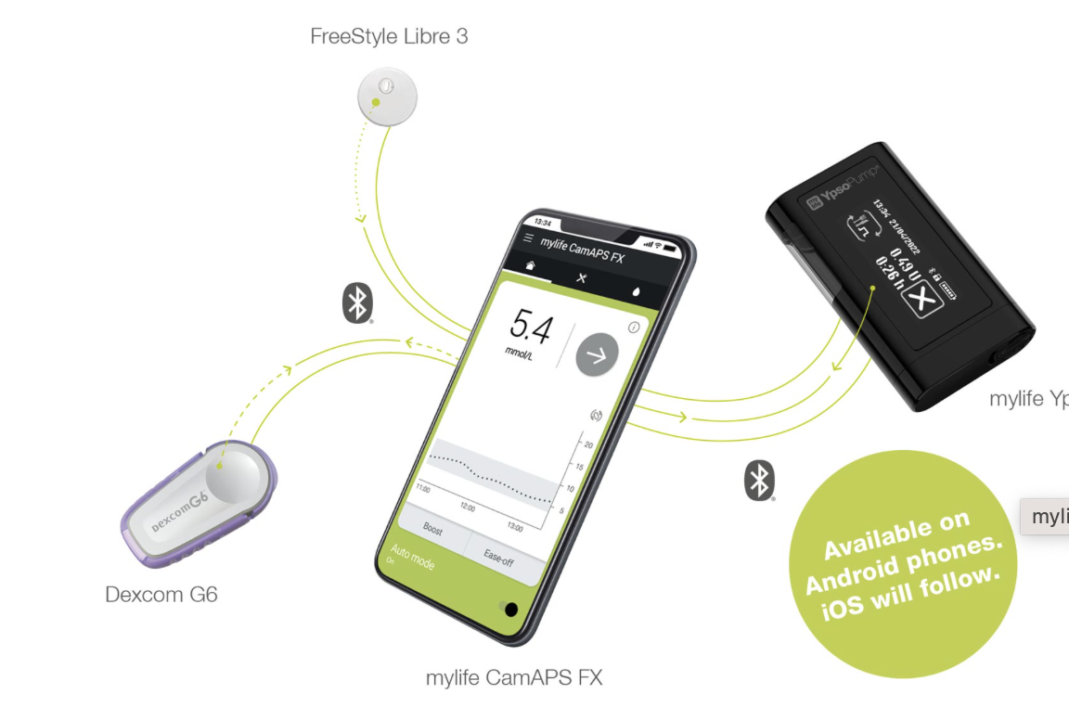
Hybrid closed loops

Slide 18

Very Variable Pump baseline for technology in Wales
Some services have few barriers to tech (beyond staff resource, ubiquitous barrier in Wales)
Other services with multiple barriers – business cases for pumps or exceptional funding applications
Highest proportion 23% (86% HCL)
Lowest proportion 8.5 % on pumps (19% HCL)

Slide 19
Priorities for HCL in Wales (Year 1 to 2)
Children and young people below the age of 25
Pregnant people / people planning pregnancy
Those diagnosed since the advent of the pandemic – January 2020
Traditional priority groups – life threatening / job threatening hypoglycaemia
2,431 in adult services in Wales in above priority groups not already on pumps (plus 756 children)

Slide 20
HCL in Wales
NO CENTRAL FUNDING!
All Health Board CEOs, planners, financial directors are aware / on board with the rationale for this and the “we can’t afford not to do this” mantra
Most centres have completed / are writing business cases for staff and equipment
For example, in my Health Board it would take 17 years to on board priority groups alone with existing resources

Slide 21
Education in HCL
Commenced a programme to upskill specialist diabetes doctors, nurses and dietitians in HCL therapy – pre-learning, face-to-face learning, post learning plus competencies
Webinars to educate inpatient staff and primary care staff on what they need to know
Clinical case discussions to support less experienced centres

Slide 22
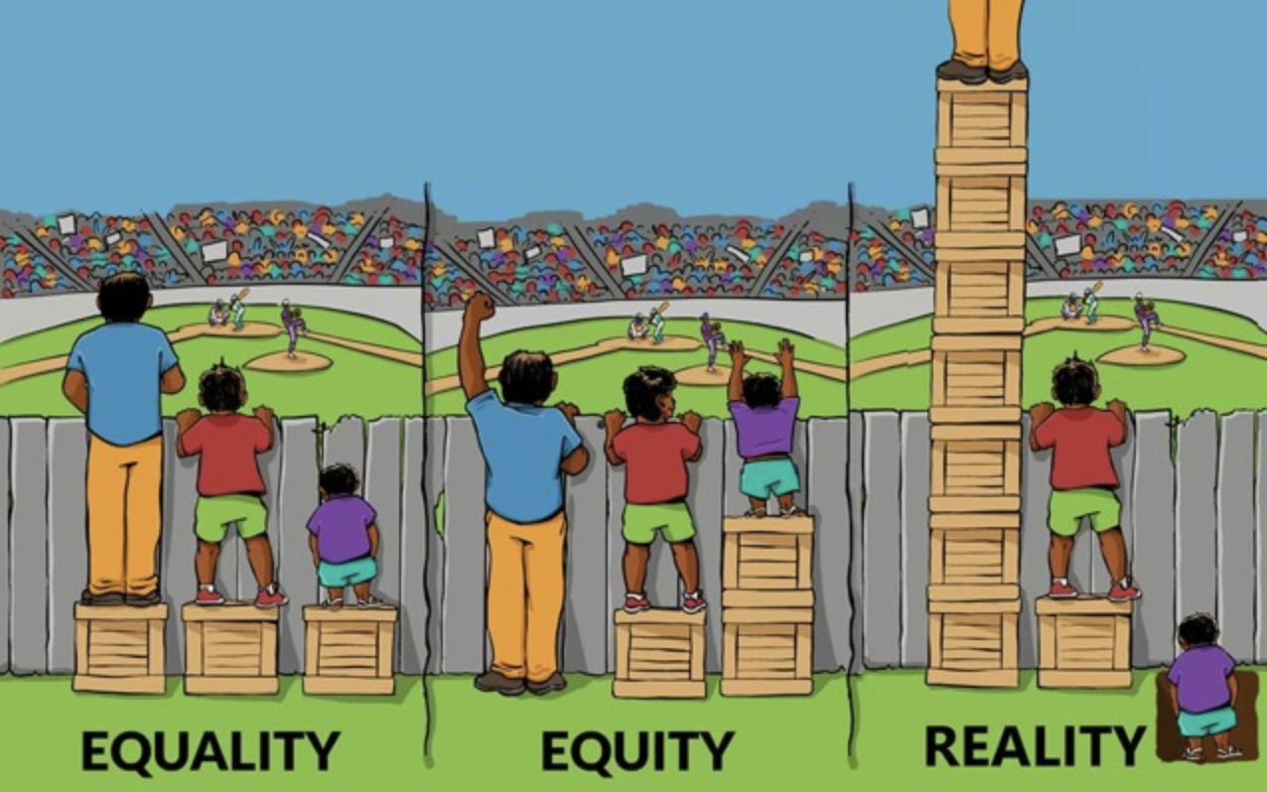
Inequalities in HCL
Similar to other health systems there are unacceptable inequalities in pump use based on deprivation and ethnicity
Reducing paperwork / form filling
Finding those lost to follow up from secondary care – maybe 30% (most frequent in the most deprived, ethnic minority background and age) and encouraging referral
Working in different languages, accessing tech and expenses
Individualising approach in those who would struggle with carb counting, literacy and have additional support needs

Slide 23
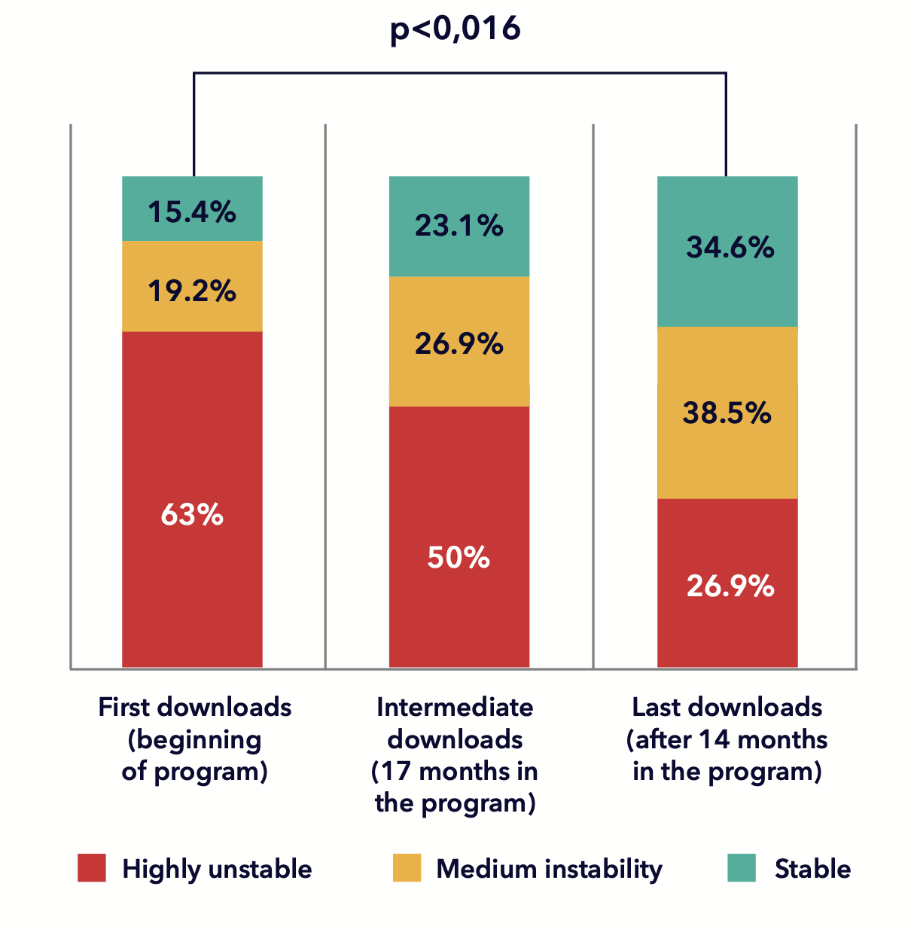
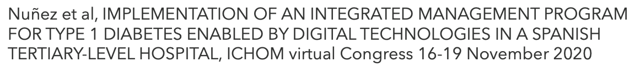
HCL Follow up
We need to get maximum benefit from these systems for each patient. Maximum benefit from staff resources
In Cardiff we are using Medtronic Care Connect to triage our patients into red / amber / green and exploring how this can improve our follow up and outcomes
Another Health Board is working on a trial of the Diabeter system to improve outcomes

Slide 24
Type 1 Diabetes and Disordered Eating
Affects upto 140,000 of the 400,000 with type 1 diabetes in the UK
Risk factors – history of disordered eating, diabetes related stress, poor body image and hypoglycaemia fear
Insulin with-holding, glucose level manipulation, weight fluctuation
Much greater risk of all complications including DKA
e.g. retinopathy 84%
30 x greater risk of death than age-matched controls
High association with depression and anxiety

Slide 25
Do treatment modalities alter TIDE risk?
Intense focus on food and glucose management may precipitate or worsen disordered eating in type 1 diabetes
Pumps may affect body image and intensify the focus on food and glucose control
Does the treatment regime affect TIDE?

Slide 26
MDI vs pumps VS HCL in TIDE
Most studies show a lower level of disordered eating in pumps vs MDI*
Is this selection bias e.g. there is a lower level of pump use in anorexia nervosa **
Pumps may be avoided – tight glucose control (often auto mode switched off)
Data downloads often reveal the issue: bolus omission, low CHO intake, repeated bolus for binging etc
HbA1c lower using HCL than pumps ***. There are some management advantages
* J Eat Disord 10, 46 (2022). https://doi.org/10.1186/s40337-022-00571-4
** Diabetic Medicine. Vol 8 issue 7. https://doi.org/10.1111/dme.14581
*** Diabetes Technol Ther 2024 Apr;26(4):229-237

Slide 27
Setting the scene for the day
We have an enormous unmet need in around 30% of people with type 1 diabetes
We are lacking in detecting it, discussing it and helping people with it
Services are not meeting the need
TIDE is leading to avoidable complications and death
Today is about addressing this need
Thank you

