Slide 1
Living with Type 1 Diabetes - Finding an Eating Disorder
Presented by Sara Crowley
@Type1Hurdles

Slide 2
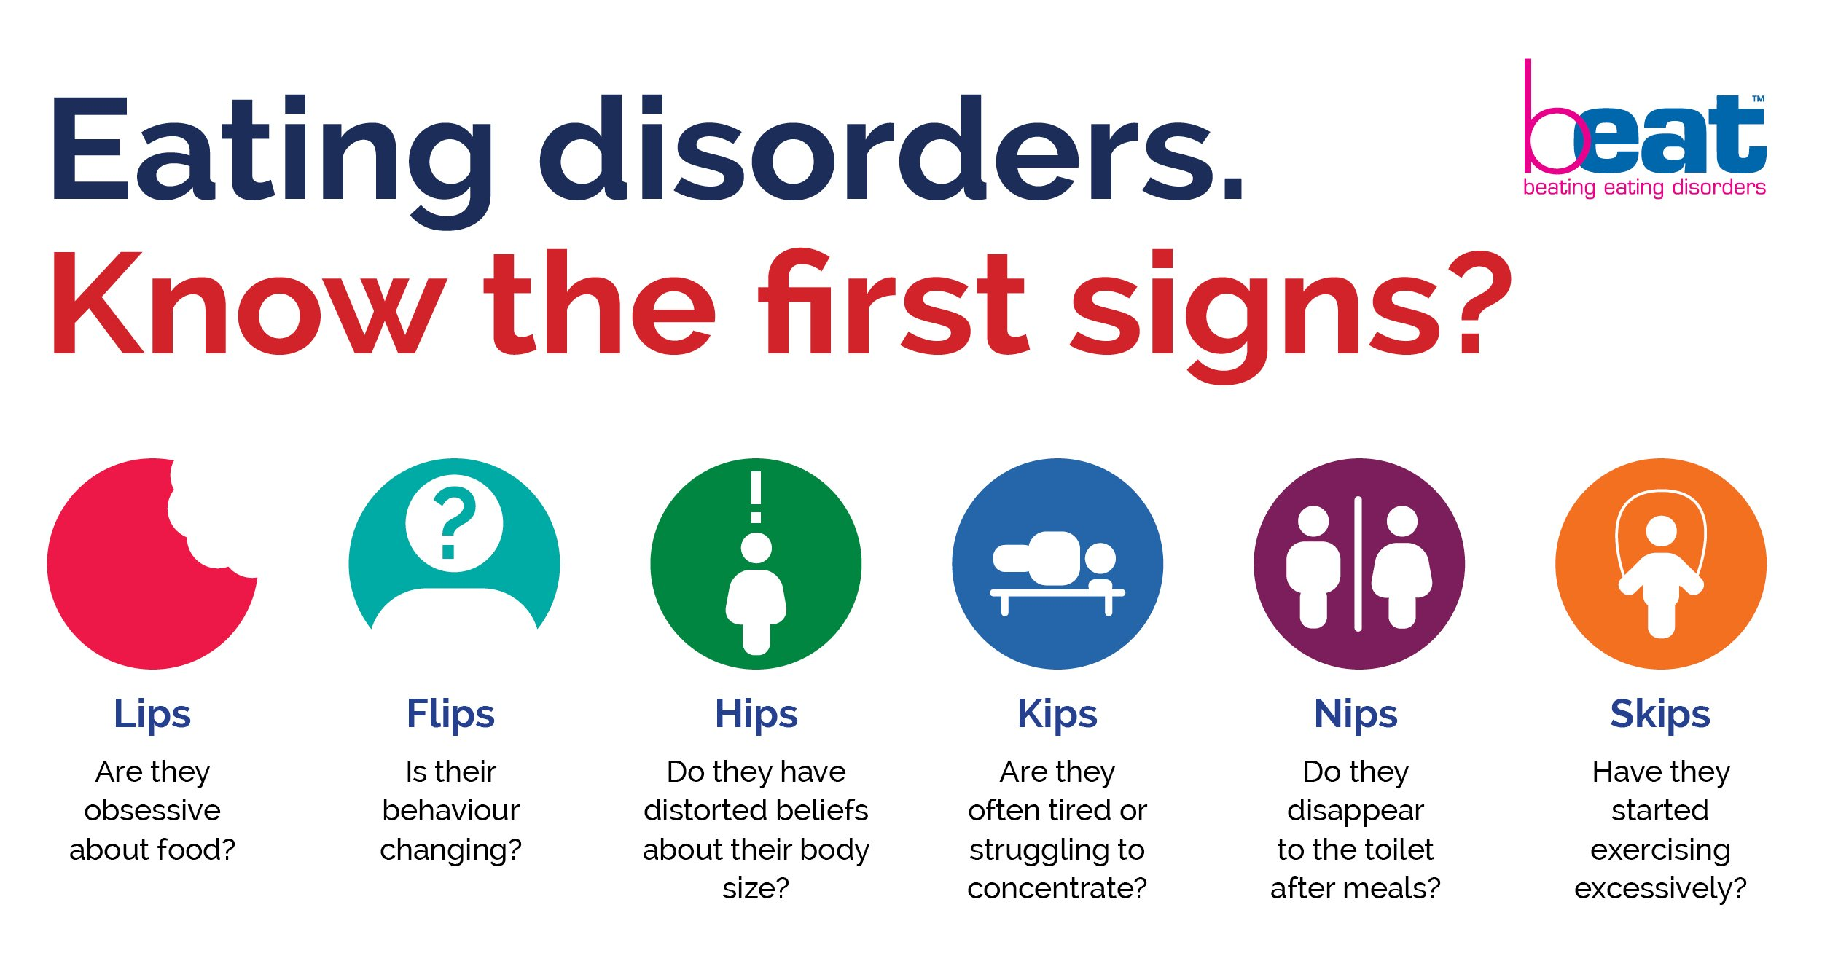
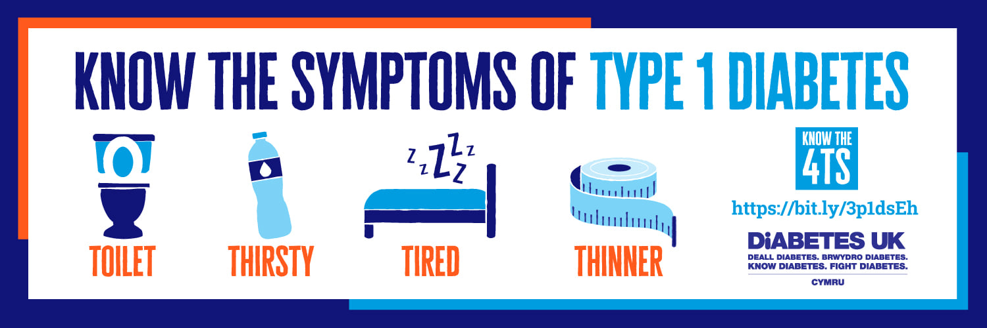
Symptoms What are we taught to look for?
People with Type 1 diabetes are significantly more likely to develop an eating disorder than their peers without the condition. (Beyond Type 1)

Slide 3
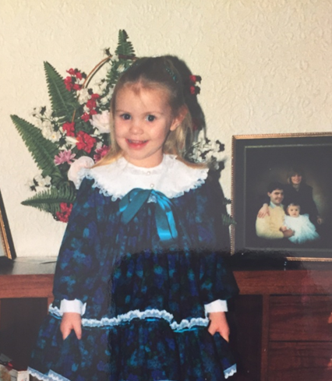
1990, aged 3.
To my knowledge, nowhere in my medical notes will you find mention of an eating disorder. Except it’s there, in my HbA1c history, if someone looked beyond my numbers.
I have never been able to access any form of help in terms of psychology for the trauma of being diagnosed as a child with a chronic condition. For diabetes distress. For diabetes burnout. For any aspect of diabetes related mental health.
As a result, my coping mechanism through my teenage years became T1DE.

Slide 4



If I was missed, how many more people like me are not accounted for?
The scale of the problem is unknown, because it can’t always be measured, it’s not easily fixed, and put simply, we are being overlooked...

Slide 5
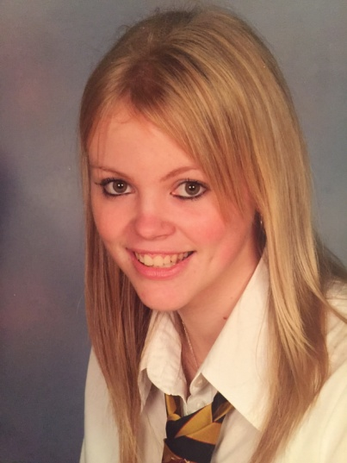
2005, aged 17.
This is my last school picture under paediatric care. I am seventeen. I’ve been manipulating insulin for five years at this point. A year previous I experienced my first (and only!) DKA admission on record, waking up in intensive care.
I am struggling.
I am smiling.
I am also achieving elsewhere in my life.
I befriend bulimia, to release feelings that I’ve not been taught how to process.
Its my comfort. Type 1 diabetes is heavy.

Slide 6
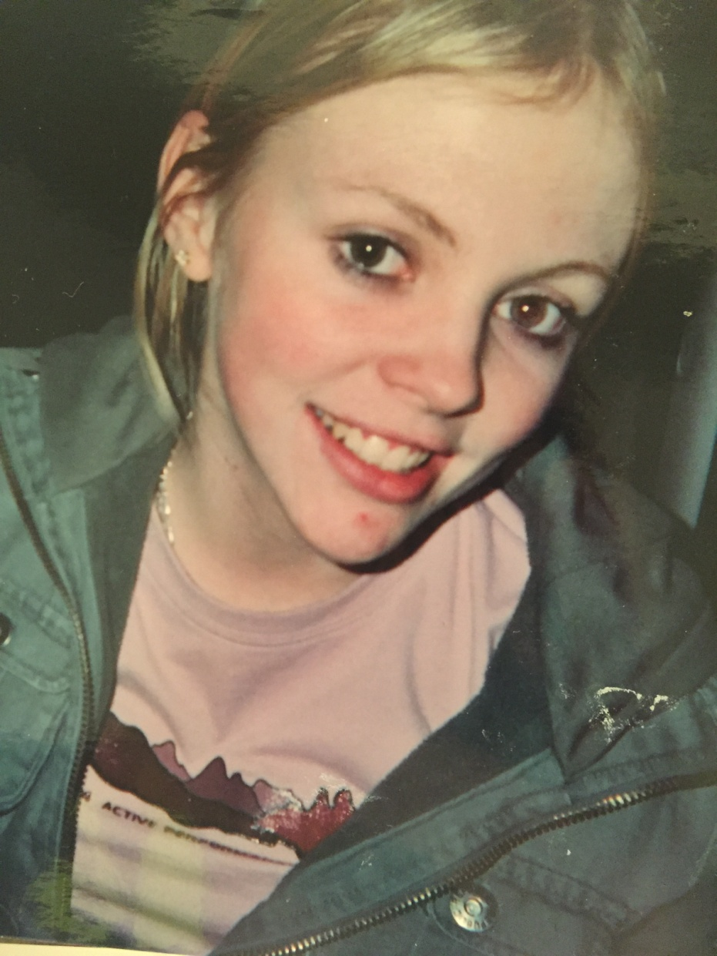
2006, aged 19.
This picture was taken within my first year of being under adult care. I’ve never ‘disengaged’ from services. I would not have been known to be a ‘frequent DNA-er.’ I was attending clinic appointments, but I didn’t find the set-up particularly useful. For me, it was an afternoon of feeling like what was asked of me was unrealistic, unachievable and perpetuated a deep fear of failure. I never felt good enough, leave clinic and feel even worse.
This became a path of destruction and unknown unintentional self-harm.
***
My team, as much as me need more resource.

Slide 7
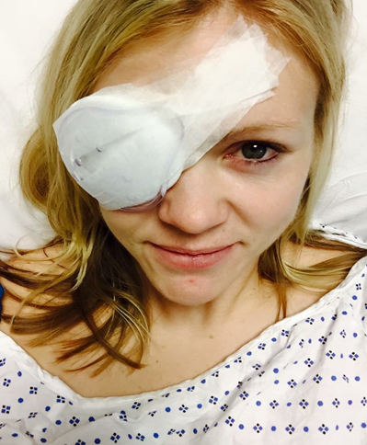
2015, aged 27.
‘I don’t want to open a can of worms.’ - Eating disorders thrive on secrecy
We all need to understand mental health and be able to support and talk about it.
Of the long list of ‘diabetes complications’ I was warned about, why wasn’t mental health, including my risk of T1DE one?
Not acknowledging the impact of diabetes on my mental health has without a doubt been a contributing factor that led to me to the complications they warned me about.
This picture is just one.
But, we can change this.

Slide 8
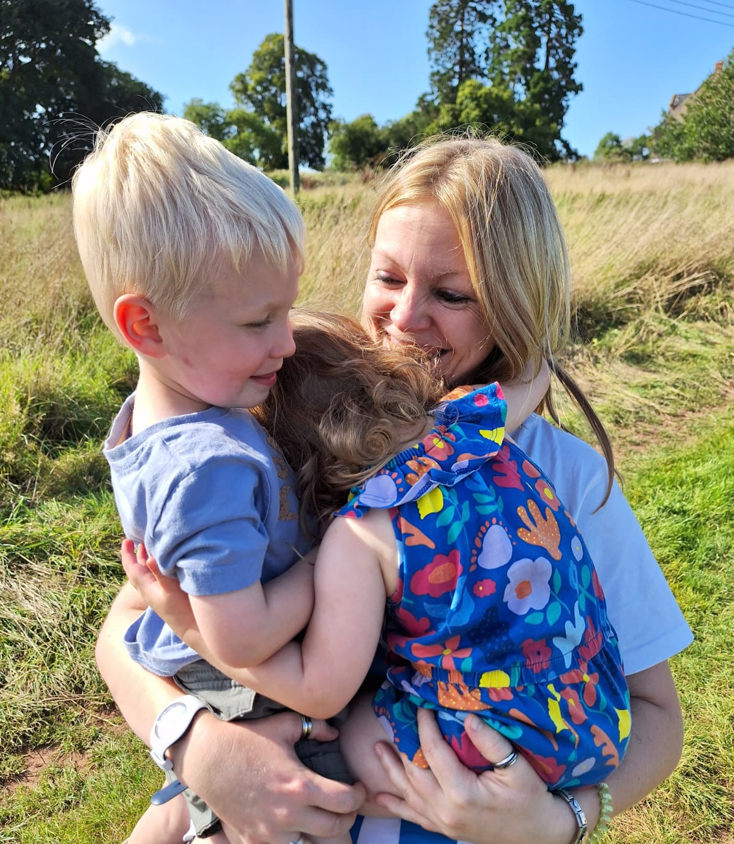
2023, aged 35.
Thankfully, I am in a much better place.
I am in recovery of T1DE.
I am smiling, and have so many reasons to do so.
I am living with Type 1 diabetes, and its complications.
And yet, some days, I still struggle.
I still get diabetes distress, alarm fatigue, burnout. Guilt.
I still feel that struggling teen, without appropriate tools.
I still need (on-going) psychological support.
I now ask for it , but I cannot get it.
It doesn’t exist in my area for Type 1 diabetes.
My team needs a clinical psychologist as much as me.
Services need to be psychologically minded, from the start.

Slide 9
Behind the numbers on the scales - Underneath the surface
Restrict food to manage diabetes
Hypo
Guilt and failure
Low self-esteem
Binge
Guilt
Purge
Repeat.
It was less about weight loss/body image and more about a lack of control and burnout

Slide 10
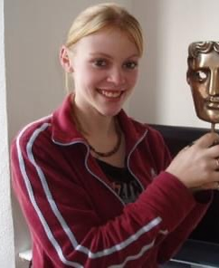
Other factors or potential triggers Too important to be overlooked
Power imbalance
PWD/HCP
The impact ‘clinic’ had on my self-care
Perfectionism
4-7mmol
Coming to terms with sexuality
Unhealthy relationships
Isolation
(No peer support)
Lack of awareness on mental health
Unhelpful and stigmatising language
Complications
Intense fear of failure
Moderation
Triggers

Slide 11
Missed signs or symptoms Do you see or ask about these in your clinic?
High HbA1c
74+ is a sign, mine was almost 140.
Not wanting to share my blood glucose readings.
Weight fluctuation and unexplained weight loss (do not rely on BMI).
Persistent thirst frequent urination.
Fatigue, lethargy,, interrupted sleep, frequent naps.
1 DKA Admission
100s of near misses, no record of these.
Thrush.
No period for 6+ months.
Stockpiles of insulin and supplies.
Gaunt face, grey complexion, rosy cheeks
Self-harm
Cuts not healing, scarring.
Other common eating disorder behaviors and/or factors.

Slide 12

Things that have helped me
I have found my own regimen of what individually works for me and my life.
I don’t avoid a single food group. ‘Everything in moderation.’
DAFNE helped me find freedom with food and carbs.
Finding my voice – and developing the confidence to use it.
Learning to be more open with those around me.
Diabetes tech
Introduced when I was ready to use it.
Trained myself to rethink numbers as information.
Setting my own expectations and knowing my limits.
Practicing and exploring different ways of self-care.
I had to make friends with my body and learn to like myself.
I removed scales and full length mirrors in my house for a while.
I’ve learned when to challenge my thoughts and when to listen to them.

Slide 13
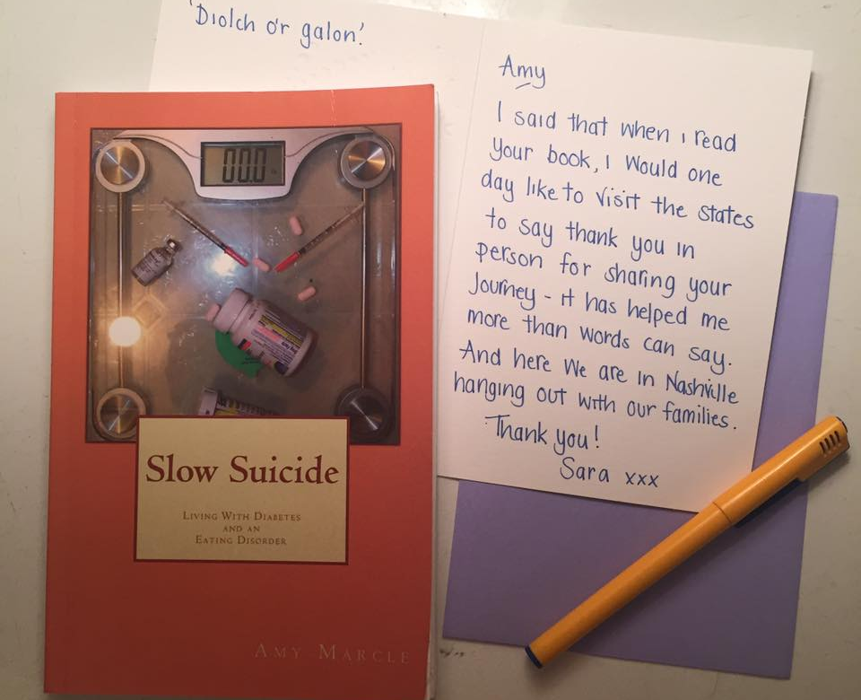
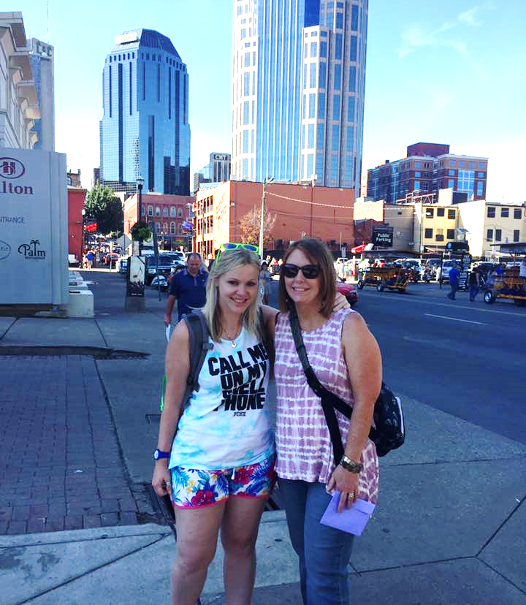
Diolch.
For every person like Amy and myself that is willing to speak up about T1DE, there are so many struggling in silence, who can’t access support, falling through cracks, between services and criteria.
Shortening their lives.
Thank you for listening.
Be curious, you can change the trajectory.
Open the can of worms.
Start with three words: ‘Are you OK?’
Meeting Amy Marcle, author of Slow Suicide. Nashville, TN USA, Aug 2017.

