Slide 1
Moving on or Moving Away? Experience from the Adult Diabetes Service
Dr Fainia Kavvoura
Consultant Diabetologist
Royal Berkshire NHS Foundation Trust

Slide 2
Overview
Facts about RBH transition and YAC
Challenges in YAC
CV risk management in Young T2D
Contraception and pre-conception
Patient’s experience
Transition nurse experience

Slide 3
POLL
What age do you transition YPwT2D to the adult/YAC service
<17
17
18
>18

Slide 4
Diabetes Transition to Adult Care in the RBH
Transition process starts at 14 yrs of age and usually patients’ care transfer is completed around 17 (>18 in YPwT1D)
YPwT2D meet the Adult Diabetes team (Consultant and Nurse) and are taken to see the adult clinic location on the same day
Transition PDSN, Paeds dietician and psychologist continue to support until age 19
YPwT2D diagnosed at the age of 16 or older will move straight to the Adult YAC with support from PDSN, dietician and psychologist from Paeds service
Open channels with Paeds Diabetes team regarding YPwT2D, before transition

Slide 5
YAC in RBH and YPwT2D
In 2023: 11 patients
Females: 8 (72.8%)
BAME background: 7 (63.6%)
Median BMI 35.4 (100% BMI>25)
Median HbA1c: 41 (5: HbA1c<48)
Metformin: 9 patients (81.8%)
MDI: 3 (27.3%)
GLP1RA: 4 (36.4%)
SGLT2-i: 3 (27.3%)
Basal Insulin: 2 (18.2%)

Slide 6
Challenges in the YAC
Engagement of patients is variable
Resources are significantly less than Paeds in terms of doctors’ numbers, DSN, dietetic and psychology support
Clinic traditionally has been geared to YPwT1D and local peer support group is only for YPwT1D (Berkshire Young People with Diabetes Council (BYPDC))
YPwT2D face significant stigma particularly around weight
Perception of T2D as being “milder” or “normalised”

Slide 7
YAC for PwT2D
Consistency of messages across Paeds and Adult team regarding:
Importance of diagnosis
Implications of diagnosis
Remission of diabetes possible contrary to T1D
Support available
Resources available
Working together in an MDT approach in view of complexity of issues experienced at that particular stage of life
Leaving family home
Starting work
Relationships with peers
Peer support challenging
Starting a family

Slide 8
Clinical Case 1
AA admitted with severe DKA in June 2017 aged 16
Male, BAME, ASD
At diagnosis:
HbA1c: 119 mmol/mol
Negative antibodies,
BMI 36,
Managed as T2D with MDI from diagnosis
07/2017: HbA1c: 97 mmol/mol, Basal insulin dose reduced from 60 units to 50 units ON, Metformin started, BMI: 36.5
08/2017: HbA1c: 72 mmol/mol, Basal insulin dose reduced further to 3 units (from 30 units)
09/2017: off insulin completely
10/2017: HbA1c: 45 mmol/mol, on metformin 500 mg BD, BMI: 35.5
11/2017: HbA1c: 39 mmol/mol on metformin 500 mg OD, BMI: 37

Slide 9
Clinical Case 1
02/2018: HbA1c: 54 mmol/mol, on metformin 500 mg BD (misses the ON dose), BMI: 38.3
05/2018: HbA1c: 45 mmol/mol, on metformin 1 gr BD, BMI: 39
08/2018: HbA1c: 43 mmol/mol, on metformin 500 mg BD, BMI: 39.6
10/2018: HbA1c: 50 mmol/mol, on metformin 500 mg BD (variable adherence), BMI: 39.7
01/2019: HbA1c: 52 mmol/mol, on metformin 500 mg BD, BMI: 40.6
05/2019: HbAc: 42 mmol;mol (metformin 500 mg BD, BMI: 39.5)
09/2019: Transition clinic, HbA1c: 49 mmol/mol, BMI: 40.6
12/2019: DNA in 1st YAC OPA
Lost to FU until 07/2021: tele review

Slide 10
Clinical Case 1
09/2021: HbA1c: 41 mmol/mol on metformin 500 mg BD, BMI: 40.6, started on dulaglutide
06/2022: HbA1c: 39 mmol/mol, on dulaglutide 1.5 mg OW, metformin 500 mg BD, BMI: 41.1
02/2023: admitted with DKA (ph:7, ketones 6.6), whilst on GLP1RA (?adherence)
UCPCR: 0.68, HbAc: 110 mmol/mol
restarted on MDI, continued on GLP1RA and metformin
Offered FSL
03/2023: GMI : 37 mmol/mol, off Novorapid, reduced Levemir to 20 units BD

Slide 11
Clinical Case 1

Slide 12
Clinical Case 1
ISSUES:
Fluctuating HbA1c with variable adherence to medications
No weight loss effect by GLP1 RA
Engagement with YAC
Repeat severe DKA but hypoing on insulin

Slide 13
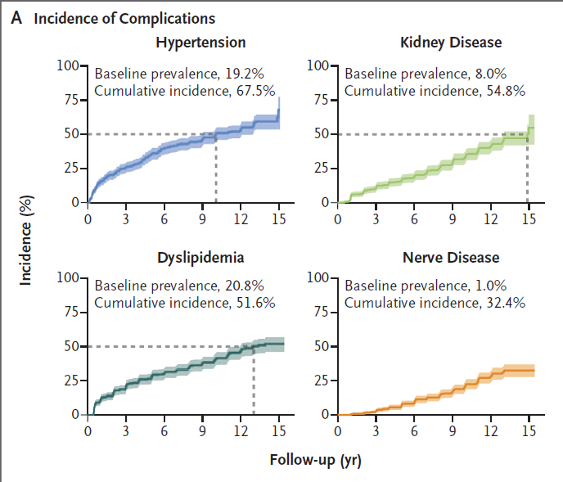
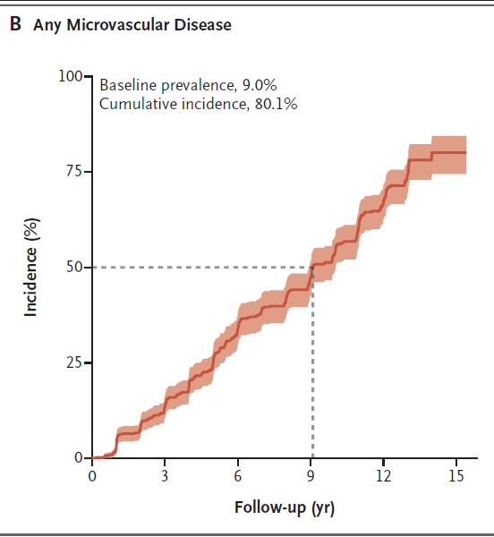
Diabetes Complications
TODAY study group, N Engl J Med 2021;385:416-26.
Notes:
Panel A shows the baseline prevalences and cumulative incidences of hypertension, dyslipidemia (low‑density‑lipoprotein or triglyceride dyslipidemia), kidney disease, and nerve disease. Panel B shows the baseline prevalence and cumulative incidence of any microvascular complication. The dashed lines in Panels A and B indicate the time when the cumulative incidence reached 50%, and the shaded bands
represent 95% confidence intervals. Baseline refers to the time of enrollment in the clinical trial.

Slide 14
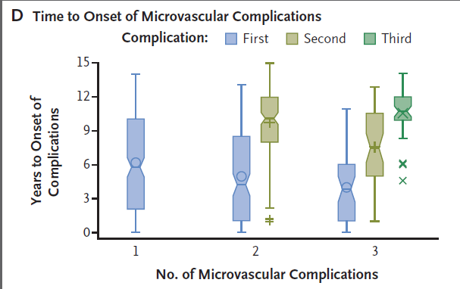
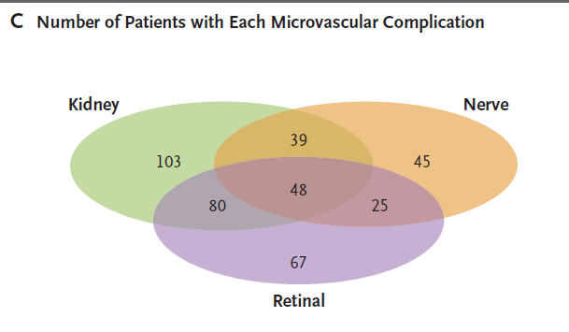
Diabetes Complications
At the time of the last visit:
270/677 (39.9%) had no complications of diabetes,
215 (31.8%) had one complication,
144 (21.3%)had two, and
48 (7.1%) had three
Panel D shows the years to onset of the first and subsequent (if applicable) microvascular complications among participants with one, two, or three complications.
The bottoms and tops of the boxes represent the first and the third quartiles, respectively, and the horizontal lines inside the boxes indicate medians. The symbols inside the boxes indicate means, and the symbols outside the boxes outliers. I bars indicate the minimum and maximum range, excluding outliers.
TODAY study group, N Engl J Med 2021;385:416-26.
Notes:
Panel C shows the numbers of patients with kidney, nerve, and retinal complications. Panel D shows the years to onset of the first and subsequent (if applicable) microvascular complications among participants with one, two, or three complications. The bottoms and tops of the boxes represent the first and the
third quartiles, respectively, and the horizontal lines inside the boxes indicate medians. The symbols inside the boxes indicate means,
and the symbols outside the boxes outliers. I bars indicate the minimum and maximum range, excluding outliers.
The cumulative incidence of any microvascular complication was 50.0% by 9 years and 80.1% by 15 years

Slide 15
Diabetes Complications
The risk of developing any macrovascular complication is 2x in Young T2D.
the risk of MI is 14x in YT2D than in non-diabetes patients (2-4x in patients with middle/later life onset of T2D)
In summary: YT2D is associated with more macrovascular and microvascular outcomes and a more rapidly progressing severity of complications than in T1D or late-onset T2D.
Hillier TA, et al Diabetes Care 2003; 26: 2999–3005.
Gu W, et al. Diabet Med 2014; 31: 84–91.

Slide 16
Diabetes Complications
Other complications include:
impaired hearing
Reduced fertility
premature decline in cognitive function
Mental health conditions (eg depression)
Lerman-Garber I et al. Endocr Pract 2012; 18: 549–57.
Bener A, et al. Int Urol Nephrol 2009;41: 777.
Nolan JJ. Diabetologia 2010; 53: 2273–75.

Slide 17
Management of commorbidities
Pharmacotherapy
No data to show a reduction in adverse cardiovascular events with rigorous control of cardiovascular disease risk factors in T2D adolescents; typically < 30% achieve glycaemic or lipid targets
less likely to be prescribed lipid-lowering treatments, renin-angiotensin system inhibitors, or anti-platelet drugs
Yeung RO, et al. Lancet Diabetes Endocrinol 2014; 2: 935–43.
Miglani S,
Reinehr T, et al. Horm Res 2008; 69: 107–13.
Notes:
Various reasons: dherence, reluctance by atients and clinicians in view of age
QRICK2 only valid for >25
If no evidence, is it best to start or not to start?

Slide 18
Real Life experience
Challenging to initiate pharmacotherapy for other comorbidities (eg HTN, hyperlipidaemia) in YPwT2D:
Burden of “too many medications from a young age”
Clinicians hesitancy in view of young age, particularly in women
Variable adherence
Perception of patients and family of the severity of the disease and the need for medications
No strong evidence to support their use in prevention of longterm complications

Slide 19
Pre-conception and YT2D
Women with YT2D often have PCOS:
irregularity in periods
Insulin resistance antagonises weight loss
Hirsutism impacts further on body self-image and confidence
Addressing contraception is of paramount importance
Choice of contraceptive strategy depends on the individual but should always be addressed

Slide 20
Pre-conception and YT2D
Regular discussions about pregnancy:
Important to plan pregnancy
Start 5 mg folic acid at least 3 months before trying to conceive
Aim for HbA1c<48mmol/mol
Stop any teratogenic drugs (statins, ACE-i/ARB) or drugs not known to be safe to conceive on (SGLT2i, GLP1RA)
May need to start insulin to achieve good control
Information on antenatal care in women with T2D and the need to inform us of the pregnancy asap

Slide 21
Patient’s perspective

Slide 22
DSN Reflection on the T2D Service at Royal Berkshire

Slide 23
Challenges
Set up of service mostly suited for YPwT1D making it not easily adaptable to YPwT2D
Lack of material and resources for YPwT2D both locally and nationally
Tendency to transfer patients from Children Services to YAC earlier than YPwT2D

Slide 24
Challenges
Those with learning disabilities require more interventions and support
Paediatric Dietetic support is excellent but after 19yrs of age is limited
Young Adult PDSN support is offered regularly until the age of 19yrs where the DSN support becomes limited
Notes:
LD: which could only be effective with day to day or very regular support which may not be feasible

Slide 25
What can be improved?
Education geared towards T2D in Children and Young People
Appropriate literature for T2D in Children including medical management for Paeds Doctors to follow
T2D guide handbook for parents and young people

Slide 26
Plans Going Forward
Working on a Newly Diagnosed with T2D Booklet for YP and Parents
Offer in workshops and study sessions directed at T2D in YP and children
Supporting research initiatives

Slide 27
Summary
T2D in YP although rare pauses various challenges to the YAC service
Importance of engagement of patients and how to achieve this
Importance of addressing comorbidities and complications of YPwT2D
Preconception advice is of paramount importance
Listening to the voices of YPwT2D and working collaboratively in the MDT

Slide 28
Thank you!
Voidomatis river, Epirus, Greece

