Slide 1




Quality Improvement project to improve early diagnosis of Type 1 Diabetes in children and young people (CYP) and evaluate the incidence of DKA across Wales post COVID-19 Pandemic.
Kezia Stanford 3rd Year Medical Student– Cardiff UNIVERSITY
DR Ambika Shetty Consultant Paediatrician– Cardiff and the Vale UHB

Slide 2
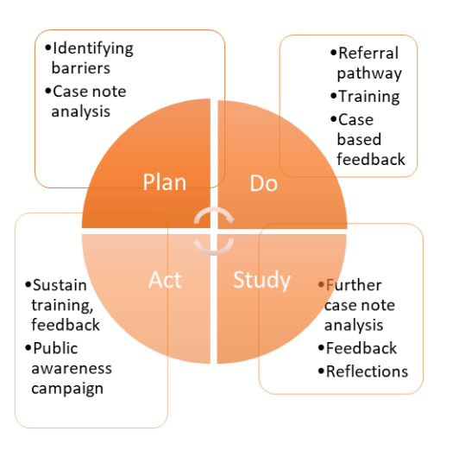
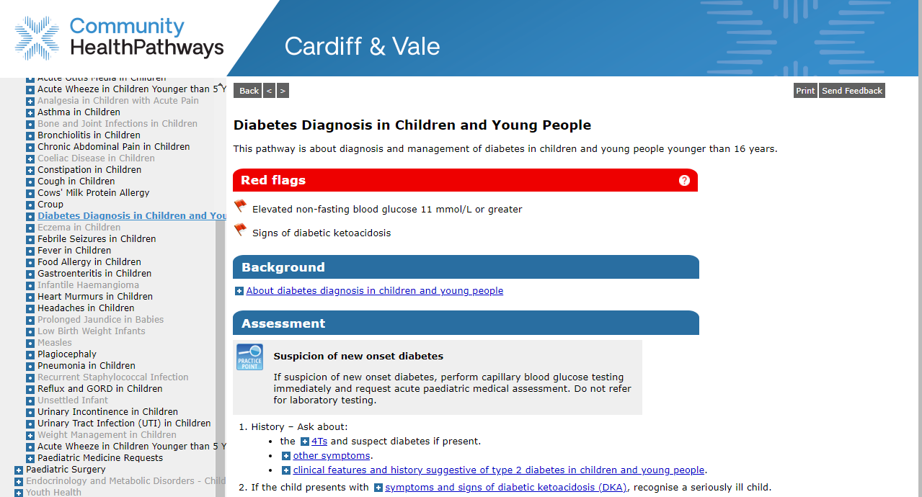
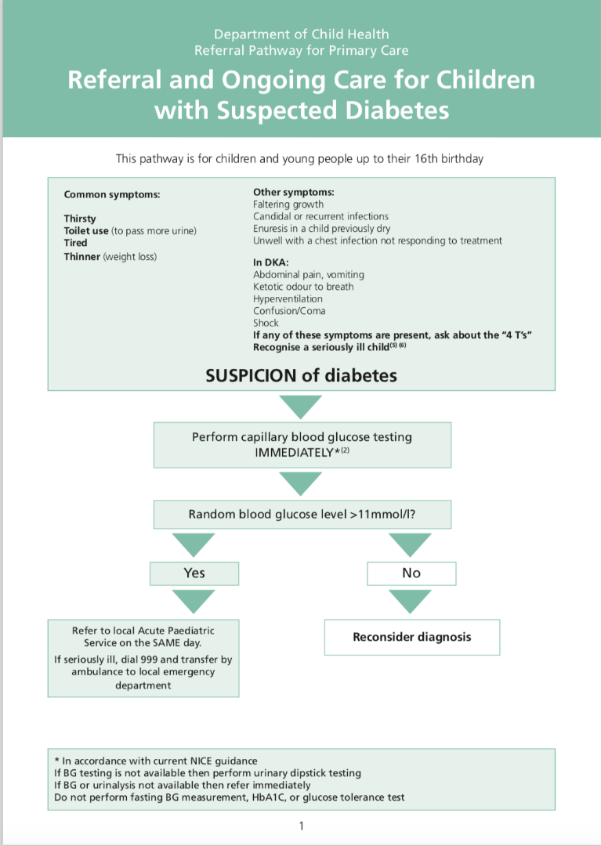
Background
Most CYP present with symptoms of T1D (4Ts) to primary care.
Delayed diagnosis is common and associated with increased risk of developing life-threatening diabetic ketoacidosis (DKA).
In the context of DKA incidence rising, QI initiatives were rolled out in 2018 to try and change this.
QI Initiatives:

Slide 3
Project Aims
To Analyse the effects of the QI across 6-year period on the incidence of DKA at diagnosis across Wales.
To Improve healthcare pathways to ensure early diagnosis of T1DM.

Slide 4
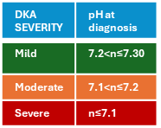
Method:
Time Period: 6 years of data
Pre-pandemic: 01/04/18 – 31/03/20
During pandemic: 01/4/20-31/03/22
Post-pandemic: 01/01/23 – 31/12/24
DKA divided into severity using pH at diagnosis
ALL WALES
Data from the Brecon Registry of all CYP in Wales with newly diagnosed T1DM.
Research points being:
Incidence of T1DM and DKA
Severity and Mortality of DKA
Comparison between Health Boards
Age at diagnosis
CAVUHB
Analysis of CAVUHB using case notes of all newly diagnosed CYP.
Research points being:
Delayed diagnosis
Delayed presentation
Methods of testing
Feedback to primary care
Notes:
Commonly asked question: how did you classify delayed diagnosis and delayed presentation?
Delayed diagnosis: Prior presentation to healthcare where something was not picked up- lead to DKA
Delayed presentation: CYP presenting in DKA at first presentation of symptoms

Slide 5
Method limitations
Pre-pandemic 01/04/18 – 31/03/20
During pandemic 01/4/20-31/03/22
Post-pandemic 01/01/23 – 31/12/24
There is a gap in the chosen time frame for data collection between 31/03/22 and 01/01/23.
In the future, this project should be further continued to include these dates to ensure it is accurately representative.

Slide 6
RESULTS: All Wales DKA at Diagnosis
Since the pandemic, there has been a 22.8% decrease in new T1DM diagnoses (n=394 to n 304). This is a change from 22.4% increase seen in the pandemic.
The highest rate of DKA at diagnosis was during the pandemic.
Most common age group for diagnosis was 9-12 years.
1 Mortality due to undiagnosed T1DM at the start of the pandemic.
 | Pre-Pandemic | Pandemic | Post-Pandemic
Number of new T1D Diagnoses | 322 | 394 | 304
Of which number in DKA | 102 | 138 | 102
% in DKA at diagnosis | 31.7% | 35% | 33.6%

Slide 7
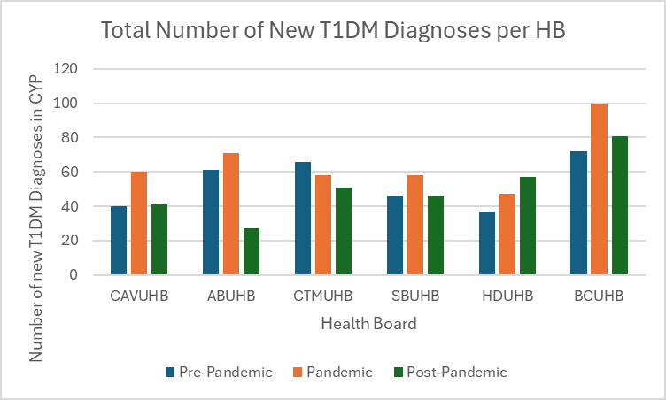
RESULTS: Number of New T1DM Diagnoses per HB
5/6 health boards have seen a decrease in number of new T1DM diagnoses since the pandemic.

Slide 8
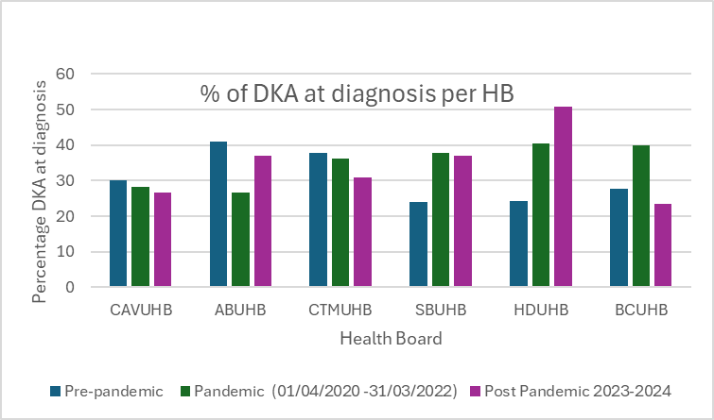
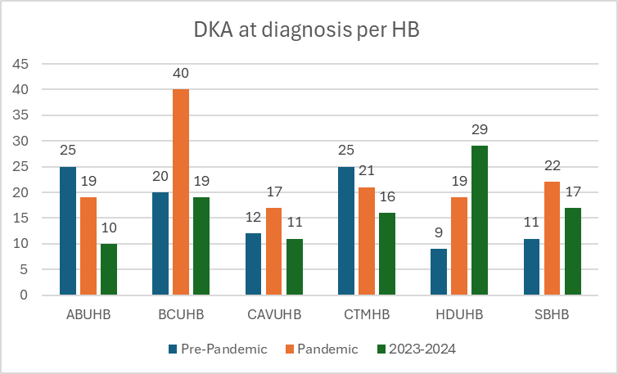
Results: DKA at Diagnosis per HB
Post-pandemic:
Highest % = HDUHB at 50.8%
Lowest % = CAVUHB (at 26.8%) and BCUHB (at 23.5%)
Number of cases of DKA at diagnosis per HB across 6 years.

Slide 9
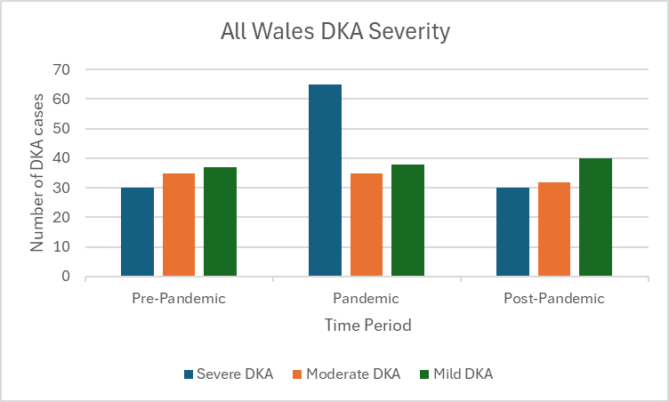
Results: All Wales DKA Severity
During the pandemic, there was a significant increase in the severe DKA’s to more than double that of the pre-pandemic period.
(n=30 to n=65).
This decreased back to n=30 post-pandemic.

Slide 10
Results: DKA Severity per HB
Lowest number of severe DKA cases: CAVUHB
Highest number of severe DKA cases: HDUHB
Highest number of severe DKA cases: ABUHB
Highest number of severe DKA cases: CTMHB
Lowest number of severe DKA cases: CAVUHB
Lowest number of severe DKA cases: CAVUHB

Slide 11
Results: DKA Severity per HB
Pre-Pandemic | Pandemic | Post-Pandemic
ABUHB: 36% BCUHB: 35% CAVUHB: 8.3% CTMUHB: 28% HDUHB: 44% SBUHB: 27% | ABUHB: 26% BCUHB: 55% CAVUHB: 24% CTMUHB: 67% HDUHB: 58% SBUHB: 41% | ABUHB: 50% BCUHB: 21% CAVUHB: 18% CTMUHB: 31% HDUHB: 28% SBUHB: 35%
This table demonstrates the percentage of DKAs per HB which presented as a severe DKA.

Slide 12
Results: CAVUHB Analysis
No increase in rate of DKA at diagnosis in CAVUHB.
Pre-pandemic rate of delayed diagnosis of 17.5% compared to 6.7% during the pandemic and 7.9% post pandemic.
More delayed presentations than delayed diagnosis.
In the post-pandemic period, 81.25% of patients who presented to GP were diagnosed via capillary blood glucose test (NICE Guidelines gold standard).
Above 70% cases diagnosed in primary care across all 6 years.
 | Pre-Pandemic | Pandemic | Post-Pandemic
Total T1DM Diagnosis | 40 | 60 | 41
Total DKA at Diagnosis | 12, 30% | 17, 28.3% | 11, 26.8%
Total Mild DKA | 5 | 10 | 5
Total Moderate DKA | 6 | 3 | 4
Total Severe DKA | 1 | 4 | 2
Diagnosed in Primary Care | 31 | 42 | 29
Delayed Diagnosis (n, %) | 7, 17.5% | 4, 6.7% | 3, 7.3%
Delayed Presentation (n, %) | 6, 15% | 12, 20% | 7, 19.4%
Feedback letter to the GP (n, %) | 25, 62.5% | 32, 53.3% | 21, 51.2%

Slide 13
Results: CAVUHB Analysis
Reasons for delayed diagnoses:
Pre-pandemic: 7 delayed diagnosis – 6 due to triage delays, 1 had a fasting BG test.
Pandemic: 4 had delayed diagnosis- 2 due to delayed triage. 4 in severe DKA were delayed presentations to HCPs and promptly diagnosed, 2 were assumed to have COVID symptoms.
Post-pandemic: 3 had delayed diagnosis. 1 due to triage process, 1 had HbA1c and 1 due to missed symptom recognition.
Rates of POC testing and prompt referral:
Pre-pandemic: 75%
Pandemic: 91%
Post-pandemic: 81.25%
Notes:
Yes it should be the same

Slide 14
Results: Summary
Across Wales:
5/6 health boards have seen a decrease in number of new T1DM diagnoses since the pandemic.
Since the pandemic, there has been a 22.8% decrease in new T1DM diagnoses (n=394 to n 304). This is a change from 22.4% increase seen in the pandemic.
During the pandemic, there was a significant increase in the severe DKA’s to more than double that of the pre-pandemic period and the post pandemic period,(n=30, n=65, n=30).
In CAVUHB:
No increase in DKA at diagnosis over the last 6 years in CAV.
Over 70% of CYP being diagnosed in primary care across all 6 years.
Decrease in incidence of delayed diagnosis since Pre-Pandemic.
No decrease in incidence of delayed presentation since Pre-Pandemic.

Slide 15
Where are we now?
Sustained education: Dr Ambika Shetty spoke at CPET session on 30/04/2025 and had positive feedback from the GPs.
“Her talks have shaped the way I question all parents of sick kids and dramatically increased my use of glucometer.”
“I also cascade this training to our GP trainees”
The QI innovations have shown a general trend of improvement in promoting early diagnosis of T1D in CAVUHB.
Structured proactive delivery across Wales
National network T1D early diagnosis SIG: Public health awareness and education to reduce delayed presentations.
Health Pathways

Slide 16
Conclusions + Discussion Points
Higher DKA rates at diagnosis remain in some UHBs.
No increase in DKA at diagnosis over the last 6 years in CAVUHB.
Delayed presentation rather than delayed diagnosis cause for DKA at diagnosis in CAVUHB, highlighting the importance of further public awareness campaigns.
The plan is to continue QI cycles across Wales. This will seek to further improve early diagnosis, reduce delayed presentations and reduce incidence of DKA at diagnosis.
To deliver the teaching in different health care settings in primary care. Specifically, pharmacy settings as the “common ailments” and “choose pharmacy” schemes become used more.

Slide 17
Resources
National Children & Young People’s Diabetes Network
  www.cypdiabetesnetwork.nhs.uk/national-network/dka-prevention-at-diagnosis/
Diabetes UK
  www.diabetes.org.uk/The4Ts
  https://shop.diabetes.org.uk/products/diagnosing-type-1-diabetes-pathway-hcps
NICE: Diabetes (type 1 and type 2) in Children and Young People: Diagnosis and Management
  www.nice.org.uk/guidance/ng18
I would like to give thanks to Dr Ambika Shetty and the rest of the paediatric diabetes team at Noah’s Ark Children’s Hospital for their time, teaching and support.
Thank you to Rhia Williams, the Brecon Data Group Administrator.

