Slide 1
NPDA 24-25
Dr Simon Fountain-Polley

Slide 2

NPDA - current movements
  Wales now has a representative
    Project Board
    Methodology and Dataset Group

Slide 3
NPDA – coming up
Agreement to stop adjusting for ethnicity and deprivation
Reduction in variability of results to the point where adjustment is less meaningful
PREM data out

Slide 4
NPDA - thoughts
Psychology input into High HbA1c response
Are we using the Dashboard?
How are we using the Dashboard?

Slide 5
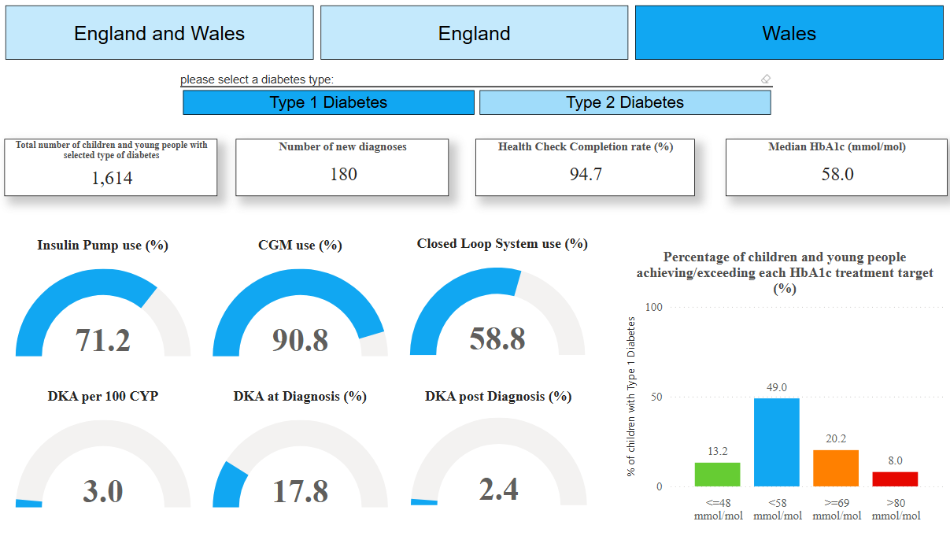
NPDA 24-25

Slide 6
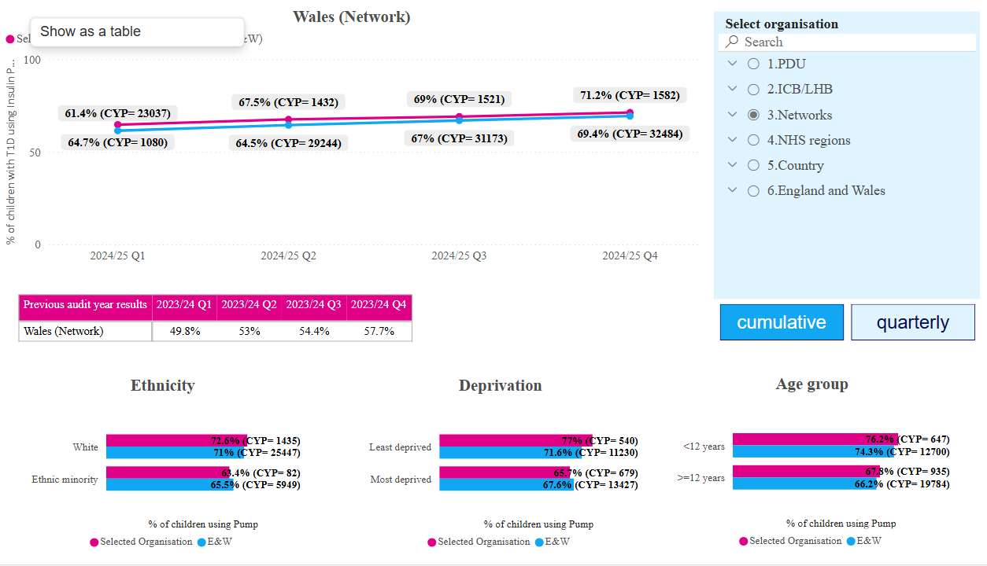
NPDA 24-25 – Pump Use

Slide 7
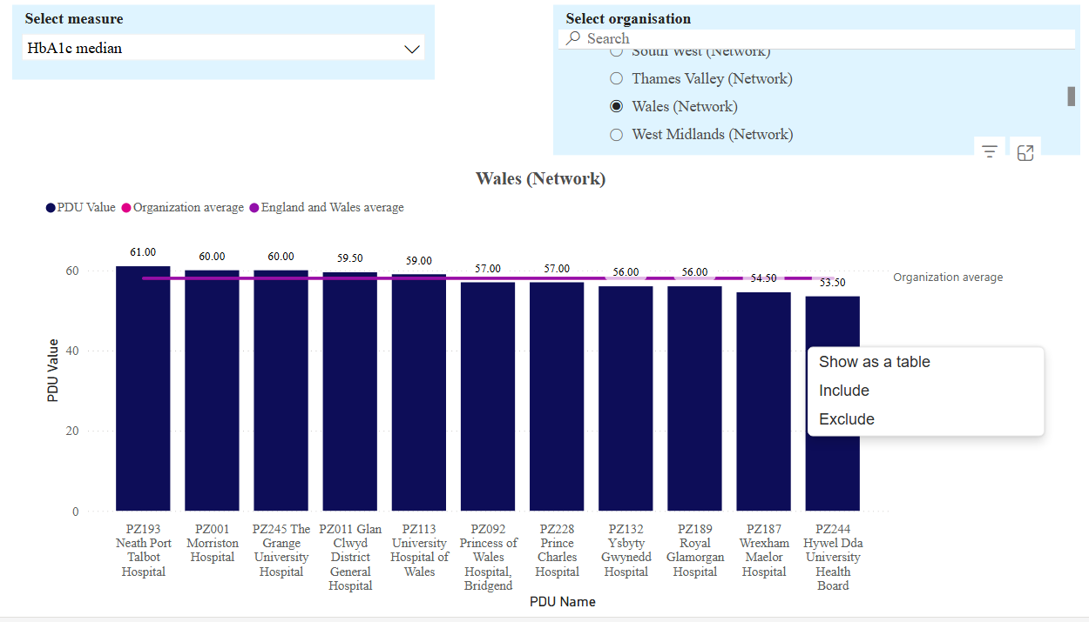
NPDA – 24-25

Slide 8
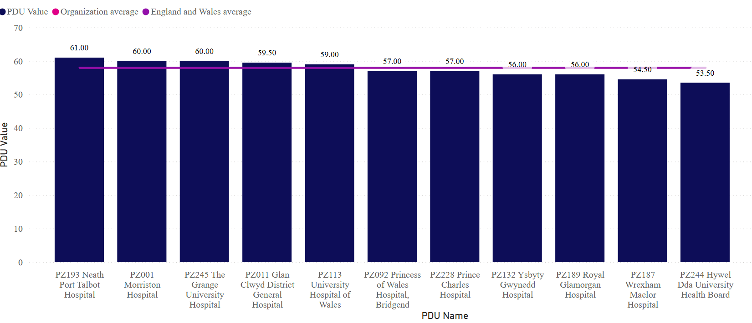
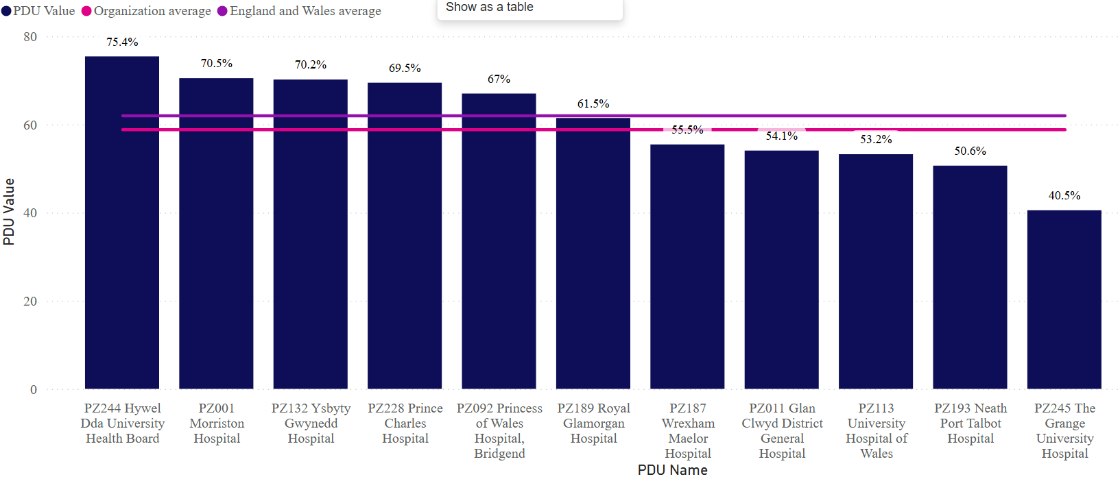
NPDA – Dashboard for comparisons

Slide 9
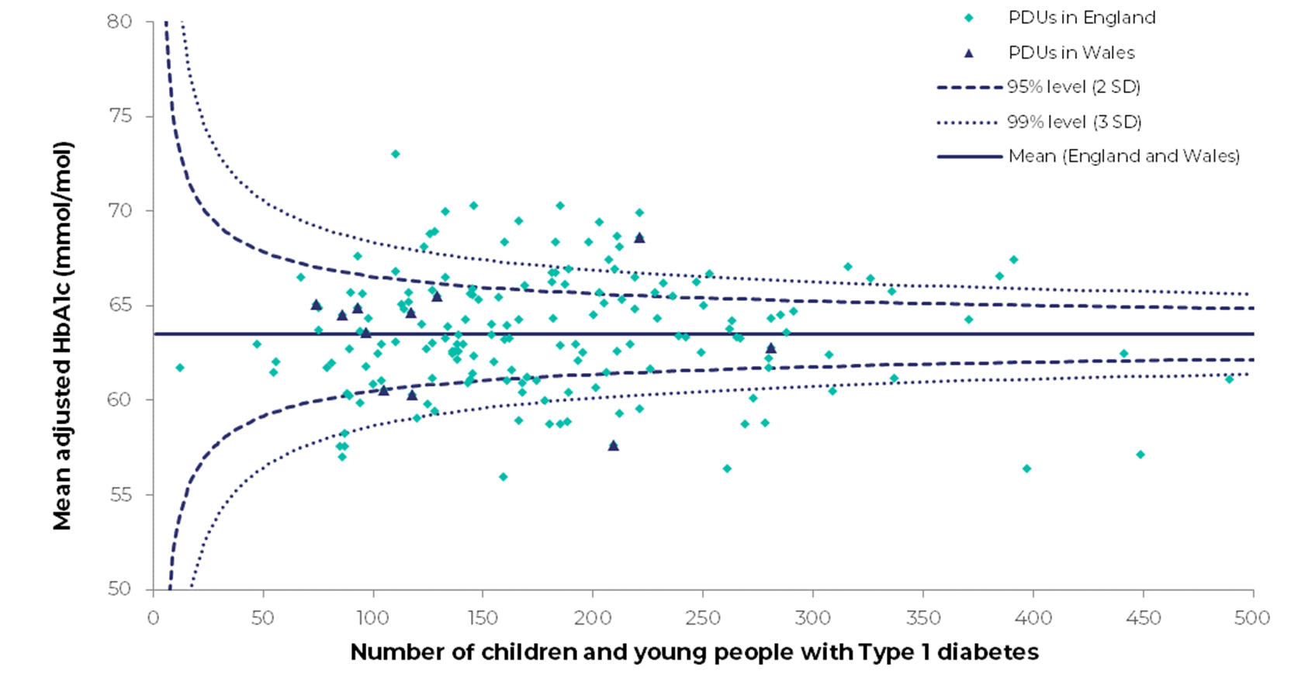
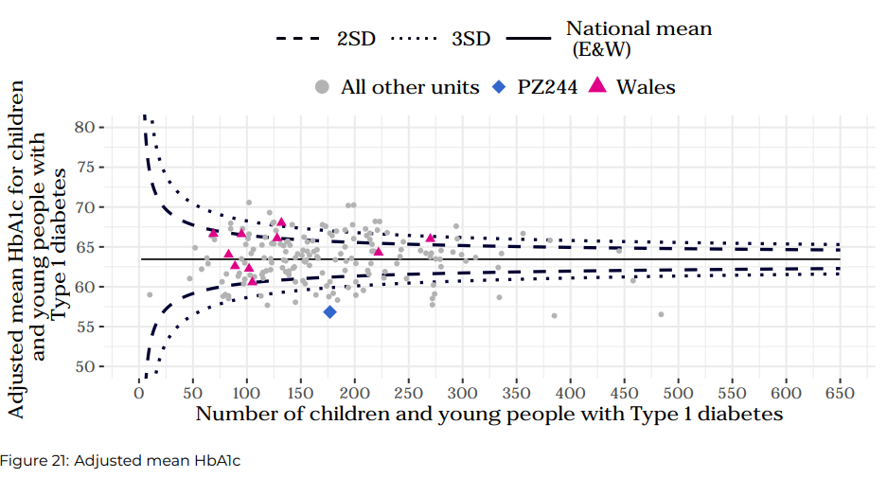
NPDA 23-24 Adjusted Mean HbA1c

Slide 10


NPDA – pressure

