Slide 1
Complications of Diabetes QIP
Eleanor Gait-Carr
ST7 Paediatrics (SPIN Diabetes)

Slide 2
Current practice
Monitoring for hypercholesterolaemia, microalbuminuria and hypertension
3 separate guidelines
For >12s:
  BP measured at all appointments
  Bloods and urine collected at annual review
All appointments are afternoon (bloods not fasted, urines not early am)

Slide 3
Step One: Audit

Slide 4
Step One: Audit
Reviewed 2024 data for 147 CYP >12y
Type 1 and Type 2 included
Audited whether CYP had been screened and also whether we actioned results appropriately, against ISPAD 2022 guidelines

Slide 5



Hypercholesterolaemia
33%
8%
Microalbuminuria
abnormal results
of abnormal results actioned appropriately
13%
87%
abnormal results
of abnormal results actioned appropriately
Hypertension
55%
0%
abnormal results
of abnormal results actioned appropriately
Notes:
41/126 abnormal
3/40 actioned appropriately (1 not applicable due to background condition)

Slide 6
Step One: Audit
Established there was room for improvement!
Ideas:
  Feedback to whole team
  Ensure accurate reference ranges (differences between guideline/WCP/letters)
  Put BP centile charts in guideline and clinic rooms
  Do we need to change to am appointments? Should we buy a home BP monitor?

Slide 7
Step One: Audit
Established there was room for improvement!
Ideas:
  Feedback to whole team
  Ensure accurate reference ranges (differences between guideline/WCP/letters)
  Put BP centile charts in guideline and clinic rooms
  Do we need to change to am appointments? Should we buy a home BP monitor?
Updating the guidelines may help us!

Slide 8
Step Two: Guideline

Slide 9
Step Two: Guideline Update
Three guidelines into one
Updated to ISPAD 2022
Removed theory/blurb
Included flow chart for ease of understanding and quick reference
Added BP centile charts
Updated template letters to send to families when results are abnormal

Slide 10
Guideline Update
Format for each section:
  Flow chart
  Explanation
  Example letters
Collaboration with MDT to ensure steps work in our context
Extra appointments may be necessary
Secretarial support re template letters

Slide 11
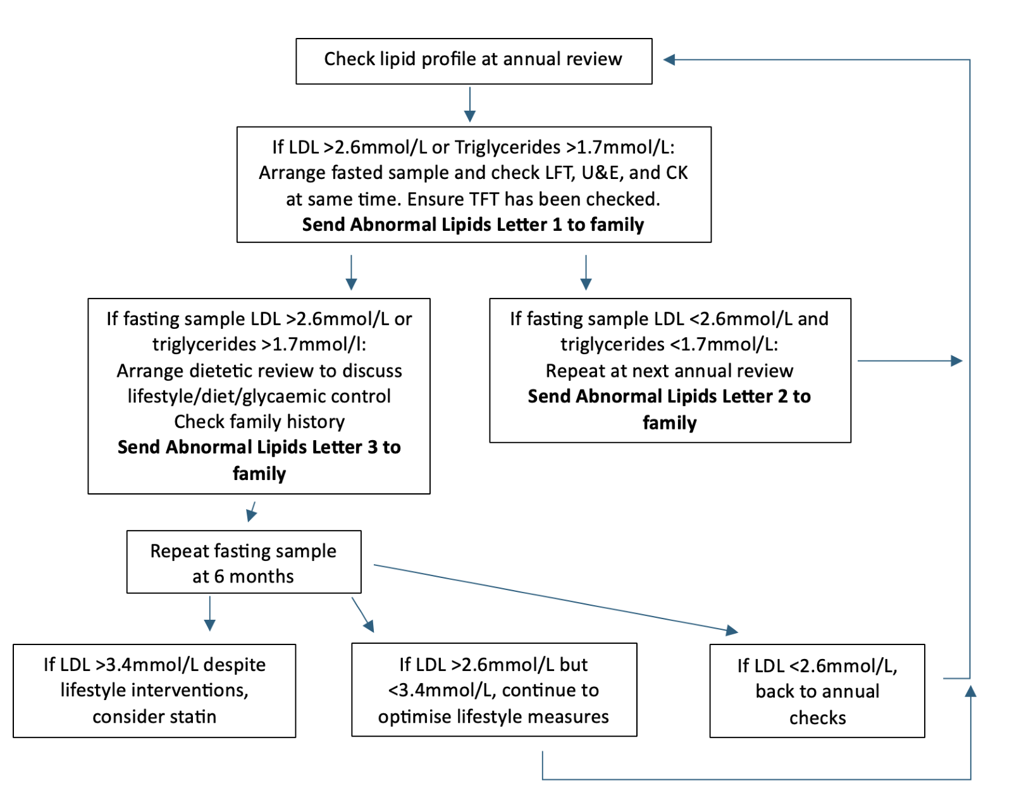

Slide 12
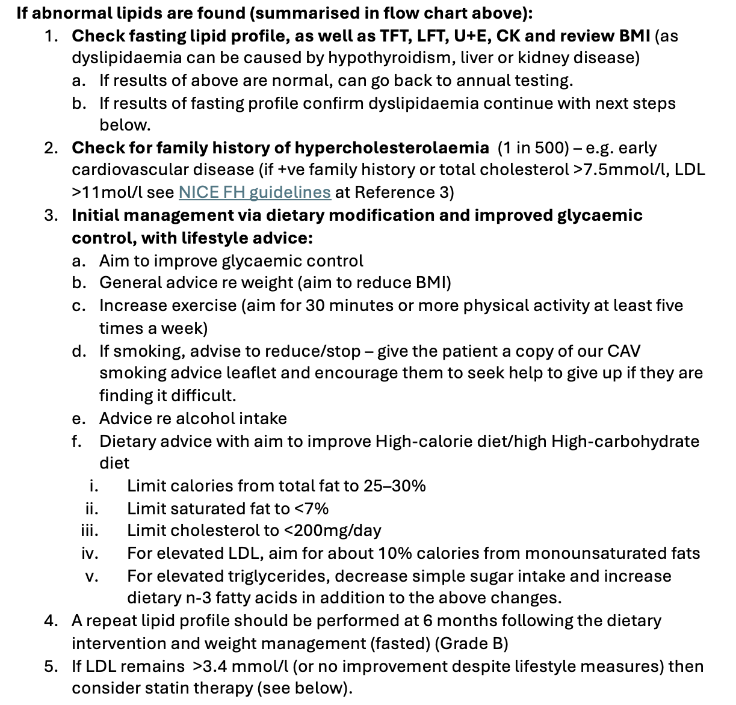

Slide 13
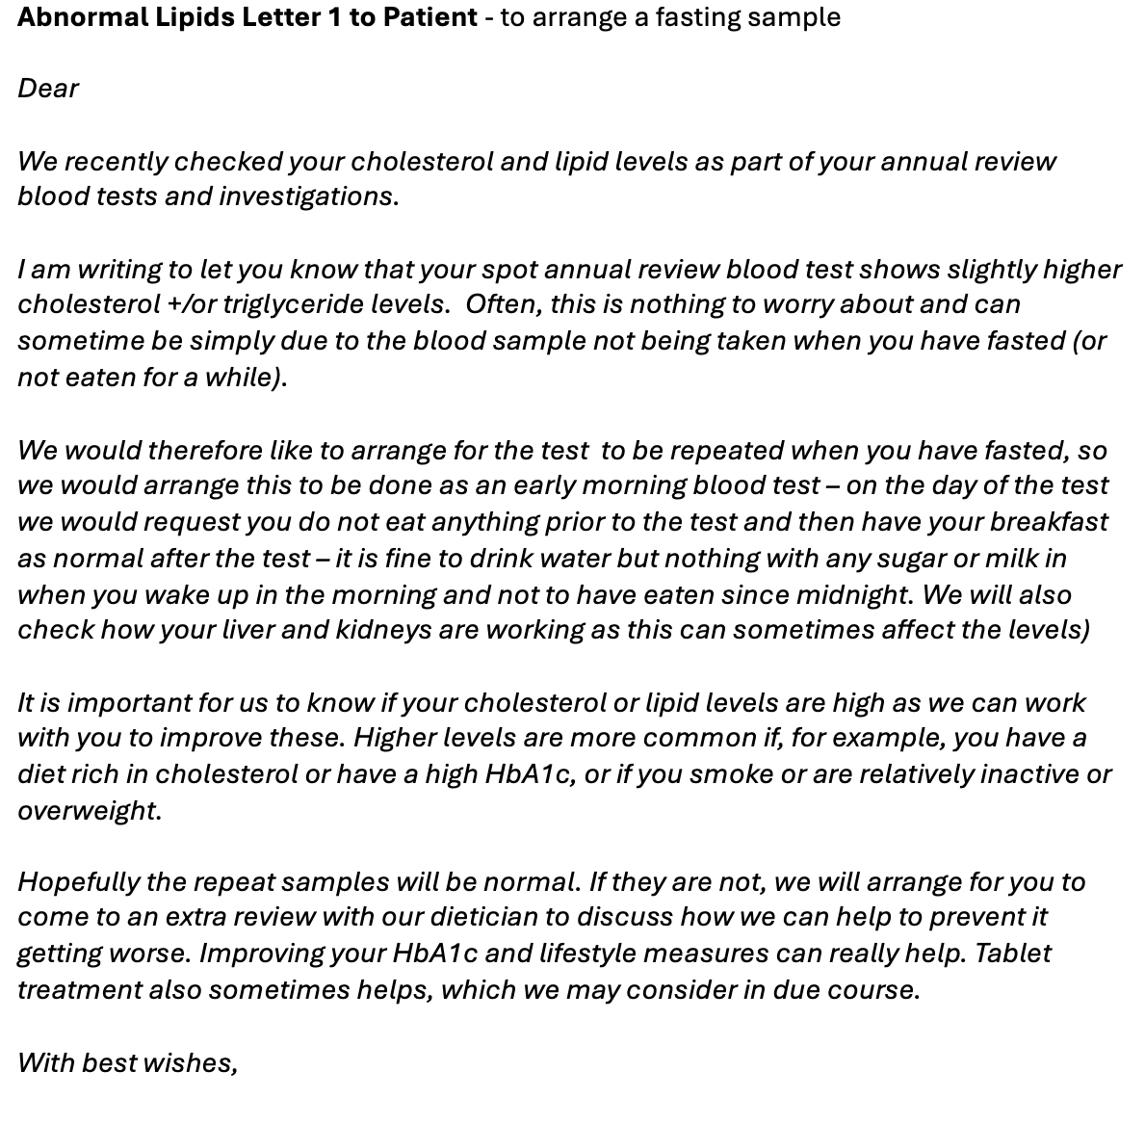

Slide 14
Step Three: Re-Audit
(Coming 2026...)

Slide 15
Thank you
Any questions or ideas to share?

