Slide 1

Managing Type 1 Diabetes in School
ABUHB Paediatric Diabetes Team
2021
On behalf of the Children and Young People’s Wales Diabetes Network
Endorsed by SEREN
Notes:
Welcome to this training about managing Type 1 Diabetes in School. This training has been developed by the Paediatric Diabetes Team in Aneurin Bevan University Health Board on behalf of the Wales Diabetes Network. This training is aimed at individuals who look after children with Type 1 Diabetes such as teachers, teaching assistants, coaches and others.

Slide 2

Overview of the Session
What is Type 1 diabetes?
How to check blood glucose levels & ketones
Injecting insulin
Dietary Management
Calculating insulin doses
Insulin Pump Therapy
Hypoglycaemia
Hyperglycaemia
FreeStyle Libre / Continuous Glucose Monitoring
Exercise in school
Exams
Notes:
The full training covers (READ SLIDE) however this training is made up different videos and your local team will advise you which need to be watched depending on which training you need to undertake. All children will have an Individual Healthcare Plan in place from their local diabetes team. Please refer to these for specific information.
2

Slide 3
Aim
Highlight and provide an overview of the skills and information required to support a child or young person (CYP)with diabetes.
Notes:
The aim of the training is to highlight and provide an overview of the skills and information required to support a child or young person with diabetes. Appropriate diabetes care in the school and early year setting is necessary for all young people’s immediate safety, long -term well being and ability to achieve optimal academic performance. Please note that people with diabetes are protected under the Equality Act 2010, therefore pupils cannot be seen to be discriminated against. In view of this, appropriately trained staff need to be available for all activities the YP participates in, including breakfast clubs, after school clubs and residential trips. It is important for several members of staff to be trained so that there is always someone available to supervise the YP’s diabetes. This is particularly important for times when the usual diabetes trained staff member is not available.

Slide 4
Type 1 Diabetes
Your body needs fuel to give you energy. When you eat carbohydrate, it is converted into glucose.
The glucose travels around the blood stream. It cannot be used as energy until it enters the cells.
Notes:
Read slide

Slide 5
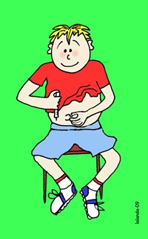
Type 1 Diabetes
The pancreas is the part of the body where insulin is made. Insulin works as a key, allowing the glucose to enter the cell. The glucose can then be used for energy.
When you have type 1 diabetes your pancreas does not produce insulin. You have to inject the insulin.
Notes:
Read first box
Type 1 Diabetes is an autoimmune disease where your pancreas does not produce insulin. It is not linked to your diet. Insulin needs to be injected. The only alternative to injections is an insulin pump.

Slide 6
Type 1 Diabetes
When there is not enough insulin, the body will create an alternative source of energy resulting in the production of ketones
Notes:
Read slide
A build up of ketones in the blood causes the young person to feel really unwell and can lead to serious illness

Slide 7
Signs and Symptoms of Type 1 Diabetes
Notes:
The classic signs and symptoms of diabetes are known as the 4 T.s. Needing the toilet more, an insatiable thirst, tiredness, and looking thinner due to weight loss. There is also an increased likelihood of infections and the presence of ketones in the blood and urine.
The young person may also suffer with other issues such as thrush, bed wetting, infections or changes in behaviour.

Slide 8
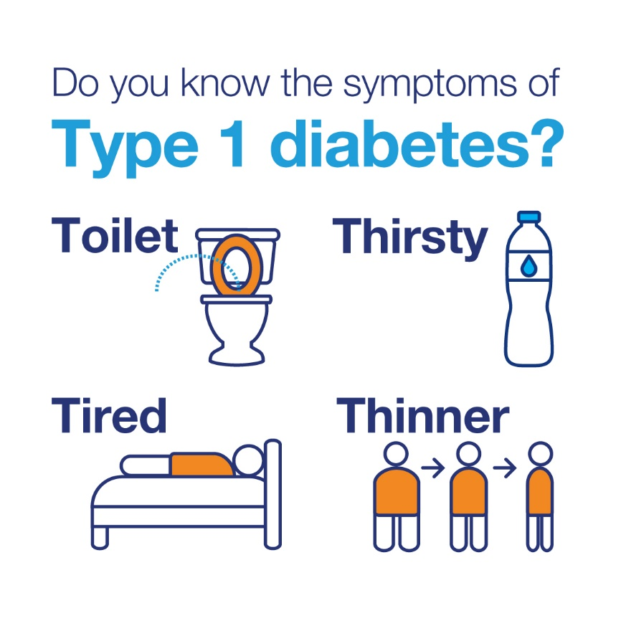
Signs and Symptoms
Also:
Ketones
Infections
Behaviour changes
Notes:
The classic signs and symptoms of diabetes are known as the 4 T.s. Needing the toilet more, an insatiable thirst, tiredness, and looking thinner due to weight loss. There is also an increased likelihood of infections and the presence of ketones in the blood and urine.
The young person may also suffer with other issues such as thrush, bed wetting, infections or changes in behaviour.

Slide 9
Importance of Optimal Type 1 Diabetes Management
Maintain blood glucose levels between
4- 7 mmol/L before meals
Ensure child reaches full growth potential
Children develop into independent healthy adults
Achieve full academic potential
Notes:
The aim is to maintain the blood glucose levels between 4 and 7 mmol/l before meals. We talk about ‘time in target’ which means aiming to maintain the young person’s blood glucose levels between 4 and 10 mmol/l in between meals. This takes into account the natural rise in glucose levels after eating.
It is important to optimise the management of Type 1 Diabetes in order to ensure the young person is able to concentrate and learn effectively in order to reach their full potential, participate in all activities and develop into independent healthy adults.

Slide 10
Importance of Optimal Type 1 Diabetes Management
To prevent short term complications associated with diabetes:
Low blood glucose (hypoglycaemia)
High blood glucose (hyperglycaemia)
Promote full-time school attendance
Notes:
Read slide. It is important to aim for optimal management in order to keep young people in school as much as possible so they are able to reach their full academic potential. Pupils will need time off to attend their appointments and they should not have their attendance record penalised for this.

Slide 11
Importance of Optimal Diabetes Management
The risk of developing long term complications is increased if the person’s glucose levels are above the optimal range for long periods of time.
Eyes | Diabetes is the leading cause of blindness in people of working age
Kidneys | The leading cause of renal failure
Feet | The 2nd most common cause of lower limb amputations
Heart | Mortality rates from coronary heart disease are 5 times higher
Pregnancy | Women with diabetes face additional risks during pregnancy, at birth and to the baby
Life Expectancy | Can be reduced by approx 10-15 years – JDRF
Notes:
The importance of optimal diabetes management.
The risk of developing long term complications is increased if the person’s glucose levels are above the optimal range for long periods of time. These complications can include problems with eyes, kidneys, feet, the heart, during pregnancy and overall can reduce life expectancy. Although this information is very negative, over the last few years as new technologies have improved and been made available to aid optimal management, the impact on life expectancy has reduced and continues to do so.

Slide 12
Documentation
“Local authorities and governing bodies must have regard to this statutory guidance when carrying out their duties in promoting the welfare of children who are learners at the education setting, including meeting their healthcare needs. The guidance also applies to activities taking place off site as part of normal educational activities.”
Supporting learners with healthcare needs
Welsh Assembly Government 2017

Slide 13

Dietary Management
Notes:
Dietary management of Type 1 diabetes

Slide 14
Principles of Dose Adjustment
Rapid acting insulin is given with food and a background insulin is given once or twice daily
Notes:
The Principles of dose adjustment
Rapid acting insulin such as Novorapid, Humalog, Apidra or Fiasp is given at each meal and some snacks. Long acting insulin such as Levemir, Lantus or Tresiba is given once or twice daily.
The amount of rapid acting insulin will change depending on the blood glucose level before the meal and the amount of carbohydrate that the meal or snack contains. The amount of long acting insulin is not affected by the amount of food eaten or the blood glucose level at that time. This dose doesn’t vary from day to day but may change over time as the young person grows.

Slide 15
Food
Food consists of a mixture of nutrients. The ones that provide energy in the diet are:
Protein
Fat
Carbohydrate
It is important to eat a healthy varied diet for long term health. Young people with diabetes do not need a specific diet.
Notes:
Read slide
The Eatwell Guide as shown here provides a guide for a healthy balanced diet. This is the same for everyone regardless of whether they have diabetes or not. Young people with diabetes do not need to follow a specific diet but should be encouraged to have healthy meals and snacks and limit the amount of high fat and high sugar foods and drinks consumed.

Slide 16
Digestion of Food
Notes:
The Digestion of food.
Protein foods such as meat, fish, eggs, cheese, nuts and soya are digested and broken down into amino acids. Amino acids only have a small effect on blood glucose levels.

Slide 17
Digestion of Food
Notes:
Fats such as margarine, butter, oil and creams are broken down into fatty acids which also only have a small effect on blood glucose levels

Slide 18
Digestion of Food
Notes:
All food containing carbohydrate will be broken down into glucose. This will therefore increase the blood glucose levels.

Slide 19
Which Foods contain Carbohydrate?
Carbohydrate is found in the following foods:
Notes:
Carbohydrate is found in many types of food. The main foods which contain carbohydrate can be broken down into 4 types. The first is cereal starches. These include anything that is made from grains such as rice, bread, flour products, breakfast cereals, pasta, noodles and couscous

Slide 20
Which Foods contain Carbohydrate?
Notes:
Vegetables starches will also be broken down into glucose. Examples of these are potatoes, sweet potatoes, yams, peas, sweetcorn, beans and lentils. Most other vegetables contain a small amount of carbohydrate however as this amount is so small, we don’t usually count them

Slide 21
Which Foods contain Carbohydrate?
Notes:
Fruit, fruit juice, milk and other dairy products contain natural sugars. These will also break down in the digestive system into glucose and therefore effect the blood glucose levels.

Slide 22
Which Foods contain Carbohydrate?
Notes:
Sugar can also be added to food. These foods include sweets, jam, sugary drinks, chocolate, biscuits and cakes. Whilst we say that people with diabetes can have these foods, it is also advised that in order to have a healthy balanced diet these foods and drinks should not be consumed all the time. Therefore we advise choosing healthier snack options such as a yoghurt or fruit and opting for sugar free drinks.

Slide 23
Notes:
This table can be used as a quick reference guide for which food do and don’t contain carbohydrate.

Slide 24
Aim of Carbohydrate Counting
Encourage a healthy balanced diet
Allow the CYP to choose the type and amount of carbohydrate they wish to eat
Match it with the appropriate amount of rapid acting insulin (e.g. Novorapid, Humalog, Fiasp, Apidra) in order to help maintain glucose levels between 4 – 10 mmol/l
Notes:
The aim of carbohydrate counting is to encourage a healthy balanced diet whilst allowing the young person to choose the type and amount of food they wish to eat. Years ago, the management of diabetes included matching the amount of food to the fixed dose of insulin. This meant that the same amount and type of food needed to be eaten regularly. Today, we aim to match the appropriate amount of rapid acting insulin such as Novorapid, Humalog, Fiasp or Apidra to the amount of food eaten. This means that if the young person isn’t very hungry one mealtime and eats less food, less insulin is given. If they are hungry and eat more food, then more insulin would be given. This helps maintain the blood glucose levels

Slide 25
Resources available to help calculate carbohydrate
Books
Food labels
Internet websites
Apps
Weighing scales
Notes:
There are many resources available to assist with carbohydrate counting. These include books, food labels, manufacturer or restaurant websites, apps and weighing scales

Slide 26
Food Labels
Use the total carbohydrate to calculate insulin doses
Do not use the “of which sugars” on food labels
Inaccuracy can result in low blood glucose level (hypoglycaemia) or high blood glucose level (hyperglycaemia)
Notes:
When using food labels, it is important to use the total carbohydrate value rather than the ‘of which sugars’ valve. This is because all the carbohydrate will be broken down into glucose, not just the sugar. Using the ‘of which sugars’ valve can result in an inaccurate dose of insulin being given. Do not round up on individual carb amounts.
This is an example of a food label. Many labels will include the typical valve for 100g of the product and information per serving. In this examples, the packet of crisps weighs 30g therefore as it is likely that the young person will eat the whole bag, the valve given per 30g serving can be used. Again, the carbohydrate valve rather than the ‘of which sugars’ valve needs to be used therefore in this packet of crisps there is 16.8g of carbohydrate.

Slide 27
Using the ‘per 100g’ value
Notes:
Some products many not provide the ‘per serving’ information. Examples of this is on pasta or rice packets. Therefore this calculation will need to be used. Firstly the amount of carbohydrates per 100g valve will need to be found from the label. Please remember to check that this is the information for the product as it will be eaten. For example, please ensure that the information used for pasta or rice is for the cooked product.
Once this valve has been found, this number will need to be divided by 100. This gives you the amount of carbohydrate in 1g of the food.
The portion that the young person is going to eat should then be weighed.
To work out the amount of carbohydrate in the portion, multiply the answer from step 2 (the amount of carbs in 1g) by the answer for step 3 (the portion size weight)

Slide 28

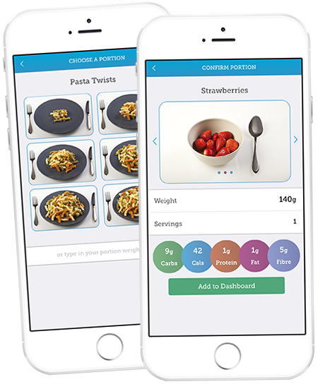
Carbs & Cals Book & App
Notes:
The carbs and cals book and app are useful quick reference resources for carbohydrate counting. They contain pictures of food with different portion sizes and the amount of carbohydrate contained in the food.

Slide 29
Carb Counting Practical
Over the next few slides there are a school menu, food labels and pictures from carbs & cals
Using these resources, please work out how many grams of carbohydrate are in each meal
The answers are given later in the presentation
Notes:
Read slide

Slide 30
SCHOOL MENU
Food | Portion | Carbohydrate (g)
Cheese & tomato pizza | 1slice
Jacket wedges | 1 serving
Sweetcorn | 1 serving
Mixed salad | 1 serving
Crunchy Fruit Crumble | 1 serving
Custard | 1 ladle
 | Total Carbohydrate =

Slide 31
SCHOOL MENU
Food | Portion Size | Weight (g) of food | Carbohydrate (g) per portion
Hawaiian or cheese and tomato pizza | 1 slice | 130 | 30
Jacket wedges | 1 serving | 167 | 30
Quorn bolognaise | 1 serving |  | negligible
Pasta | 1 serving | 200 | 20
Sweetcorn | 1 serving | 70 | 10
Carrots | 1 serving |  | negligible
Mixed salad | 1 serving |  | negligible
Jacket potato with skin | ½ medium 1 small | 110 170 | 25 35
Jacket potato without skin | ½ medium 1 small | 110 170 | 20 30
Baked beans (potato filling) | 1 ladle | 60 | 10
Crunchy Fruit Crumble | 1 serving | 75 | 20
Custard | 1 ladle 2 ladles | 70ml 140ml | 10 20

Slide 32
CARBS & CALS
Food | Portion | Carbohydrate (g)
Pizza slice -chicken, deep pan oven baked | 1 small slice (65g)
Sausage roll | 1 sausage roll (63g)
Gingerbread man | 1 gingerbread man (58g)
Chicken Breast | 1 chicken breast (90g)
Chocolate cake | 1 slice of cake (40g)
 | Total Carbohydrate =

Slide 33
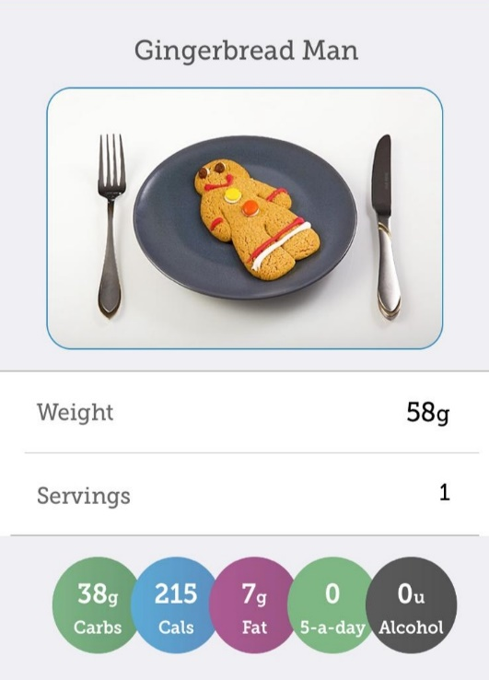
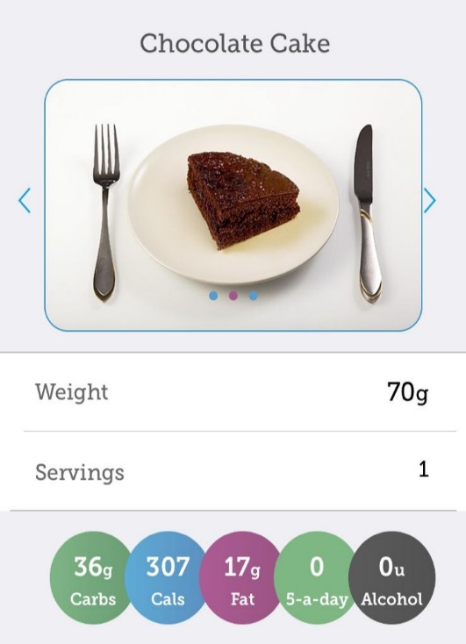
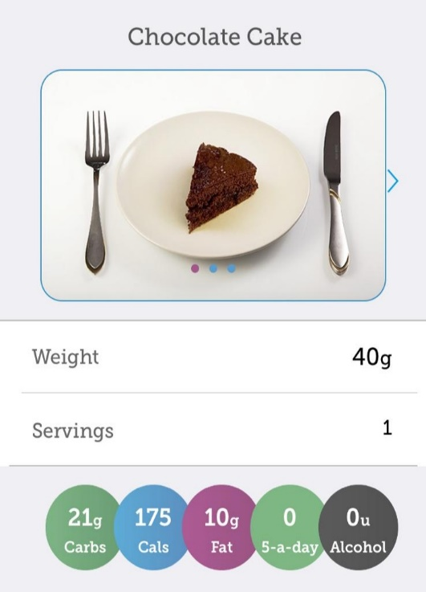
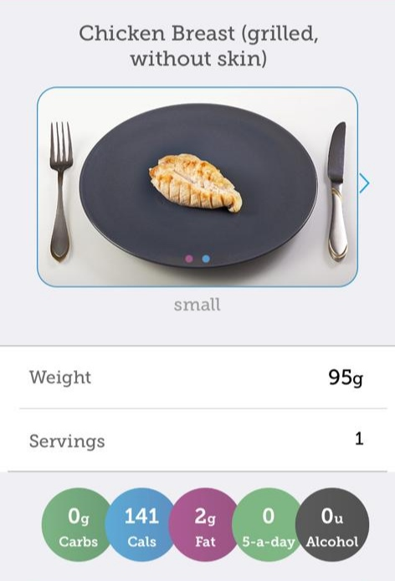
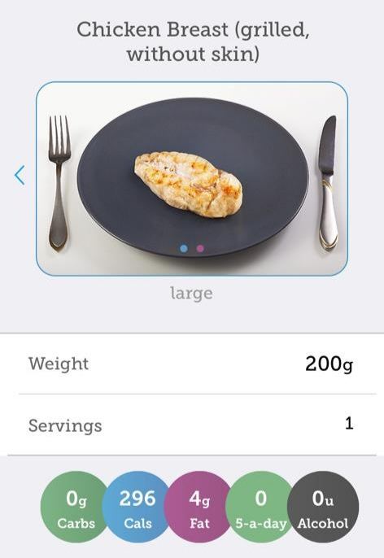
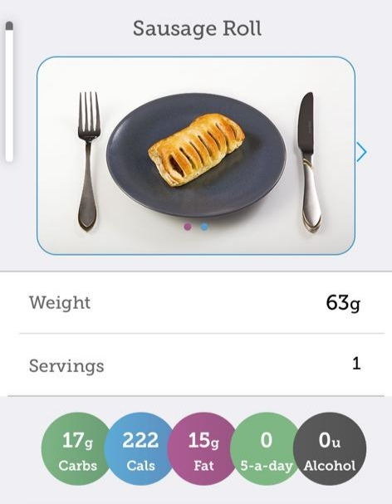
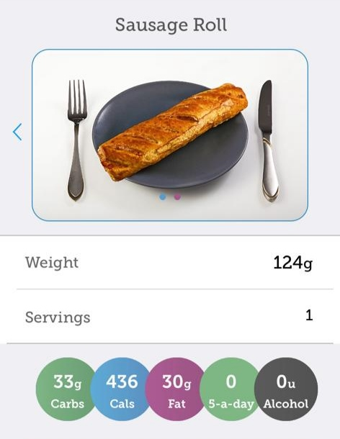
CARBS & CALS

Slide 34
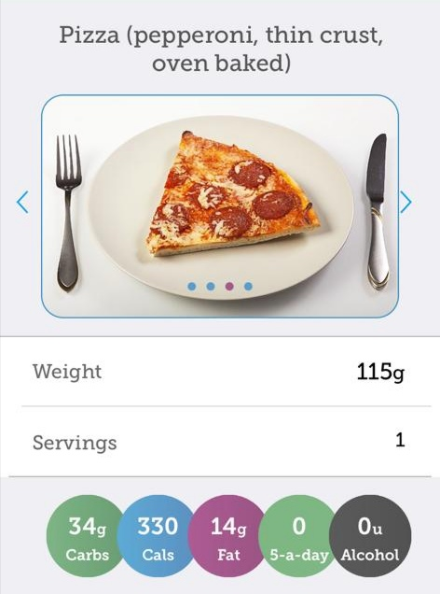
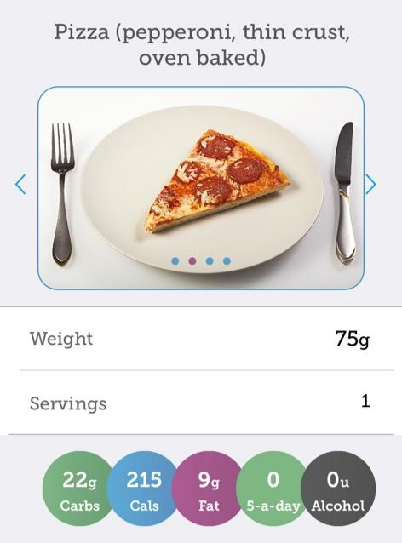
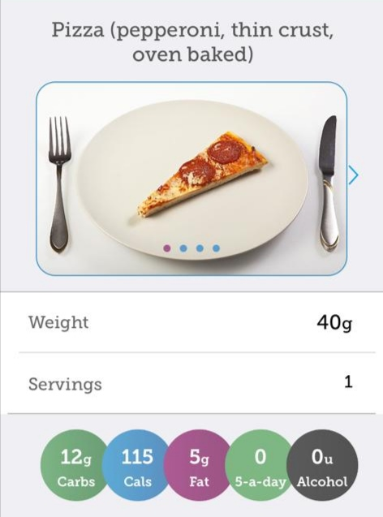
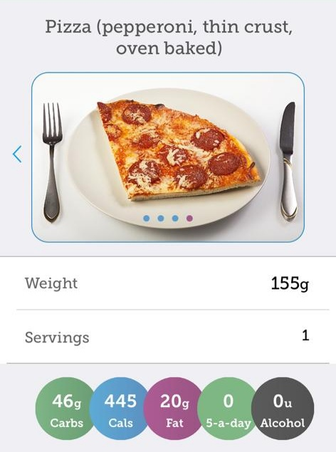
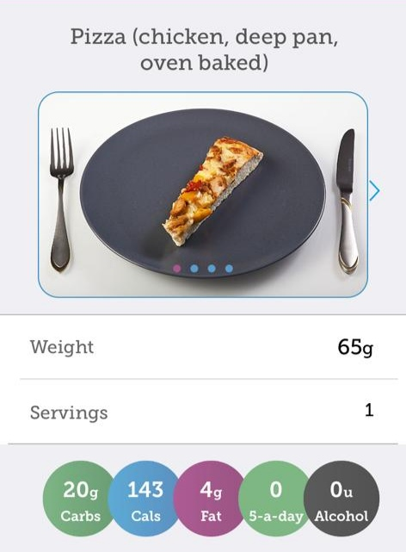
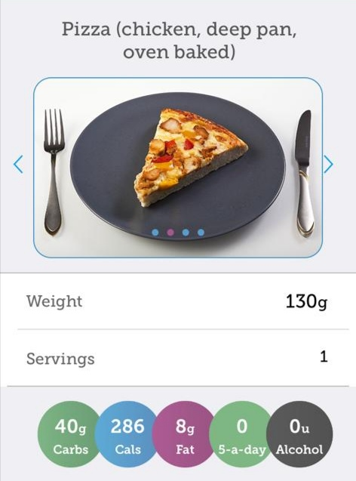
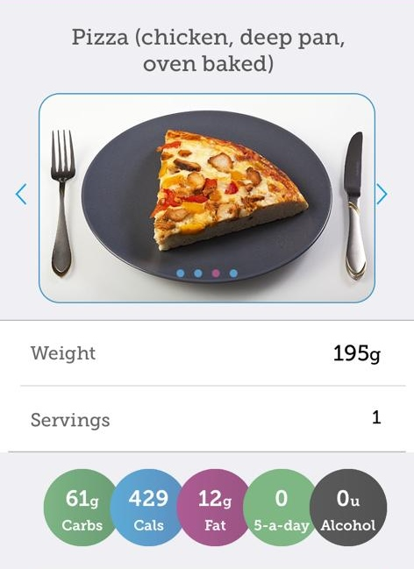
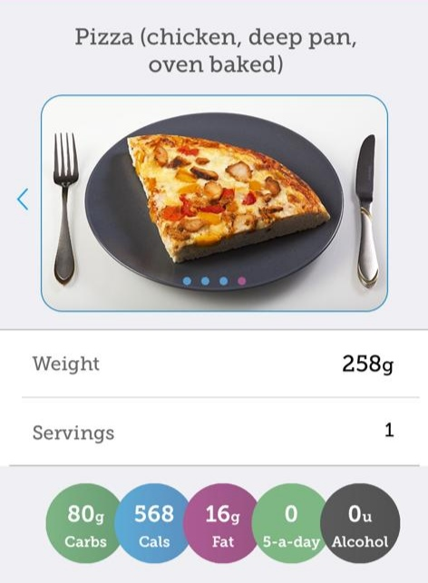

Slide 35
FOOD LABELS
Food | Portion | Carbohydrate (g)
Ham Sandwich (Kingsmill) | 2 slices of bread
Walkers Rdy Salted Crisps | 1 packet (Walkers)
NAKED Tangy Lime Raisins | 1 pack (25g)
Cadbury Mini Roll | 1 Roll
Rich Tea Biscuit | 1 biscuit (8.3g)
Capri-Sun Orange | 1 x 200ml pouch
Total

Slide 36


FOOD LABELS
Typical Values | Per 25g pack | Per 100g
Energy | 132 kcal | 526 kcal
Fat | 8.0g | 31.9g
Carbohydrate | 12.3g | 49.2g
Of which sugars | 0.1g | 0.4g
Protein | 1.5g | 6.1g
Typical Values | Per 25g pack | Per 100g
Energy | 68 kcal | 272 kcal
Fat | 0.1g | 0.4g
Carbohydrate | 17.3g | 69.3g
Of which sugars | 17.3g | 69.3g
Protein | 0.5g | 2.1g

Slide 37

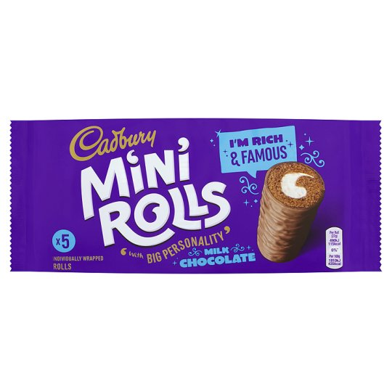
Typical Values | Per biscuit (8.3g) | Per 100g
Energy | 38 kcal | 459 kcal
Fat | 1.3g | 15.5g
Carbohydrate | 6.2g | 74.7g
Of which sugars | 1.7g | 20.2g
Protein | 0.6g | 7.0g
Typical Values | Per roll | Per 100g
Energy | 115 kcal | 435 kcal
Fat | 6.2g | 23.0g
Carbohydrate | 20.7g | 76.7g
Of which sugars | 11.4g | 42.4g
Protein | 1.3g | 4.8g

Slide 38


Typical Values | Per 200ml carton | Per 100ml
Energy | 82 kcal | 41 kcal
Fat | 0g | 0g
Carbohydrate | 20g | 10g
Of which sugars | 20g | 10g
Protein | 0g | 0g
Typical Values | Per slice | Per 100g
Energy | 95 kcal | 238 kcal
Fat | 0.8g | 2.0g
Carbohydrate | 17.8g | 44.6g
Of which sugars | 1.5g | 3.8g
Protein | 3.6g | 9.0g

Slide 39
Carb Counting Answers

Slide 40
SCHOOL MENU
Food | Portion | Carbohydrate (g)
Cheese & tomato pizza | 1slice | 30
Jacket wedges | 1 serving | 30
Sweetcorn | 1 serving | 10
Mixed salad | 1 serving | 0
Crunchy Fruit Crumble | 1 serving | 20
Custard | 1 ladle | 10
 | Total Carbohydrate = 100

Slide 41
CARBS & CALS
Food | Portion | Carbohydrate (g)
Pizza slice -chicken, deep pan oven baked | 1 small slice (65g) | 20g
Sausage roll | 1 sausage roll (63g) | 17g
Gingerbread man | 1 gingerbread man (58g) | 38g
Chicken Breast | 1 chicken breast (90g) | 0g
Chocolate cake | 1 slice of cake (40g) | 21g
 | Total Carbohydrate = 96 (g)

Slide 42
FOOD LABELS
Food | Portion | Carbohydrate (g)
Ham Sandwich (Kingsmill) | 2 slices of bread | 35.6
Walkers Rdy Salted Crisps | 1 packet (Walkers) | 12.3
NAKED Tangy Lime Raisins | 1 pack (25g) | 17.3
Cadbury Mini Roll | 1 Roll | 20.7
Rich Tea Biscuit | 1 biscuit (8.3g) | 6.2
Capri-Sun Orange | 1 x 200ml pouch | 20.0
Total |  | 112.1g

Slide 43
Calculating Insulin Doses

Slide 44
Calculating Insulin Doses
The dose of rapid acting insulin depends on:
carbohydrate content of meal
Blood glucose level at the time
Notes:
When calculating insulin doses, the amount of rapid activing insulin e.g. Humalog, Novorapid, Fiasp or Apidra will depend on the amount of carbohydrate in the meal and the blood glucose level at that time.

Slide 45
Insulin to Carbohydrate Ratio (ICR)
Notes:
Each young person has an individual Insulin to Carbohydrate Ratio. This may be different for different meals. This example is a 1 to 10 ratio which means that for every 10g of carbohydrate, 1 unit of insulin is needed. Please refer to the young person’s Individual Healthcare plan for their insulin to carbohydrate ratio.

Slide 46
Insulin: Carbohydrate Ratio
1 unit of rapid acting insulin is given for every
10 grams carbohydrate
Carbohydrate (grams) | Insulin (units)
10 | 1
20 | 2
30 | 3
40 | 4
50 | 5
60 | 6
70 | 7
Notes:
Remember all insulin pens can give half unit doses, work out to the nearest half unit.

Slide 47
Insulin: Carbohydrate Ratio
1 unit of rapid acting insulin is given for every
15 grams carbohydrate
Carbohydrate (grams) | Insulin (units)
15 | 1
30 | 2
45 | 3
60 | 4
75 | 5
90 | 6
105 | 7
Notes:
Remember all insulin pens can give half unit doses, work out to the nearest half unit.

Slide 48
Insulin: Carbohydrate Ratio
½ unit of rapid acting insulin is given for every
7 grams carbohydrate
Carbohydrate (grams) | Insulin (units)
7 | ½
14 | 1
21 | 1½
28 | 2
35 | 2½
42 | 3
49 | 3½
56 | 4
Notes:
This example is for every 7g of carbohydrate, half a unit is needed.

Slide 49
Insulin sensitivity factor (ISF)
This is also known as a correction dose
The ISF is extra insulin needed to correct a high blood glucose level e.g. before food
If the pre-meal blood glucose level is above the CYP’s individual target you will need to calculate a correction dose
Notes:
Read slide. Please refer to the IHP

Slide 50
1 unit of rapid acting insulin is needed to reduce blood glucose level by 3 mmol/l
Blood glucose level before meal in mmol/l | Correction Insulin dose required
8-10 mmol/l | 1 unit
11-13 mmol/l | 2 units
14-16 mmol/l | 3 units
17-19 mmol/l | 4 units
20-22 mmol/l | 5 units
23-25 mmol/l | 6 units
26-28 mmol/l | 7 units
29 mmol/l or above | 8 units
Notes:
This table shows how many extra units are needed at different blood glucose levels using a 1 to 3 ISF

Slide 51
Calculating Total Insulin Dose
Insulin for carbohydrate
+
Insulin for correction (if required)
=
Total dose of insulin to be given
Notes:
The amount of insulin that is required is calculated by adding the amount of insulin needed for the carbohydrate to the amount needed for a correction.

Slide 52
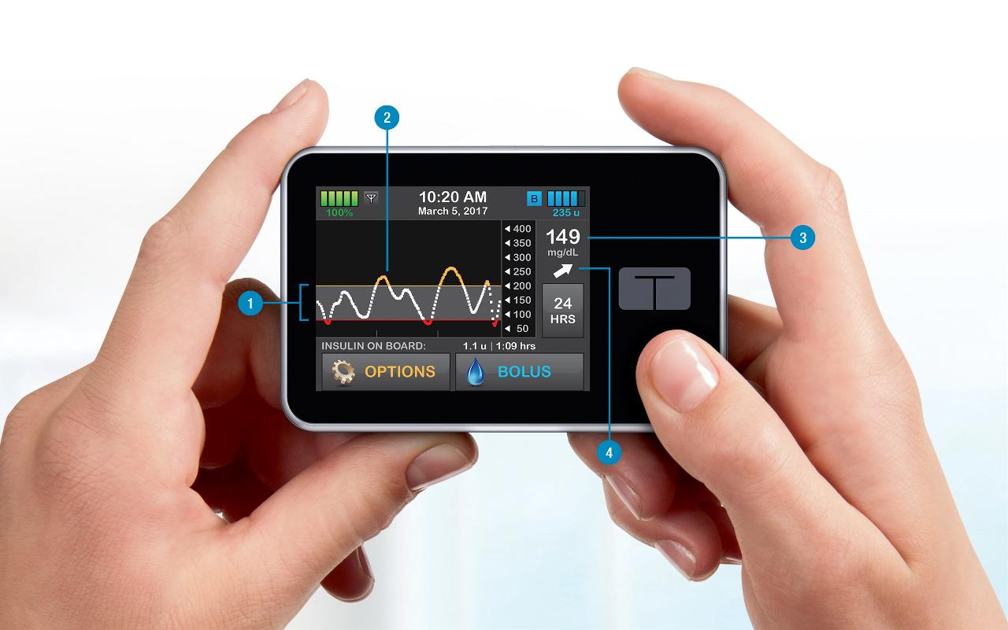
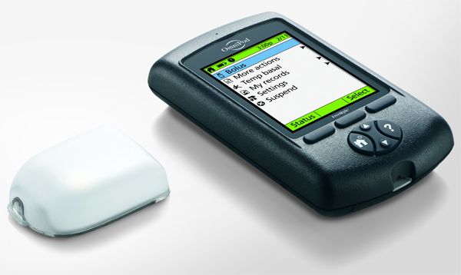
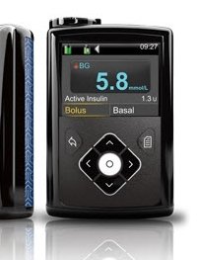
Insulin Pump Therapy
Notes:
Insulin pump therapy is an alternative way to give insulin is via insulin pump

Slide 53
Principles of Pump Therapy
Basal (background) insulin is delivered continuously via a pump
Bolus insulin is given with food
Background insulin
Notes:
An insulin pump uses fast acting insulin only but in two ways. One if to provide background insulin and the other is as a bolus with food and for corrections.
Bolus insulin - This acts in the same way as the mealtime (bolus) insulin works with injections. The pre-meal blood glucose reading will need to be added to the pump, although some meters will transfer the result to the pump via Bluetooth. The amount of carbohydrate the child is planning to eat will also need to be entered into the pump. The built-in bolus advisor will calculate how much insulin is needed. You will then need to check the recommended dose and confirm with a button push to deliver the insulin dose.
Background settings - The pump delivers the basal insulin continuously in small amounts day and night and has a similar effect to a long-acting insulin taken by those using insulin injections rather than an insulin pump. The basal insulin rate can be adjusted hourly to deliver different amounts of insulin. This is called a basal rate profile and the team will adjust the settings with the child until the basal profile is just right.
On the pump there is the ability to set temporary basal rates. This means increasing or decreasing the amount of background insulin. This can be useful in preparation for sports as by reducing the amount of insulin being given before and during the activity, it can help maintain the blood glucose levels within the target range. Please refer to the IHP for guidance.
Because the insulin pump uses fast acting insulin only and there is no long lasting insulin in the child’s system, it is important to test for ketones if the blood glucose level is above 14 mmol/l. Please follow the local guidelines in the IHP which will guide you though how to manage this. If the pump stops working, it is important to contact the parents asap as need to be dealt with within an hour.

Slide 54
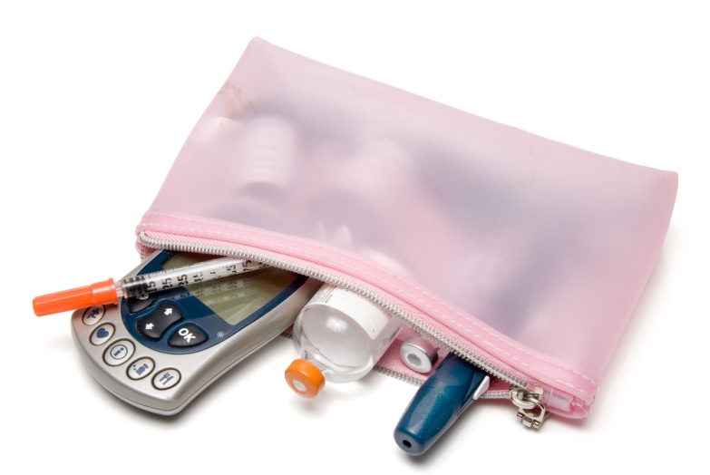
Calculating Insulin Dose Scenarios 1 & 2

Slide 55
ICR 1:10
ISF 1:3
Carbohydrate (grams) | Insulin (units)
10 | 1
20 | 2
30 | 3
40 | 4
50 | 5
60 | 6
70 | 7
80 | 8
Blood glucose level before meal in mmol/l | Correction Insulin dose required
8-10 mmol/l | 1 unit
11-13 mmol/l | 2 units
14-16 mmol/l | 3 units
17-19 mmol/l | 4 units
20-22 mmol/l | 5 units
23-25 mmol/l | 6 units
26-28 mmol/l | 7 units
Notes:
Using the insulin to carbohydrate ratio of 1 unit to 10g of carbohydrates and the insulin sensitivity factor or 1 unit to reduce the blood glucose level by 3 mmol/l, calculate the amount of insulin needed for each scenario

Slide 56
Scenario 1
Use the ICR and ISF in the previous slide to work out the total insulin dose to be injected:
MONDAY
Insulin: CHO ratio 1:10g
Insulin correction dose 1:3mmol/l
Pre meal blood glucose 14.0 mmol/l
CHO in meal 52g
Insulin for CHO ?
Insulin correction dose ?
Total insulin ?

Slide 57
Scenario 2
TUESDAY
Insulin: CHO ratio 1:10g
Insulin correction dose 1:3mmol/l
Pre meal blood glucose 6.0 mmol/l
CHO in meal 45g
Insulin for CHO ?
Insulin correction dose ?
Total insulin ?

Slide 58
Answers
Insulin: CHO ratio 1:10g
Insulin correction dose 1:3mmol/l
Pre meal blood glucose 14.0 mmol/l
CHO in meal 52g
Insulin for CHO 5 units
Insulin correction dose 3 units
Total insulin 8 units

Slide 59
Answers
Insulin: CHO ratio 1:10g
Insulin correction dose 1:3mmol/l
Pre meal blood glucose 6.0 mmol/l
CHO in meal 45g
Insulin for CHO 4.5 units
Insulin correction dose 0 units
Total insulin 4.5 units

Slide 60
Hypoglycaemia
A hypo is a blood glucose level less than 4 mmol/l
Hypo = low
Glyc = glucose
Aemia = blood
Notes:
Read the slide.
For someone who does not have diabetes, it is normal for the blood glucose levels to be below 4 mmol/l. If this happens, the body will stop the production of insulin and release a stored supply of glucose in order to increase the blood glucose levels. Because someone with diabetes has injected insulin, it is not possible to stop the action of this insulin, this is why it’s important for people with diabetes to treat a blood glucose level below 4 mmol/l. If left untreated, the blood glucose levels can decrease further

Slide 61
Signs and Symptoms of Hypoglycaemia
Notes:
There are many signs and symptoms of a hypo and everyone is different so will experience different symptoms. It is common for young people to have the same symptoms each time they have a hypo and therefore can become very good at recognising when their blood glucose levels are low. Please note that when a young person’s blood glucose levels have been running high for a long period of time (like at diagnosis) it is common for them to feel hypo when their levels are within the target range. It is recommended not to treat these symptoms unless the blood glucose level falls below 4 mmol/l and over time, as their levels become more stable, their bodies will readjust and start recognising a hypo when they are below 4

Slide 62
Signs and Symptoms of Hypoglycaemia
Weakness
Hunger
Shaking
Feeling sick
Large pupils/glazed expression
Behaviour changes e.g. irritability
Tingling around the mouth
Emotional
Visual disturbance
Headache
Tiredness
Pale face
Sweating
Dizziness
Notes:
There are many signs and symptoms of a hypo and everyone is different so will experience different symptoms. It is common for young people to have the same symptoms each time they have a hypo and therefore can become very good at recognising when their blood glucose levels are low. Please note that when a young person’s blood glucose levels have been running high for a long period of time (like at diagnosis) it is common for them to feel hypo when their levels are within the target range. It is recommended not to treat these symptoms unless the blood glucose level falls below 4 mmol/l and over time, as their levels become more stable, their bodies will readjust and start recognising a hypo when they are below 4

Slide 63
Causes of Hypoglycaemia
Notes:
The main causes of a hypo are (read slide)

Slide 64
Causes of Hypoglycaemia
Too much insulin
Too little food
Physical activity
Extremes of temperature e.g. Getting very hot or cold
Stress / Hormones
Alcohol
Notes:
The main causes of a hypo are (read slide)

Slide 65
Treatment
Notes:
The treatment for a hypo is to have some fast acting carbs. The amount needed will change depending on the young person’s weight as shown in this table

Slide 66
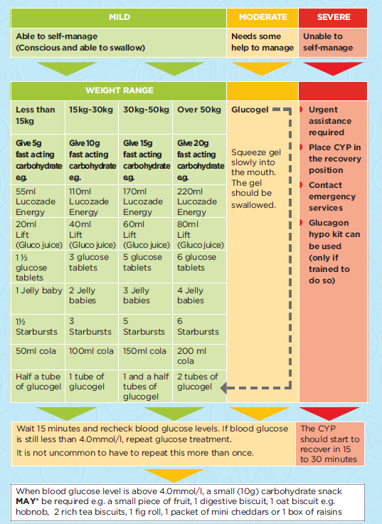
Notes:
This is the sheet the families will be provided with

Slide 67
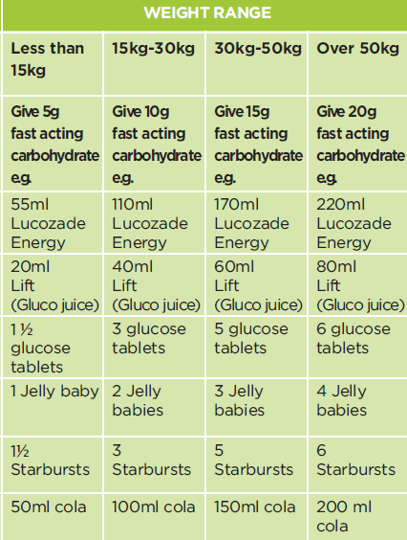
For Mild Hypos
Step 1
Notes:
In school, the children are only likely to experience hypos which will be mild and therefore the young person will need to take 5 – 20g of fast acting carbs (depending on their weight). A copy of the young person’s hypo treatment will be in the IHP, please refer to this.

Slide 68
Step 3
Step 2
Wait 15 minutes and recheck blood glucose levels. If blood glucose is still less than 4.0mmol/l, repeat glucose treatment. It is not uncommon to have to repeat this more than once.
When blood glucose level is above 4.0mmol/l, a small (10g) carbohydrate snack may be required e.g. a small piece of fruit, 1 digestive biscuit, 1 oat biscuit e.g. hobnob, 2 rich tea biscuits, 1 fig roll, 1 packet of mini cheddars or 1 box of raisins
Notes:
Step 2: They will need to wait 10 – 15 minutes before retesting their levels making sure that their hands have been washed so that there isn’t any sugary food or drink on their fingers which would give an inaccurate reading. If the blood glucose level is still below 4 mmol/l, step 1 will need to be repeated.
Step 3: When the glucose levels have risen above 4 mmol/l, a follow up snack which contains 10g of complex carbs may be required. Food such as a small piece of fruit, 2 rich tea biscuits or a box of raisins can be eaten. This step usually won’t be required for children using insulin pumps.
It is unlikely to happen, however if a young person has a severe hypo and becomes unconscious, put them in the recovery position and call 999. Do not put anything into the child’s mouth if they are unconscious including any form of hypo treatment.

Slide 69
MILD | MODERATE | SEVERE
If conscious and able to swallow | If conscious and able to swallow, but in need of assistance | If unconscious and unable to swallow
Give 10g fast acting carbohydrate, e.g: 110ml Lucozade Energy 40ml Lift (previously Gluco Juice) 2 teaspoons glucose powder in 50ml water 3 glucose tablets 100ml coke 220ml original ready to drink Ribena 2 standard jelly babies 3 Starbursts 1 mini bag (16g) of Haribo Starmix 8 jelly tots 100ml orange juice | Give 1 tube of glucogel or sports gel slowly squeezed into mouth. The gel should be swallowed. | Place patient in recovery position Call 999 for an ambulance.
Wait 10-15 minutes and recheck glucose levels, and record. If reading is still less than 4.0mmol/l, repeat process. |  | Once patient is conscious, follow treatment for moderate or mild hypoglycaemia depending on level of consciousness
When blood glucose level is above 4.0mmol/l, give a 10g carbohydrate snack e.g. a small piece fruit, 1 digestive biscuit, 1 oat biscuit, 2 rich tea biscuits, 1 fig roll, 1 packet of mini cheddars or 1 box of raisins

Slide 70
Mealtime Considerations
If CYP has had hypoglycaemia before a meal (i.e. mid-morning) DO NOT give any correction insulin with mealtime dose
If CYP has a hypo at the mealtime, give fast acting carbohydrate and reduce mealtime insulin by subtracting 10g from total mealtime carbohydrate
Notes:
If a young person has had a hypo a few hours before mealtime, then a correction dose does not need to be given. This is because the higher level has been caused by the hypo treatment and therefore is considered an artificial high. At this time, only the insulin calculated for the carbs in the meal should be given. If a correction were to be given, it is likely that the young person would have another hypo. If the blood glucose level is high at the next mealtime, a correction will be needed then.
If the young person has a hypo at the mealtime, this should be treated with fast acting carbohydrates. They will need to wait 10 – 15 minutes before retesting and therefore they will need to delay their meal by 10 – 15 minutes. Once the blood glucose levels have risen above 4 mmol/l, they can eat their meal and reduce the amount of insulin given for this meal by the equivalent of 10g of carbohydrate. For example – if the meal contains 62g of carbohydrate, you give insulin for 52g carbohydrate.

Slide 71
ICR 1:10
ISF 1:3
Carbohydrate (grams) | Insulin (units)
10 | 1
20 | 2
30 | 3
40 | 4
50 | 5
60 | 6
70 | 7
80 | 8
Blood glucose level before meal in mmol/l | Correction Insulin dose required
8-10 mmol/l | 1 unit
11-13 mmol/l | 2 units
14-16 mmol/l | 3 units
17-19 mmol/l | 4 units
20-22 mmol/l | 5 units
23-25 mmol/l | 6 units
26-28 mmol/l | 7 units
Notes:
Using the insulin to carbohydrate ratio of 1 unit to 10g of carbohydrates and the insulin sensitivity factor or 1 unit to reduce the blood glucose level by 3 mmol/l, calculate the amount of insulin needed for each scenario.

Slide 72
Scenario 3
Insulin: CHO ratio 1:10g
Insulin correction dose 1:3mmol/l
Pre meal blood glucose 12.5 mmol/l
*Had a hypo mid-morning*
CHO in meal 50g
Insulin for CHO ??
Insulin for correction ??
Total insulin ??

Slide 73
Answers
Insulin: CHO ratio 1:10g
Insulin correction dose 1:3mmol/l
Pre meal blood glucose 12.5 mmol/l
*Had a hypo mid-morning*
CHO in meal 50g
Insulin for CHO 5 units
Insulin for correction 0 units
Total insulin 5 units

Slide 74
Scenario 4
Wednesday
Insulin: CHO ratio 1:10g
Insulin correction dose 1:3mmol/l
Pre meal blood glucose 3.8 mmol/l
CHO in meal 50g
Insulin for CHO ?
Insulin correction dose ?
Total insulin ?

Slide 75
Answers
Insulin: CHO ratio 1:10g
Insulin correction dose 1:3mmol/l
Pre meal blood glucose 3.8 mmol/l
CHO in meal 50g
-10g for hypo
Insulin for CHO 5 units -1 unit
Total insulin 4 units

Slide 76
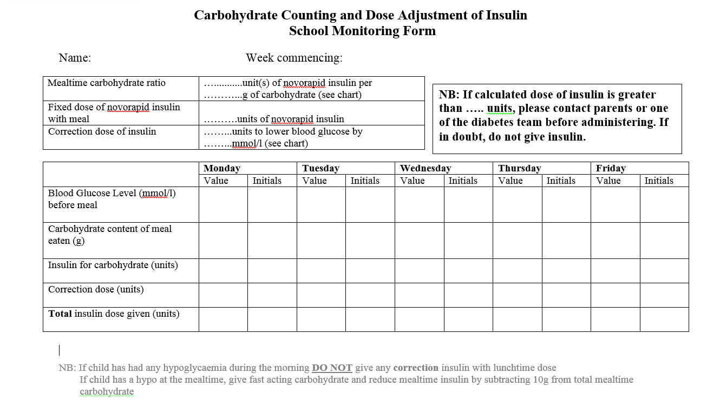
Record Sheet

Slide 77
Hyperglycaemia
This is a high blood glucose level
Hyper = high
Glyc = glucose
Aemia = blood
Notes:
Hyperglycaemia is when the blood glucose levels are high. This is typically over 14mmols

Slide 78
Signs of Hyperglycaemia
Notes:
Many of the symptoms of a high blood glucose level are similar to those seen at diagnosis. These include (read slide)

Slide 79
Signs of Hyperglycaemia
Excessive thirst
Passing excessive amounts of urine
Tiredness
Behaviour change
Blurred vision
Headache
Abdominal pain / feeling sick
Smell of acetone on child’s breath
Notes:
Many of the symptoms of a high blood glucose level are similar to those seen at diagnosis. These include (read slide)

Slide 80
Causes of Hyperglycaemia
Notes:
The main causes of a high blood glucose are (read slide)

Slide 81
Causes of Hyperglycaemia
Too little insulin
Too much food
Extremes of temperature e.g. Getting very hot or cold
Stress/Hormones
Illness
Notes:
The main causes of a high blood glucose are (read slide)

Slide 82
Treatment
Monitor and record blood glucose
Insulin correction dose typically at meal time
Drink plenty of sugar free fluids and allow additional toilet breaks
If the CYP is unwell – follow your school sickness policy
Notes:
The treatment for high blood glucose levels is to give a correction. Typically correction doses are given at meal times and NOT in between unless the child is unwell. However this may differ so please refer to the IHP. Young people should aim to drink sugar free fluids to help flush out the excess glucose. It is advised to test for ketones if the blood glucose levels are above 14 mmol/l, but there may be occasions when you do not need to test, for example immediately after a meal. Please refer to the IHP or contact the healthcare team looking after the young people as they will be able to advise you further.

Slide 83
How to Check Blood Glucose Levels and How to Give Insulin Injections
Notes:
How to check blood glucose levels and ketones
1. Get the blood glucose monitoring equipment ready
2. Wash the young person’s and your hands in warm water & dry hands – staff may wish to wear gloves (please refer to local PPE guidance)
3. Prepare the finger pricker
4. Insert the testing strip into the meter
5. Prick the side of the finger with finger picker
6. Follow the meter instructions and put the blood on the strip
7. Record and act on results accordingly
8. Dispose of lancet safely in sharps box

Slide 84
How to Check Blood Glucose / Ketones
Notes:
How to check blood glucose levels and ketones
1. Get the blood glucose monitoring equipment ready
2. Wash the young person’s and your hands in warm water & dry hands – staff may wish to wear gloves (please refer to local PPE guidance)
3. Prepare the finger pricker
4. Insert the testing strip into the meter
5. Prick the side of the finger with finger picker
6. Follow the meter instructions and put the blood on the strip
7. Record and act on results accordingly
8. Dispose of lancet safely in sharps box

Slide 85
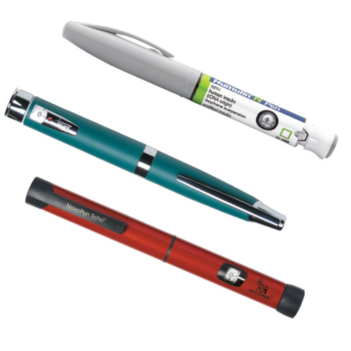
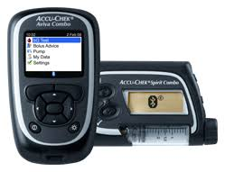
Taking Insulin
Insulin is required during the school day; a safe private area is required to administer insulin (either via pen injection or insulin pump)
Insulin is usually given before food is eaten
Additional insulin may be required to correct high blood glucose levels
The amount of insulin may need to be adjusted for physical activity
Young people with Type 1 diabetes should have an agreed Individual Healthcare Plan in place
Notes:
Insulin is required during the school day therefore provision for a safe, clean, private area to administer insulin is essential. Schools must store medication and supplies safely, in line with local school policies, to ensure they are not lost, stolen or misused. Teachers and school personnel must ensure the YP with diabetes has access to their devices and medication whenever needed. Wherever possible, the YP should be encouraged to take responsibility for managing their own medicines and blood glucose equipment in school and, as such, should be instructed in the importance of keeping their equipment safe and only using it for the purposes for which it has been supplied.
The YP with Type 1 diabetes will require different levels of supervision to manage their diabetes during the school day depending on their ability to safely self mange diabetes care. This will be outlined in the Individual healthcare plan.
Insulin is usually given (either via an insulin pen or pump) before eating. Additional insulin may be required to correct a high blood glucose level however you will need to refer to the individual healthcare plan for information about if and when this would be required.
The amount of insulin may need to be adjusted for physical activity but again, please refer to the individual healthcare plan for information regarding this

Slide 86
Injection Sites
Notes:
There are several areas that can be used for injections. These are the stomach, the outside of the top of the thighs, top of the bottom (which may or may not be used in school) and the arms as shown in these pictures.

Slide 87
Notes:
Giving an insulin injection:
Before giving an injection, gather the necessary equipment e.g. safety needle, insulin, sharps box and ensure your hands are clean. Check the expiry date, insulin type and that there is no crystallisation of the insulin.
Before starting, wash and dry your hands.
Attach the safety needle to the insulin pen
Always check pen is working before giving an injection by dialling up 2 unit and doing an ‘air shot’ test – this is where you press the plunger whilst holding the insulin pen. The insulin must be seen leaving the needle before progressing. If no insulin is seen at this point, please repeat until insulin is seen leaving the needle
Dial up dose required as advised by the meter and check amount insulin dialled in units
Identify an injection site. It is important that the YP is encouraged to rotate these sites to avoid one area being overused.
Insert the needle into the skin at 90 degrees, ensure the thumb can reach the top of the plunger
Press the plunger
Count for 10 seconds before removing
Ask the young person to remove the safety needle from the pen and dispose safely in the sharps box

Slide 88
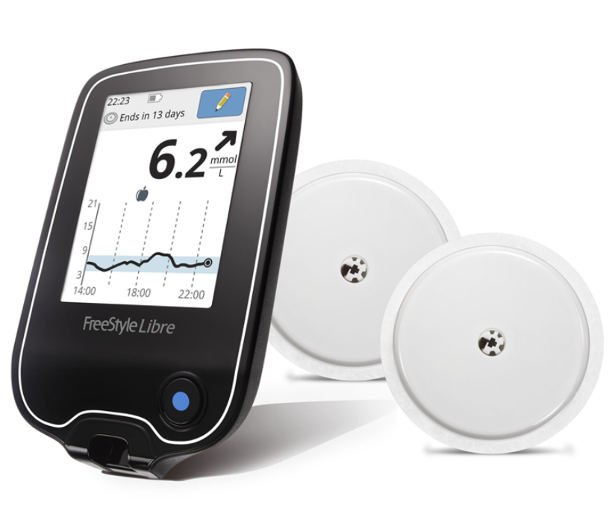
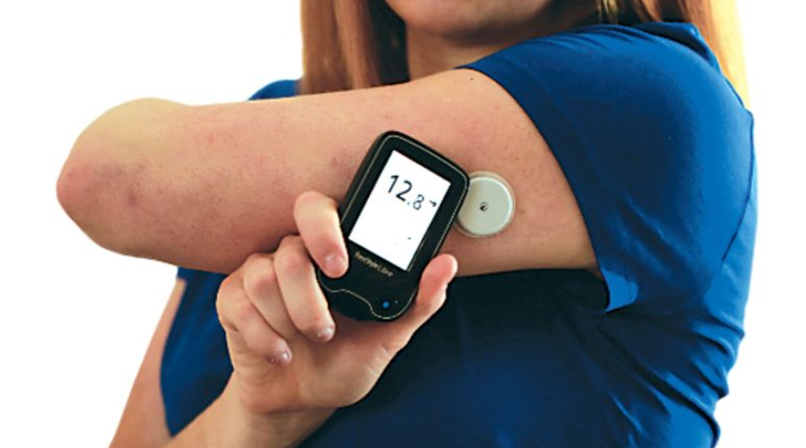
FreeStyle Libre
A flash glucose monitoring system which reads glucose levels through a sensor on the arm.
The sensor is scanned to see the glucose reading, where it’s heading and the last eight hours of continuous data.
Notes:
Read slide

Slide 89
Continuous Glucose Monitoring
A device which reads glucose levels through a sensor worn on the body.
The sensor transmits data to a separate display device, either a reader or an insulin pump
Can be set to alert wearer or carer to high and low glucose levels
Notes:
Read slide

Slide 90
Considerations
Many devices are linked to mobile phones
Young people will likely need access to mobile phones during the school day
It may help if they have access to the school’s wifi
The sensors may alarm if the glucose levels are out of the optimal target range and the young person will need to respond to this
Sensor data is different to blood glucose levels as it measures the glucose levels of the fluid around the cells rather than the levels in the blood
This means there can be a delay between the sensor reading and a blood glucose reading
Notes:
Many young people wear these devices and it is important to consider how this can be supported in school. Many devices are linked to a mobile phone app and therefore the young person will need access to their phone during the school day. It may also help if they have access to the school’s wifi in order to share their data with their carer.
Many sensors alarm if the glucose levels are above or below the optimal range and the young person will need to respond to this.
Please note that the sensor data is different to the blood glucose level data as it measures the amount of glucose in the fluid of the cells rather than the levels in the blood. This means there can be a delay between the sensor and a blood glucose reading.

Slide 91
Exercise in School
Before exercise, check glucose levels and consider delaying exercise if glucose is less than 5 mmol/l
Also consider delaying exercise if the glucose level is high
Decide if any additional carbohydrate is required
Check blood glucose after exercise.
Is carbohydrate required?
Always have a hypo remedy available (especially if doing water based sports)
Refer to Individual Healthcare Plan
Notes:
Before exercising, there are a few things to consider. The young person’s glucose level should be checked and if it is less than 5 mmol/l, exercise may need to be delayed and an additional carbohydrate snack may be needed. There is a table on the next slide to give more guidance about this. Following exercise, the young person’s glucose levels should be checked again and more carbohydrate may be needed. This will depend on what the young person is doing next. If it is nearly a meal time, additional carbohydrate may not be needed. Please refer to the Individual Health care Plan.
It is important that the young person’s hypo remedy is available nearby such as on the side of the pitch or swimming pool rather than in a changing room or locker.

Slide 92
Notes:
This table gives further guidance on when it is ok to exercise and when exercise should be delayed. It also gives more information about when additional carbohydrate may be required before exercise. A copy of this is available in the Individual Healthcare plan so please refer to this.

Slide 93
Snacks to consider using before exercise
Notes:
The previous table refers to having 10 – 20g of carbohydrate before exercise as required. This slide shows the amounts of different food and drinks that is needed to give 10, 15 or 20g of carbohydrate

Slide 94

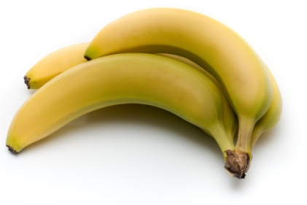
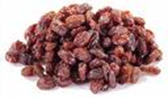
Examples of snacks after exercise if required
Drinks
200ml milk
200ml fruit juice
Food
Fruit e.g. banana
1 small box of raisins
2 digestive biscuits
1 piece toast
Notes:
At times a snack after exercise is needed. If this is the case, it is important to have food or drink that contains complex carbohydrate such as milk, a banana or a piece of toast rather than fast acting carbohydrates as outlined on the previous slide. These quantities may not be suitable for all children and staff will need to refer to the IHP or discuss suitable options with parents/carers.

Slide 95
Exercise when on a pump
Some children will use temporary basal rates on their pump when participating in activities
This will vary from child to child
The local diabetes team will have trained the family regarding this
Please refer to the IHP
Notes:
Read slide

Slide 96
Leaflet for coaches
Notes:
The SEREN Active leaflet for coaches is available for further support

Slide 97
Exams
Diabetes needs to be considered when young people are sitting exams or tests.
Support information can be found on
https://www.diabetes.org.uk/resources-s3/2018-11/1201C_Type%201%20diabetes%20and%20exams_DIGITAL.pdf
The CYP will need drinks, snacks, medical equipment and possible time out to manage their diabetes.
Your local diabetes team will be able to give you further information specific to your pupils if this is required.
Notes:
Examination Advice
During examinations or tests, most CYP will experience different levels of stress from this pressured time. Exam stress can impact on CYP with diabetes affecting their blood glucose levels, making blood glucose levels unstable, with CYP possibly experiencing hyperglycaemia (highs) or hypoglycaemia (lows). High and low blood glucose levels will affect the CYP’s concentration and ability to perform during exams; additional time may be required to ensure symptoms are managed promptly during exams including time for treatment to work.
Prior to examinations such as GCSE or A levels, schools can apply to the examination board for additional time for CYP with diabetes. The extra time is allocated if they need to treat low or high blood glucose levels. For CYP with diabetes, blood glucose levels need to be within normal range of 4 to 7 mmol/l, ideally with a blood glucose value > 5 mmol/l at the start of any examination.
Time will be required for CYP with diabetes to undertake blood glucose monitoring prior to starting the examinations or tests and also support if additional tests are required during the examinations or tests.

Slide 98
Any Final Questions?

