Slide 1



Measuring Improvement in a System
Ready Steady Go

Slide 2

The definition of improvement is one or more of these
SEAMLESS TRANSITION
S
T
E
E
E
P
S
Is it safer ?
Is it more timely?
Is it closer to best practice/ is best practice ?
Is it better use of the patients time/ our time/ resources?
Is it fairer for all our patients & no one is excluded?
Is it focused on the person/ patient’s needs & experience?
Is it sustainable over time?

Slide 3
Measurement for IMPROVEMENT requires us to think like clinicians (about how we work)
What is the situation?
What will tell me what is going on?
How do I measure these things?
What do I do to drive these measurements in the right direction?
Do I need to change how I measure them as the ‘system / person’ improves
What do I see as I sustain the improvements
Fishbone, process map, stakeholder discussions, existing data, discussions, honesty
How would my theories be seen to change things if they work in practice?
What will we measure so we know change is moving things in the right direction?
What else can I adapt/ adopt to keep up the progress?
It feels better (me and patient)
It is better (process measures)
The outcome has improved (the whole purpose of the changes)
Nothing untoward is happening behind the scenes

Slide 4
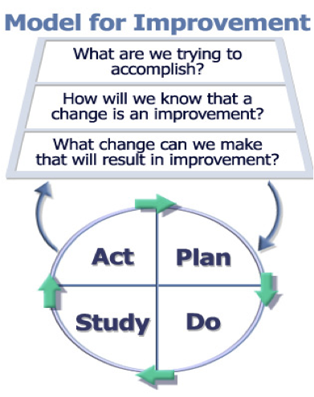
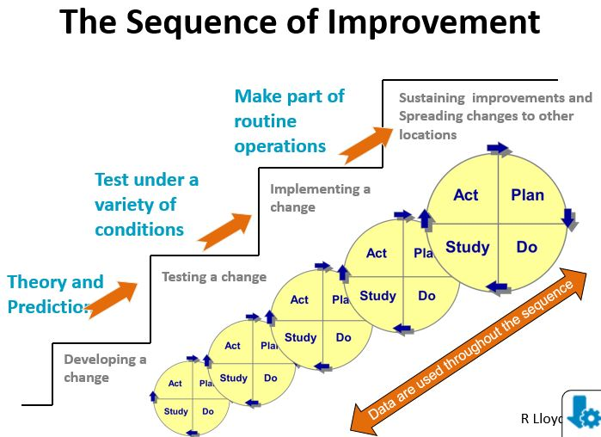
The measurement journey

Slide 5
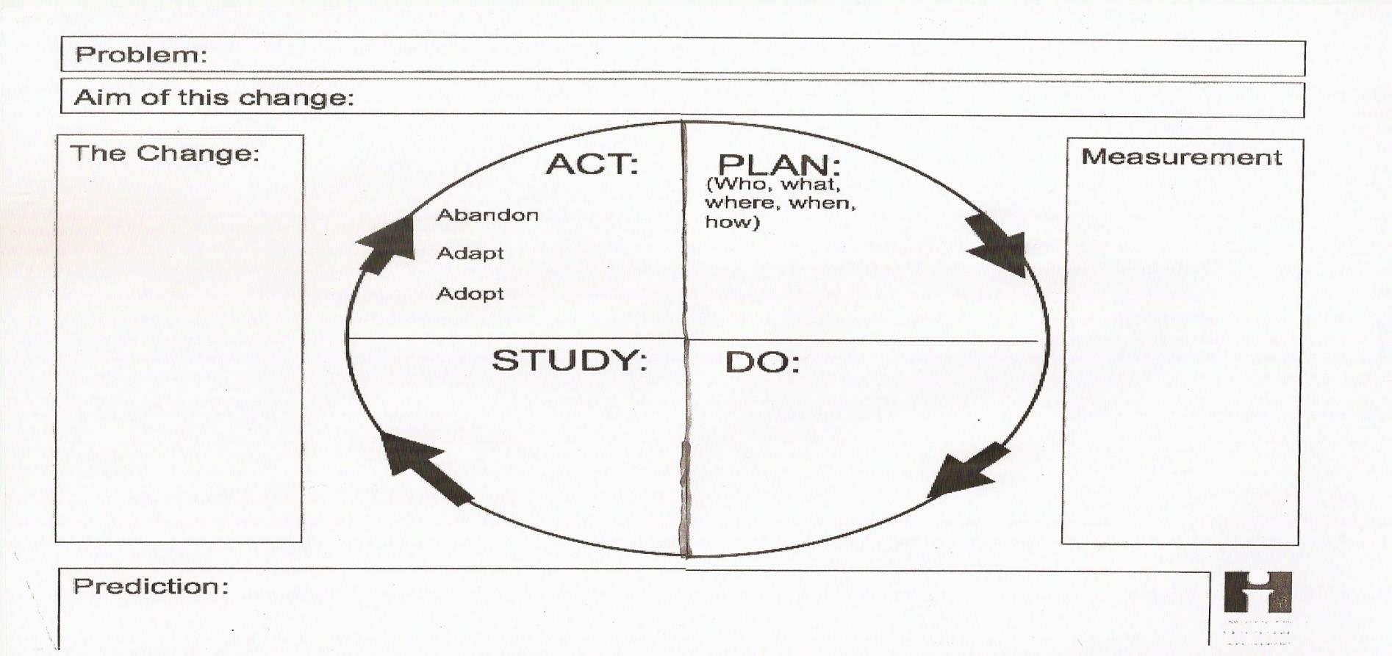
Small tests of change build will and knowledge of what works (or does not)
The small problem we are focusing on right now
What we are aiming to achieve with this change/ what is our theory behind why this is the thing to do next
Describe step by step
Describe the change we are making
How would we know this change had improved things
What happened
What did our measurement show
Do it as agreed any change is in the next test not this one
Before we test this out what do we predict is going to happen- this then feeds into what we could/ should measure- we have a theory so this is how we build it into out plan

Slide 6

Meet, discuss and then agree the next steps
ADOPT
It seemed to deliver the improvement we were looking for
We could actually & always do the work in this way
We will get better at working like this with a bit more practice
We need to test it out on other situations to check it is just as much an improvement what ever the ward/ day/ time/ patient etc
This isn’t permanent unless we decide but we want to test this out further -

Slide 7

Meet, discuss and then agree the next steps
ADAPT
We think with a tweak this will work even better
This isn’t permanent unless we decide but we want to test this out with a modification-
Don’t change more than one thing at once or you won’t be able to decide what was the change that made the difference

Slide 8

Meet, discuss and then agree the next steps
ABANDON
Our theory was well thought out but we overlooked some issues so this doesn’t work.
Lets regroup and rethink now we know what we know and how it impacts on our original idea
Rethink what we are trying to achieve and talk about this so the purpose is not lost

Slide 9
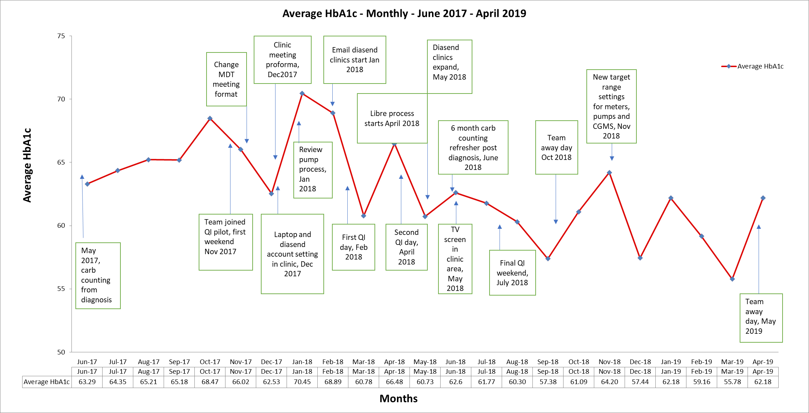
Time Ordered Data Drives Continuous Innovation in Everyone
median

Slide 10
Example : Average length of stay for newly diagnosed patients
WOW!
A “significant drop”
from 5 to 4
5
5 days
Days in ward
4 days
0
Jan- June 19
June- Dec 19
Conclusion -The protocol was a success! A 20% drop in the length of stay
Notes:
DAVE

Slide 11
Example: Average length of stay for newly diagnosed patients Before and After the Implementation of a New Protocol A Second Look at the Data
good
Protocol implemented here
Avg 1 = 5
Avg 2 = 4
Length of stay
Jan Feb March April May June July August Sept Oct Nov Dec Jan
Now what do you conclude about the impact of the protocol?
Source (adapted): R. Lloyd
Notes:
DAVE

Slide 12

Data for the purpose of seeing IF we are improving
 | Learning | Performance Management | Research
Aim | Improving care / reliability/safety/ quality | Comparing, choice, ranking, focus attention/blame | New knowledge / efficacy of Rx
Methods
Testing observable | Yes study each test | No testing | Testing blinded/controlled
bias | Consistent bias accepted | Collect more data to reduce bias | Designed to eliminate bias
Sample size | Just enough, sequential samples | 100% or relevant data | Large just in case
hypothesis | Flexible | Non | Constant/fixed/null
Testing strategy | sequential | Non | One large test
Is the change an improvement? | Analytic stats SPC Control/ run charts/time ordered | May rank up or down or % change (RAG rating) | Enumerative Stats t- test/ p value /Chi
Is data confidential? | Only used by those improving | Public | Subjects concealed

Slide 13

Hope is not a Plan Soon is not a time I think so is not evidence
Measuring across the pathway
Outcome Measures: Voice of the customer or patient. How is the system performing? What is the result?
Process Measures: Voice of the workings of the system. Are the parts/steps in the system performing as planned?
Balancing Measures: Looking at a system from different directions/dimensions. What happened to the system as we improved the outcome and process measures? (e.g. unanticipated consequences, other factors influencing outcome)
T Woodhead Boston MFA 2010

Slide 14
Our drivers/ our map/ our measurements
Transition service
Working for all young people in our Trust
By 1st March 2025
The processes of care
Ready steady go documentation for all
HBA1c stable or improving
MDT with young adults in place
Communication channels relevant to this group in place and happening
Patient and family engagement
Education sessions
Materials and resources
Psychology support in place and being used
Learning system to continuously improve our care
Community and primary care partnerships
Data collected as we go and reviewed each week
Sample patient journeys
Meeting schedule and actions
Shared care plans
Schools and clubs work
What are we doing
How often
What actions have been taken
What do our partners say about our improvement ?
We measure these we could sample 5 patients in clinic this week to see if we are doing this and steadily increase how well we are doing it?
We measure these – We could rethink how we standardise this work, test and measure how successful we are?
Have we redesigned this and checked the experience of children and parents?
Have we got all possible children seen this week/ month in the transition clinic ?
Lets get some data from this week up there to see how we are doing and what more we can learn ?

Slide 15
Having a measurement strategy for the system
Be patient this will change slowly
Measure weekly now
Keep track of these
What are we trying to achieve | Outcome Measures The consequences of working better | Process Measures The way we do the work | Balancing Measures Signs the solutions are not good enough yet
All patient in the transition cohort have the evidenced based journey from 14 till they are managed in young adult services | Transition process in place All relevant young people are included in the transition process All young people have or are moving into adult care with confidence and with the right plans, psychological support and on going clinical oversight as deemed by the standards | Ready Steady Go documents in place and used Specific transition clinics occur regularly MDT meetings/ similar with Young Adult service regularly review cases Communications for young adults routinely provided Feedback system in place for reviewing concerns Monthly review of all transition patients and their participation in the programme | Young people not attending transition clinics (capacity ) Young people not attending transition clinics (DNA) Number of emergency admissions of patients in the transition cohort. Patient and family negative feedback during and after transition

Slide 16
System overview and recommendations The Inbetweeners- 06-2023http://www.ncepod.org.uk/2023transition/The%20Inbetweeners_full%20report.pdf
Developmentally appropriate care is what we do every day.
Involving children and young people and their carers in planning care is the approach we take.
We communicate and co-ordinate ourselves as care providers effectively and efficiently to support each patient in our care.
We organise our services so transition is an effective experience for every young person.
There is strong leadership at Board and speciality level to enable and improve transition to adult services for every patient .
Three questions to answer for each of 1-5
1. What is the pathway/ how does this happen?
2. What resources would we usefully have in the future to make this even better than it is now?
3. What evidence do we have of the young persons experience of care and the known clinical requirements for high quality care. What should we measure, share, develop so as to demonstrate the quality of what we do and the gaps we still need to work on?

