Slide 1











HEALTH PROMOTION PROJECT
South East Coast & London + North West Dietitian Network
Movement– Social Media

Slide 2
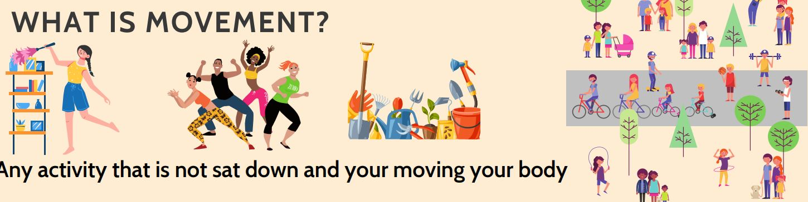
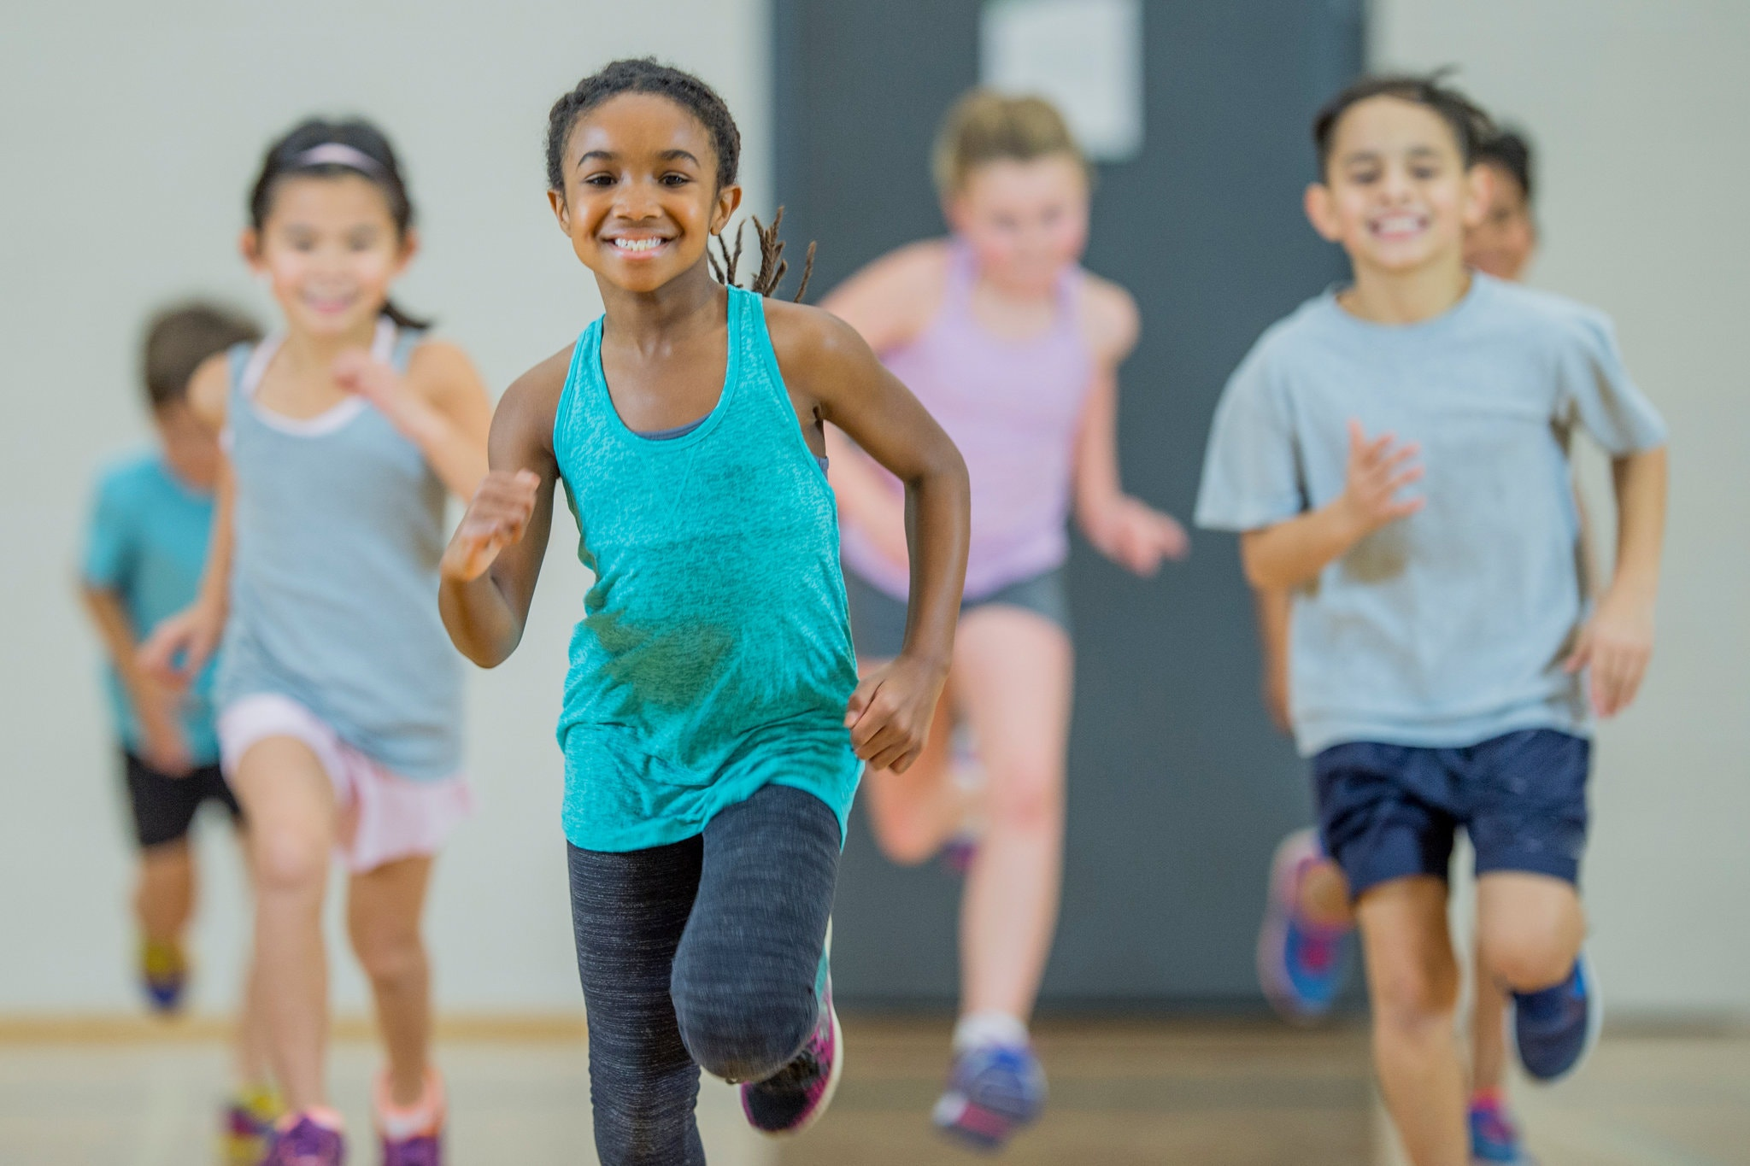
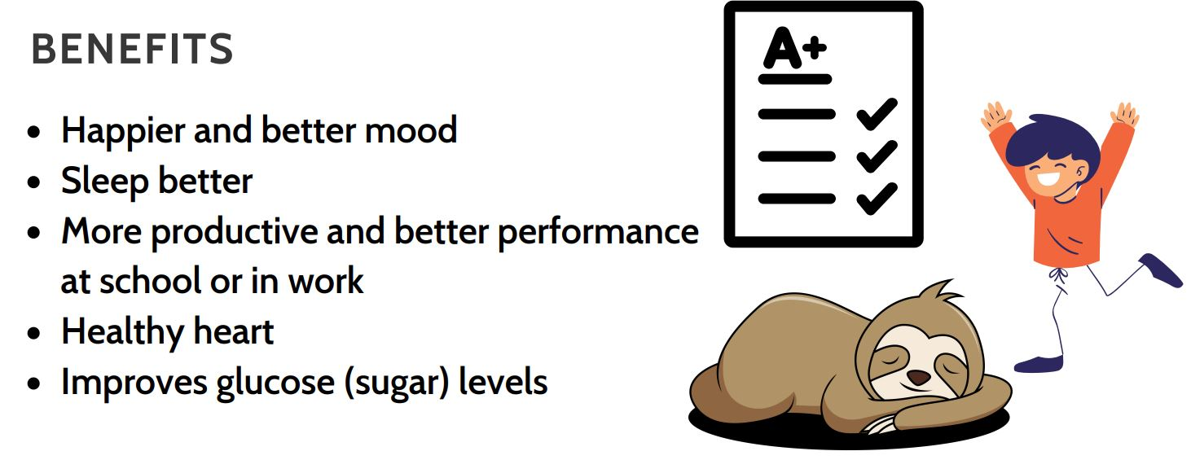
Digibete/Social media month 1
Below are 3 posts for the health promotion Topic of movement. Each newsletter has a picture for the list image and an image for the content Below are instructions for digibete, These should be posted to Digibete in month intervals. Link to digibete app: https://app.digibete.org/login You can do these all at the same time and schedule a time for them to be posted. If not using digibete the app the content and images here can be used for any social media.
Post Image 1
News Title:
What is Movement? - Healthy Lifestyles Campaign
List Image
Right Click on the image opposite, save picture. Go to the Image location and drag into the list image box.
Content: (click add text and copy and paste below)
For the next 3 months we are focusing on movement, benefits and tips
Benefits of movement
Happier and better mood
Sleep better
More productive and better performance at school or in work
Healthy heart
Improves glucose (sugar) levels
What types of activity are the best ones?
The ones that you enjoy!
That fit your schedule
That make you smile
That are fun!
That you can do with friends and family
Click here for more information about how much movement children should be doing
Click here for more information about how much movement adults should be doing
Post Image:
- Click add image
Right Click on the second image opposite, save picture. Go to the Image location on your drive and drag into the list image box on the digibete post page.
Attachments or further reading: (Additional Files or links)
- Download Newsletter one from the CYP Diabetes Network page
- Click Add File, Name: Movement Newsletter 1
- Drag and drop the file from the location you saved it on your drive
List Image
Post Image 2
Notes:
Childhood obesity strategy

Slide 3

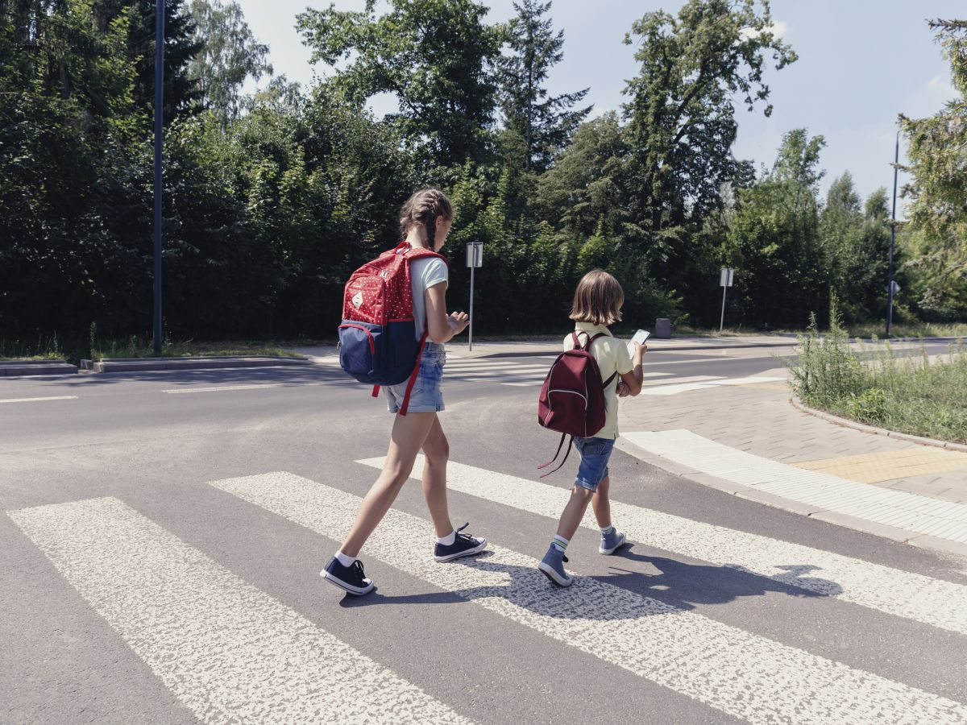
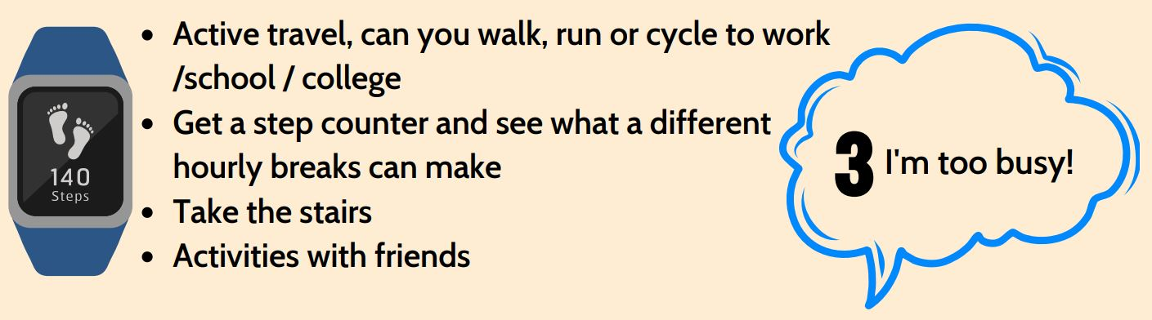
Digibete/Social media month 2
Below are 3 posts for the health promotion Topic of movement. Each newsletter has a picture for the list image and an image for the content Below are instructions for digibete, These should be posted to Digibete in month intervals. Link to digibete app: https://app.digibete.org/login You can do these all at the same time and schedule a time for them to be posted. If not using digibete the app the content and images here can be used for any social media.
Post Image 1
News Title:
What stops you from moving more - Healthy Lifestyles Campaign
List Image
Right Click on the image opposite, save picture. Go to the Image location and drag into the list image box.
Content: (click add text and copy and paste below)
For the next 3 months we are focusing on movement, benefits and tips
Reasons why you are not moving enough
The weather; it is cold, its dark and its always raining
Ideas: Click here for indoor activities , House work, Climbing the stairs, Wii fit, The gym
2) The gym is too expensive!
Ideas: Running is free: google Couch-to-5k or Park Run, Visit the park , Bike rides, Volunteering
3) I'm too busy!
Ideas: Active travel (walk, run or cycle to work /school / college), Get a step counter and see what a different hourly breaks can make, Take the stairs, Activities with friends
Post Image:
- Click add image
Right Click on the second image opposite, save picture. Go to the Image location on your drive and drag into the list image box on the digibete post page.
Attachments or further reading: (Additional Files or links)
- Download Newsletter one from the CYP Diabetes Network page
- Click Add File, Name: Movement Newsletter 2
- Drag and drop the file from the location you saved it on your drive
List Image
Post Image 2
Notes:
Childhood obesity strategy

Slide 4
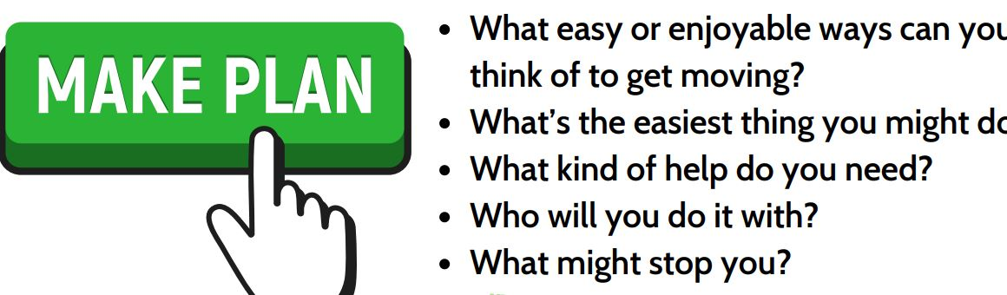
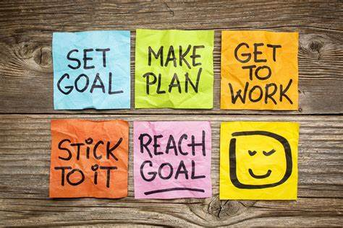
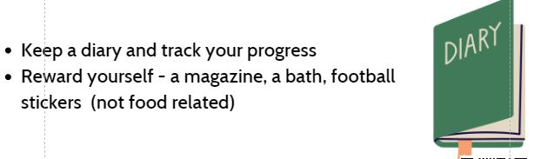
Digibete/Social media month 3
Below are 3 posts for the health promotion Topic of movement. Each newsletter has a picture for the list image and an image for the content Below are instructions for digibete, These should be posted to Digibete in month intervals. Link to digibete app: https://app.digibete.org/login You can do these all at the same time and schedule a time for them to be posted. If not using digibete the app the content and images here can be used for any social media.
Post Image 1
News Title:
How to include movement in your day - Healthy Lifestyles Campaign
List Image
Right Click on the image opposite, save picture. Go to the Image location and drag into the list image box.
Content: (click add text and copy and paste below)
For the next 3 months we are focusing on movement, benefits and tips
Way to include more movement in your day
What easy or enjoyable ways can you think of to get moving? What’s the easiest thing you might do? What kind of help do you need? Who will you do it with? What might stop you?
Set achievable goals Start small and build up What can you do this week? Next week? Next month?
Click here to see an idea for an activity goal ladder
Keep a diary and track your progress Reward yourself - a magazine, a bath, football stickers (not food related)
Click here to see an activity action planning template
Post Image:
- Click add image
Right Click on the second image opposite, save picture. Go to the Image location on your drive and drag into the list image box on the digibete post page.
Attachments or further reading: (Additional Files or links)
- Download Newsletter one from the CYP Diabetes Network page
- Click Add File, Name: Movement Newsletter 3
- Drag and drop the file from the location you saved it on your drive
List Image
Post Image 2
Notes:
Childhood obesity strategy

