Slide 1












HEALTH PROMOTION CAMPAIGN
Movement
Brought to you by:
South East Coast & London and Northwest Dietitian Network

Slide 2
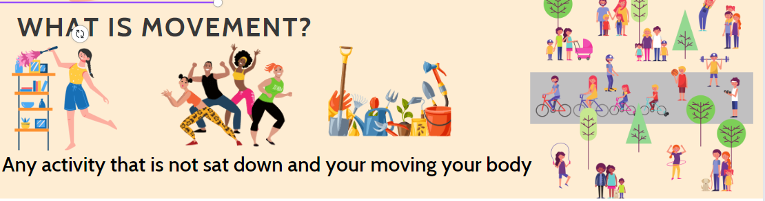
What is movement?
Any activity that is not sitting, lounging or lying down

Slide 3
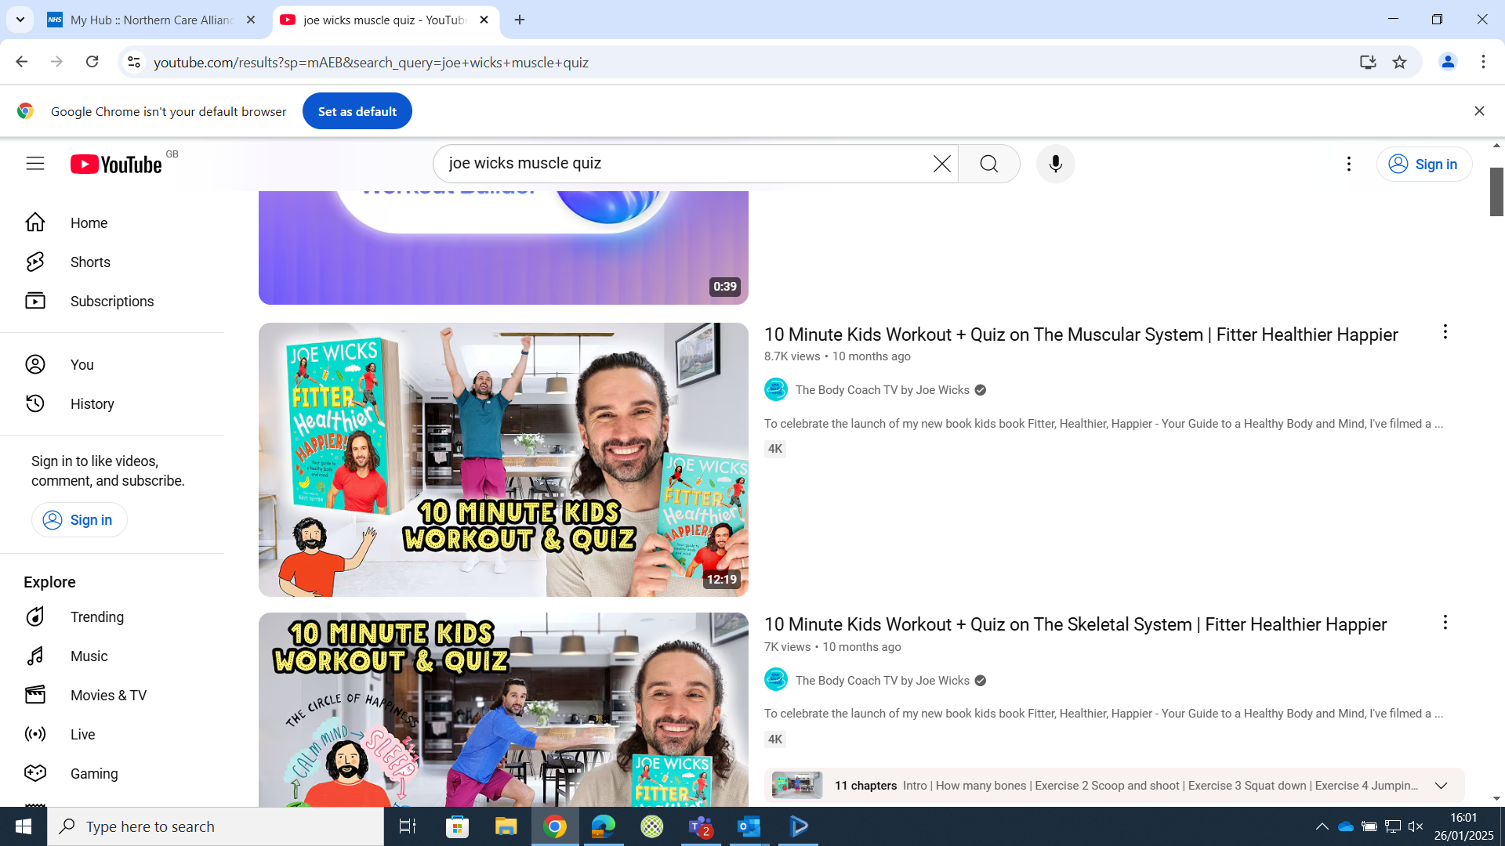
Lets get moving
Let's take 5-10 minutes for a short workout and quiz
https://youtu.be/1iY_s6dFpCc?si=-4UR8HePVx7RbVq9

Slide 4

Why recommend movement
Diabetes | General health | Mental health
Improves Hba1c Improves lipid profile Reduces all-cause mortality Reduced insulin requirements Reduce risk of hypoglycaemia particularly severe hypoglycaemia* Prolongs honeymoon period | Reduced fatigue Improved body composition Improved cardiovascular health Improves bone mineral density Reduces morbidity and mortality | Effective treatment option for adolescents diagnosed with depression Reduced symptoms of depression Improved body image Improved self esteem Reduced anxiety Improved school life satisfaction
*Quirk H, Blake H, Tennyson R et al. Physical activity interventions in children and young people with Type 1 diabetes mellitus: a systematic review with meta-analysis. Diabetes Med 2014;31(10):1163-73

Slide 5
Why are we not recommending movement?
Studies show:
GPs underestimate physical activity guidelines.
  90% felt it was part of their job but was discussed about 1/3 of the time compared with weight management and smoking
Mathews et al, 2017 found there was a lack of knowledge across health professionals on the risk reduction benefits of exercise
A questionnaire given to medical students showed only 40% aware of exercise guidelines.
  Of these only 68% could accurately recall them vs 97% accuracy for alcohol.
  Only 52% felt adequately trained to give exercise advice

Slide 6
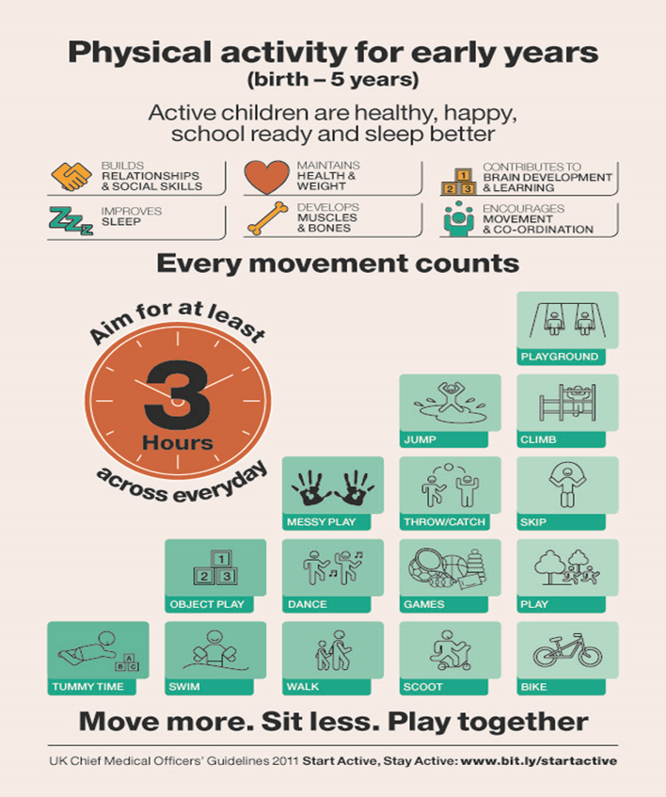
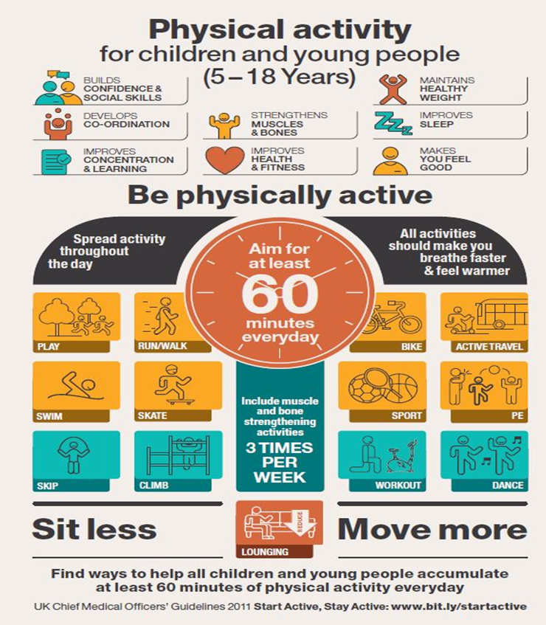
How much movement?

Slide 7

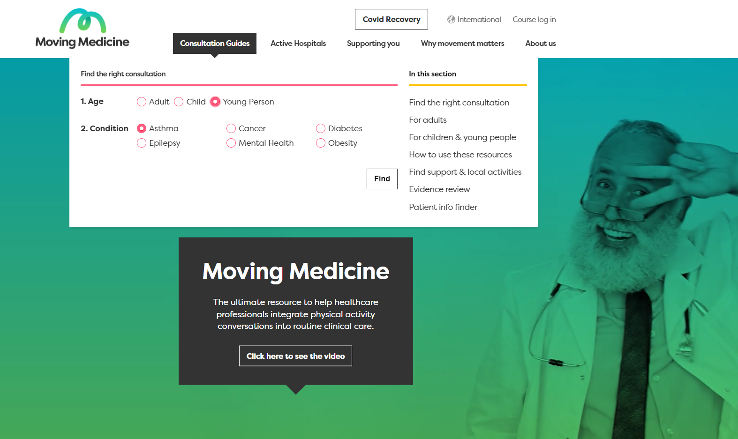
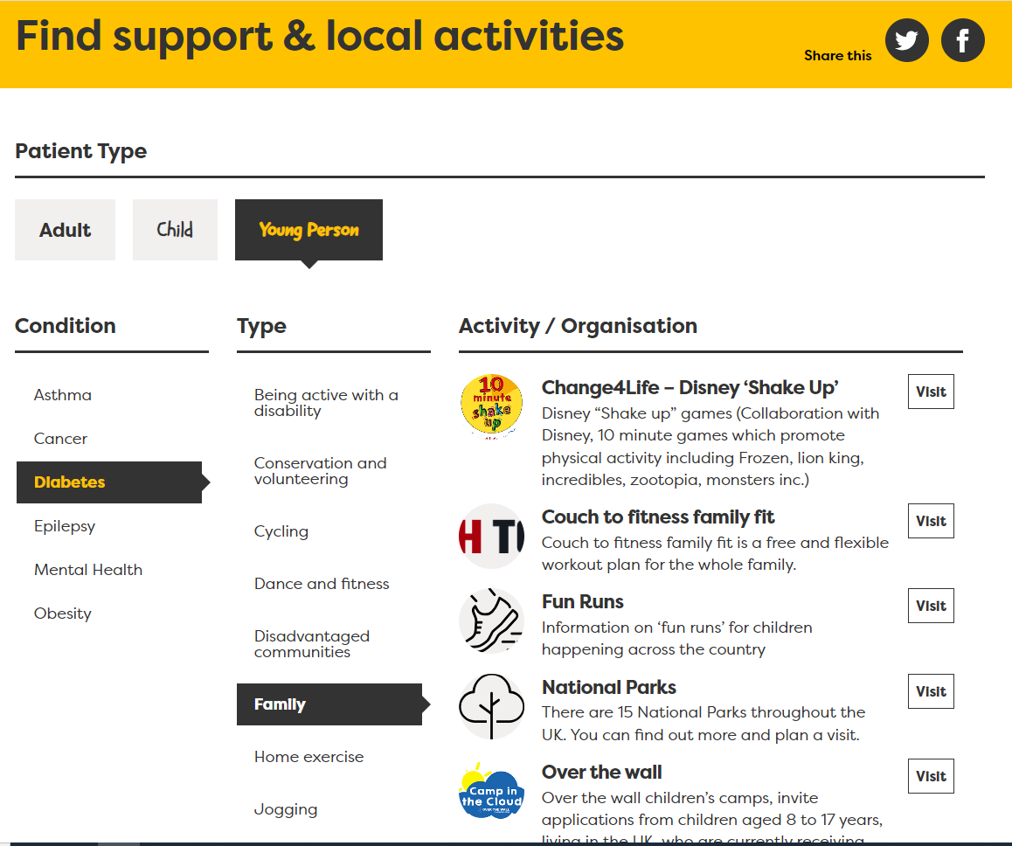
How to recommend?!
Notes:
Hihgly recommend this website
Lots of advice, consultation info, sign posting, resources

Slide 8
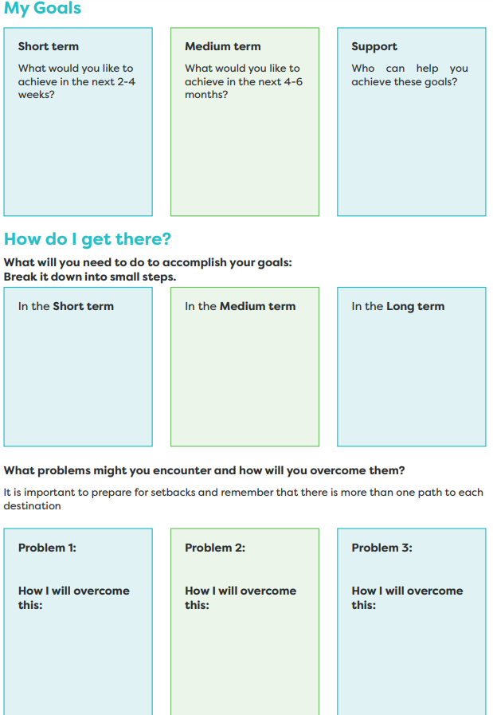
How much movement?
Findings from studies have shown that when engaging in activities for autonomous reasons (i.e., enjoying it or view as important), individuals achieve better results and manifest higher wellbeing.
When tasks are taken on for less autonomous reasons (e.g., to please others or avoid punishment), they have been shown to produce lower achievement and wellbeing
Healthy Lifestyle in Children and Adolescents and Its Association with Subjective Health Complaints: Findings from 37 Countries and Regions from the HBSC Studyhttps://www.ncbi.nlm.nih.gov/pmc/articles/PMC6765801/#:~:text=The%20most%20important%20behaviors%20associated,consumption%20%5B12%2C13%5D.
Notes:
Moving Medicine has great resources;https://movingmedicine.ac.uk/wp-content/uploads/sites/5/2021/03/Action-Planning-young-people.pdf

Slide 9
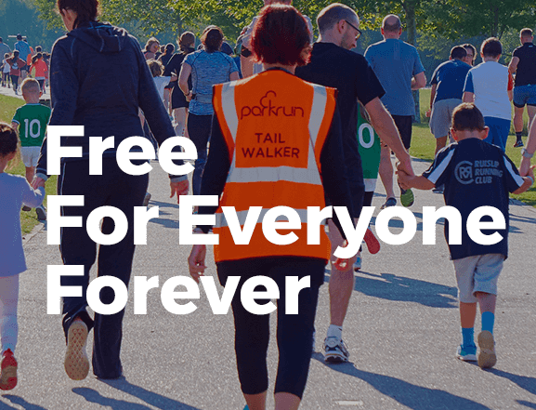
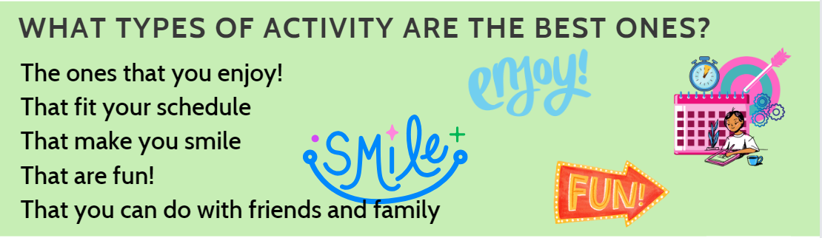

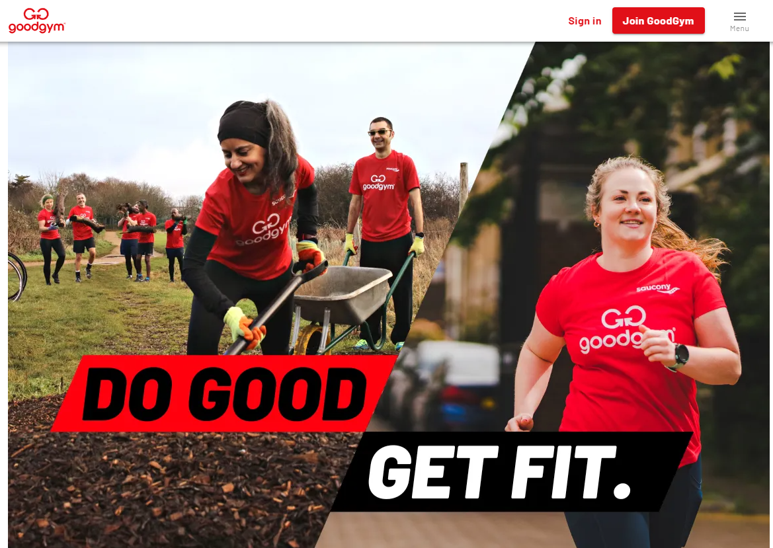
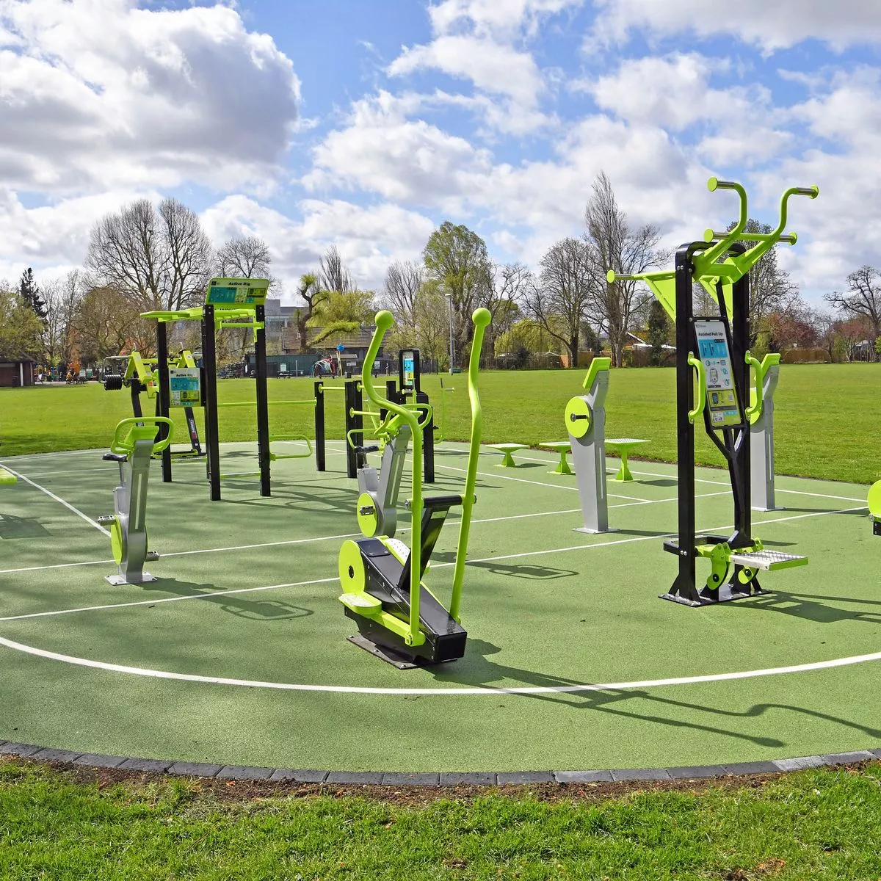
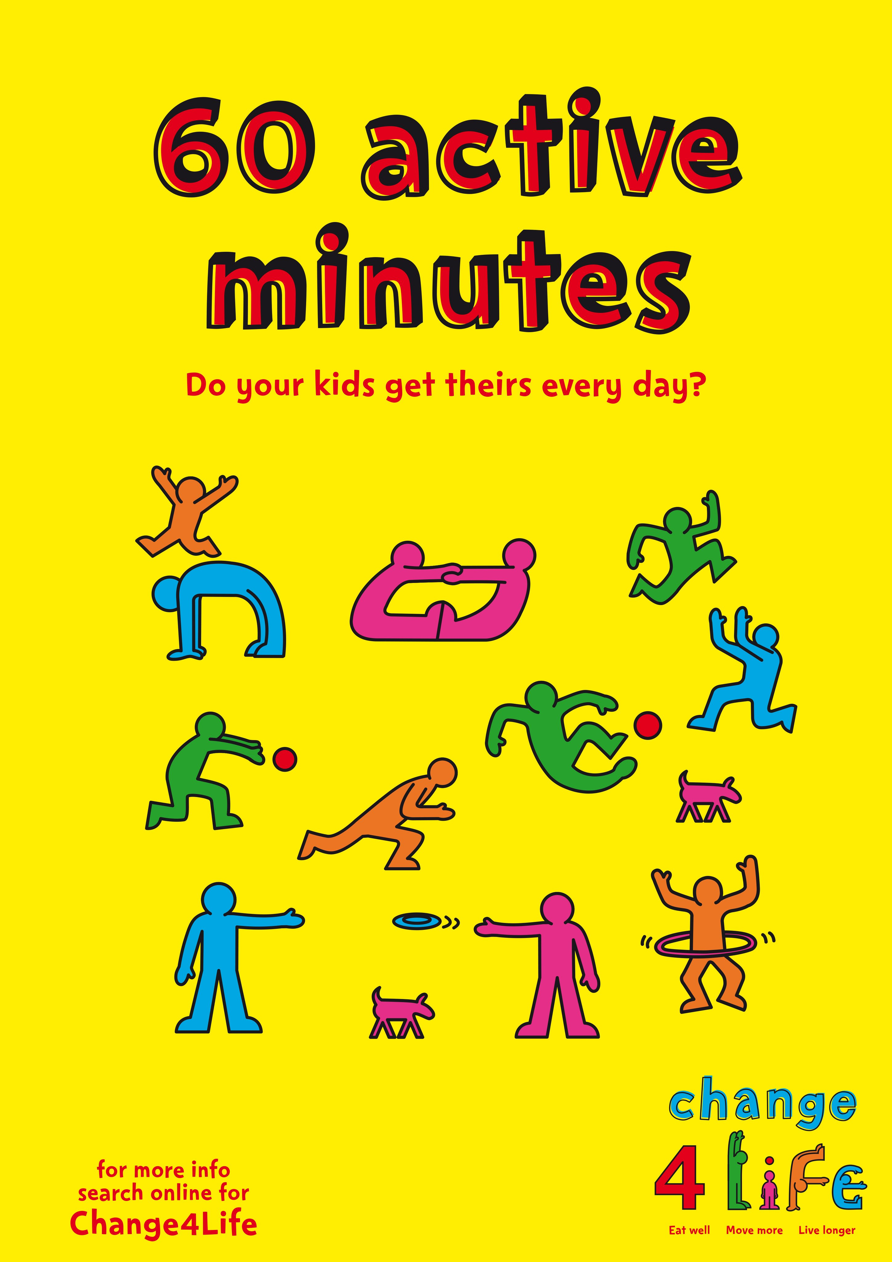
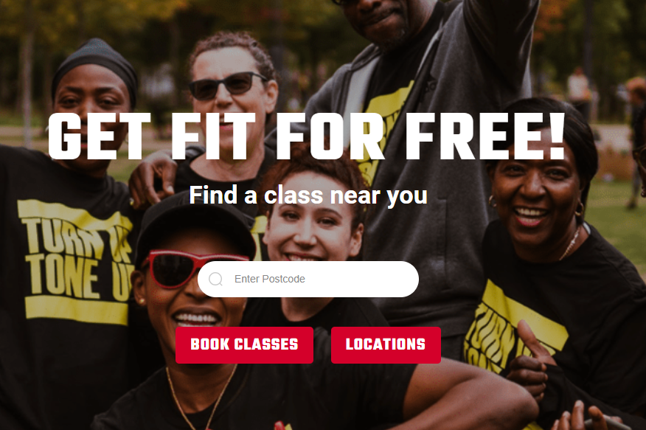
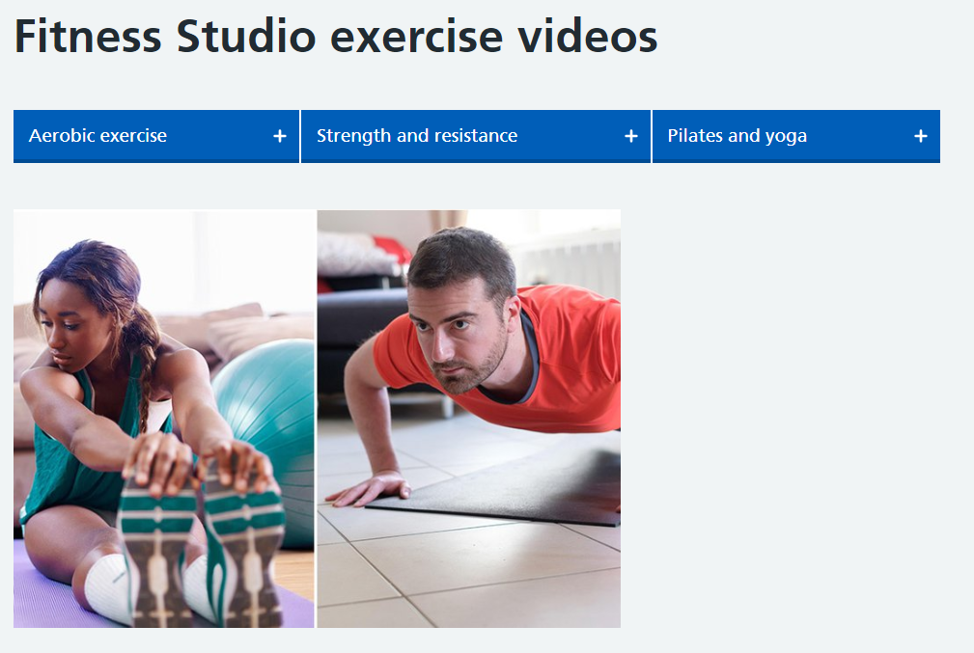

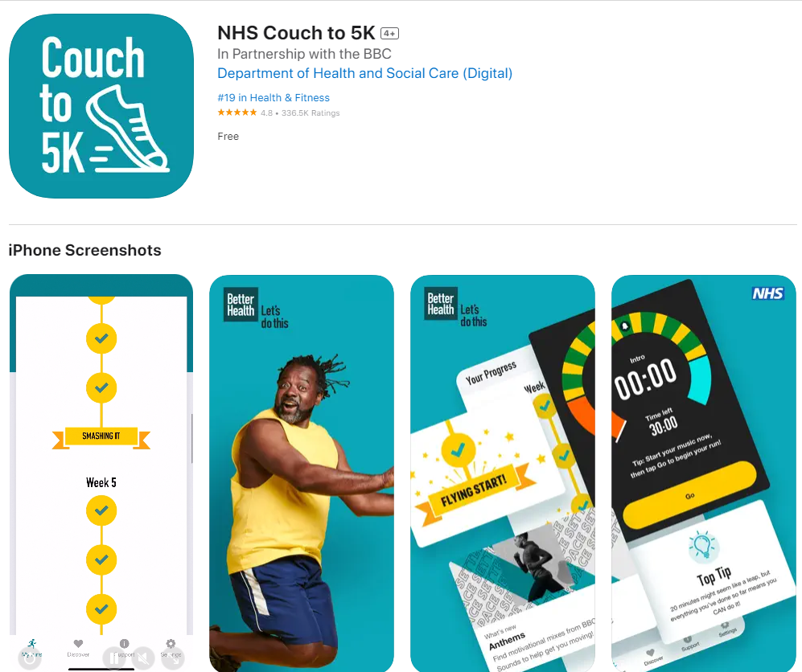

How to recommend?!
Look local!
Gyms
Youth centres
Parks
Countryside
Notes:
movingmedicine.ac.uk/
Local parks / Youth centres / gyms / gardens
NHS exercise videos, NHS Fitnes Studio: nhs.uk/conditions/nhs-fitness-studio
Free exercise Ideas: nhs.uk/live-well/exercise/free-fitness-ideas/
Couch to 5K
Park Run: parkrun.org.uk
The conservation Volunteers (Green gyms): tcv.org.uk
Our Parks, Free outdoor fitness classes: ourparks.org.uk
Change for Life activities: nhs.uk/change4life/activities

Slide 10
Resources & references

