Slide 1










Getting the balance
HEALTH PROMOTION PROJECT
South East Coast and London Dietitian Network

Slide 2
Getting the Balance – guidance on using socials
Below are 3 posts for the health promotion Topic of "Getting the Balance"
Each newsletter has:
A picture for the list image
An image for the content
Below are instructions for Digibete, These should be posted to Digibete in monthly intervals which you can schedule the date in advance.
Link to Digibete app: https://app.digibete.org/login
If not using Digibete the app the content and images here can be used for any social media.
News Title: (text will be given)
List Image
Right Click on the image opposite, save picture. Go to the Image location and drag into the list image box.
Content: (click add text and copy and paste below)
The contents will be given on each page, copy and paste into the text area provided
Post Image:
- Click add image
Right Click on the post image 1 opposite, save picture. Go to the Image location on your drive and drag into the list image box on the digibete post page. Do the same for post image 2
Attachments or further reading: (Additional Files or links)
- Download Newsletter – SALT newsletter 1 from the CYP Diabetes Network page , save it to a known location.
- Click Add File in digibete app webpage
Drag and drop the file from the location you saved it
DON’T FORGET TO CHANGE THE PUBLISH DATE TO 1 month after your previous post

Slide 3
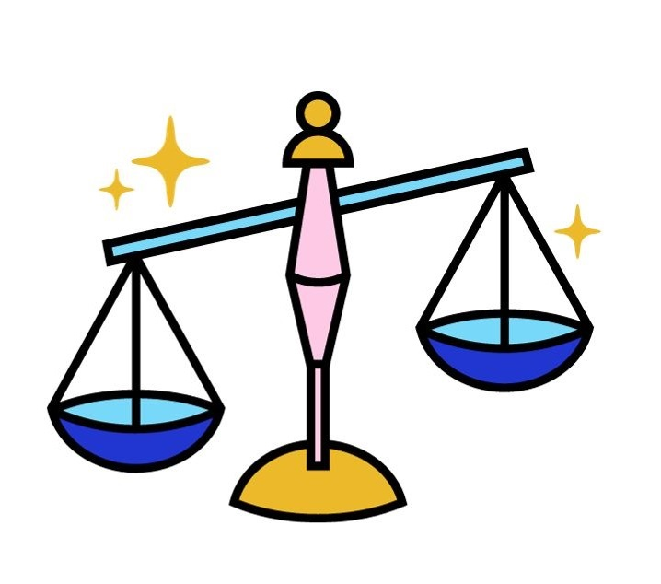
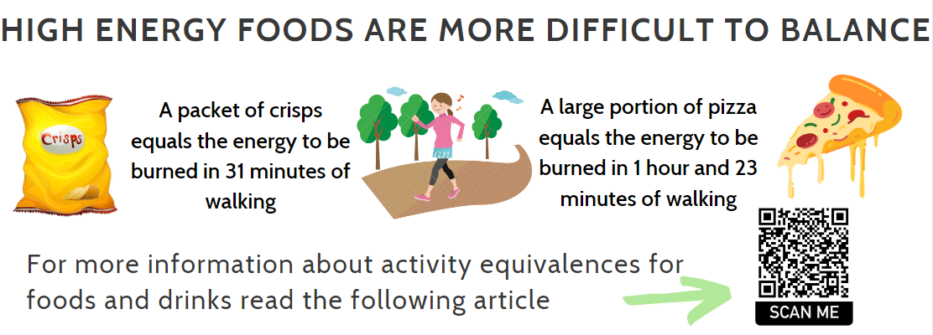
Getting the Balance – Month 1
News Title: Getting the Balance – What are Calories?
List Image Right Click on the image opposite, save picture. Go to the Image location and drag into the list image box.
Content: (click add text and copy and paste below)
WHAT ARE CALORIES?
Calories are energy in a foods and drink
Foods and drinks give your body energy to function and grow
Energy is used for breathing, keeping your heart beating, growing, and to do physical activities like walking, jumping, and running
CALORIES FROM FOOD AND DRINKS = ENERGY IN
The energy you need every day depend on:
Your age (increases with age)
Your gender (Boys need more than girls)
How active you are
ACTIVITY = ENERGY OUT
To use enough energy:
  Children should be active for at least 60minutes per day
  Adults should be active for 150minutes per week
  Follow this link for activity ideas for all the family
Post Image: - Click add image: Right Click on the post image 1 opposite, save picture. Go to the Image location on your drive and drag into the list image box on the digibete post page. Do the same for post image 2
Attachments or further reading: (Additional Files or links)
- Download Newsletter – Getting The Balance newsletter 1 from the CYP Diabetes Network page , save it to a known location.
- Click Add File in digibete app webpage: Drag and drop the file from the location you saved it
DON’T FORGET TO CHANGE THE PUBLISH DATE TO THE DESIRED PUBLISH DATE
List Image
Post Image 1

Slide 4
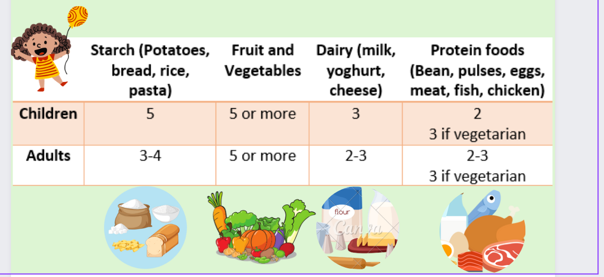
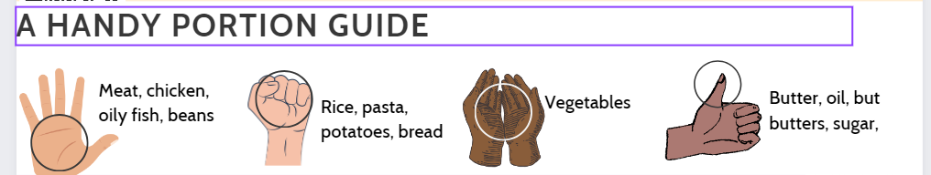
Getting the Balance – Month 2
News Title: Getting the Balance – Portions
List Image Right Click on the image opposite, save picture. Go to the Image location and drag into the list image box.
Content: (click add text and copy and paste below)
ACHIEVING THE RIGHT BALANCE
Eat a balanced and varied diet
Build activity into your normal day e.g. walking to school or work
Limit high sugar drinks
Foods high in fat and/or calories in small amounts
Portion Sizes
Following a healthy lifestyle is about getting the right types of food and drinks in amounts that are suitable for our bodies and lifestyle
Follow this link to visualise portions for toddlers and 4-year-olds from the Infant and Toddler Forum and first steps nutrition has meal ideas and lots of great guidance
Follow this link for The British Heart foundation has a guide portion size guide for adolescents and adults.
Post Image: - Click add image: Right Click on the post image 1 opposite, save picture. Go to the Image location on your drive and drag into the list image box on the digibete post page. Do the same for post image 2
Attachments or further reading: (Additional Files or links)
- Download Newsletter – Getting The Balance newsletter 2 from the CYP Diabetes Network page , save it to a known location.
- Click Add File in digibete app webpage: Drag and drop the file from the location you saved it
DON’T FORGET TO CHANGE THE PUBLISH DATE TO THE DESIRED PUBLISH DATE
List Image
Post Image 1

Slide 5
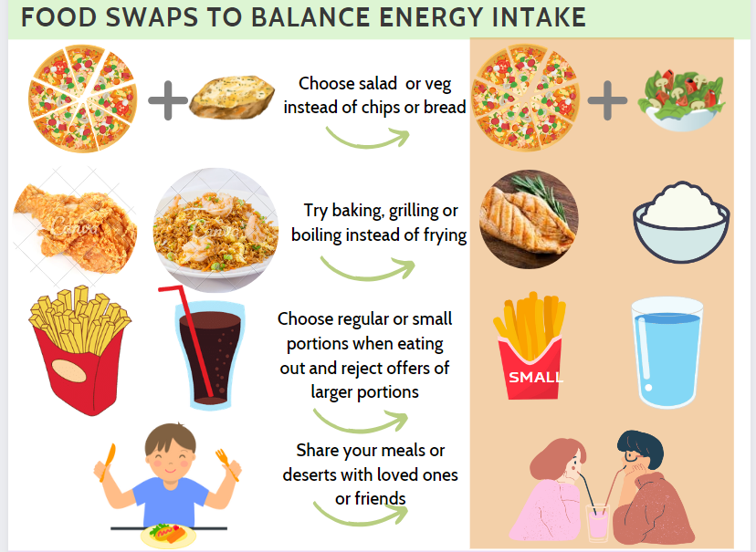
Getting the Balance – Month 3
News Title: Getting the Balance – Food swaps to balance energy intake
List Image Right Click on the image opposite, save picture. Go to the Image location and drag into the list image box.
Content: (click add text and copy and paste below)
Simple swaps can make a big difference, for more food swaps follow this link
Click for the NHS food scanner App which canfind healthier choices for next time you shop
Getting the balance when talking about food
Avoid dieting talk
Healthy bodies can be different shapes and sizes
Food is not "good" or "bad", try saying "everyday" or "sometimes" foods
If food is a hard topic for you and meals are no longer fun or are becoming stressful, speak to your health care team for support
If you need some help with talking to your child about weight, follow this link
Post Image: - Click add image: Right Click on the post image 1 opposite, save picture. Go to the Image location on your drive and drag into the list image box on the digibete post page. Do the same for post image 2
Attachments or further reading: (Additional Files or links)
- Download Newsletter – Getting The Balance newsletter 2 from the CYP Diabetes Network page , save it to a known location.
- Click Add File in digibete app webpage: Drag and drop the file from the location you saved it
DON’T FORGET TO CHANGE THE PUBLISH DATE TO THE DESIRED PUBLISH DATE
List Image
Post Image 1

