Slide 1










Getting the balance
HEALTH PROMOTION PROJECT
South East Coast and London Dietitian Network

Slide 2
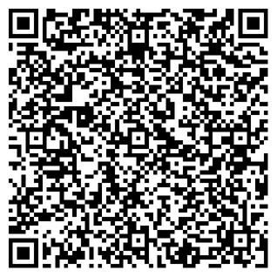
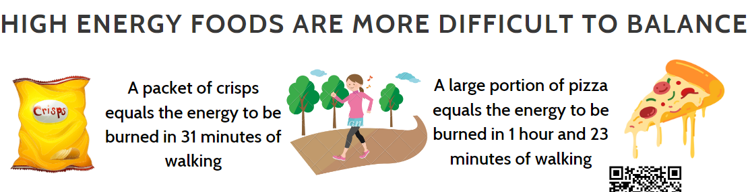
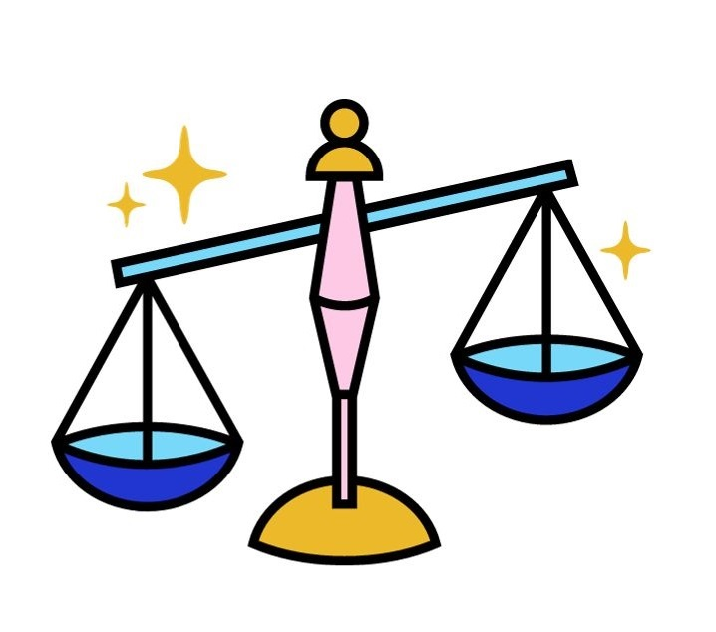
Getting the Balance
Find out how healthy your diet is - Norfolk County Council
Others:
Food Portion Distortion Quiz: Portion Sizes & Serving Sizes (medicinenet.com)
Microsoft Word - healthy eating quiz adults.doc (healtheducationtrust.org.uk)

Slide 3
Getting the Balance
It is estimated that on average, adults’ diets contain 200 to 300 more calories than recommended a day, (PHE, 2018)
Children who are already overweight or living with obesity are consuming up to 500 more calories than are required for a healthy body weight.
In the financial year 2020 to 2021, the NHS in the UK is estimated to have spent £6.5 billion on overweight and obesity related ill-health. This is around 4.7% of the NHS budget.
Reducing obesity and improving diets is essential to increasing healthy life expectancy.

Slide 4
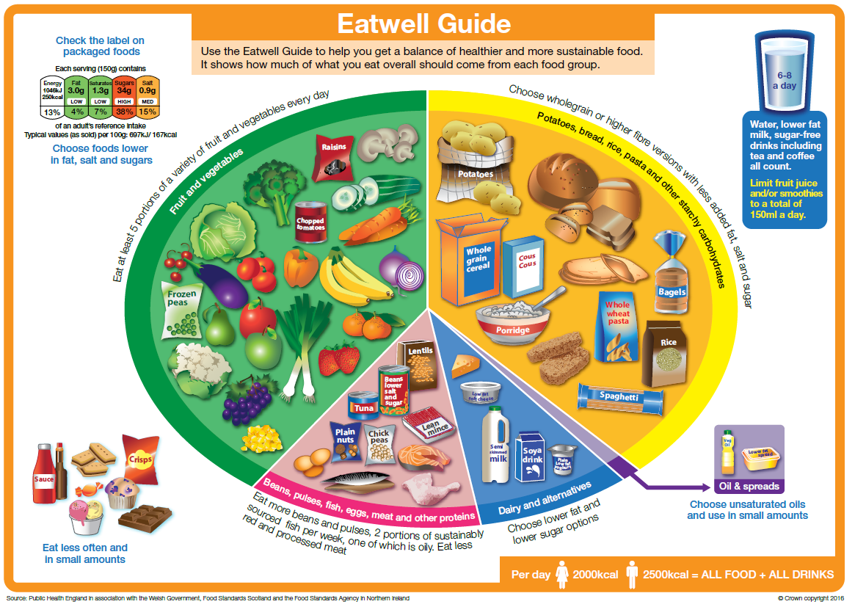
Getting the Balance
If you’re a front-line health and care professional, you should:
talk to patients about the importance of a healthy, balanced diet at relevant moments
  Ask for permission or ask what steps already taking
refer a patient to your local dietetic service, if you feel they would benefit from more tailored advice on their diet.
role model healthy eating in your team and work environment
  displaying the Eatwell Guide poster on walls of consultation rooms and waiting areas.
Resist using unhealthy foods as ‘treats’ for patients for example, sweets at the front desk or directly to children following treatments. Instead, you could
  have a cold-water dispenser in the waiting room and NHS branded stationery or healthcare related samples for patients for example toothpaste samples in dental clinics, or stickers for children
For more generalised resources you may find it useful to familiarise yourself with the:
  NHS Food Scanner app
  NHS Weight Loss Plan app
  Better Health: losing weight
  Better Health: healthier families
  British Dietetic Association website factsheets
Explore the Eatwell Guide page. This page contains:
  government dietary guidelines
  the Eatwell Guide image and explanation in the Eatwell Guide booklet
  the quick guide gives information on the evidence base underpinning government dietary recommendations
  a guide to what, why and how for the Eatwell model
explore nutrition advice on NHS.UK, for example red meat and the risk of bowel cancer­­­
Information taken from : Healthy eating: applying All Our Health - GOV.UK (www.gov.uk)

Slide 5
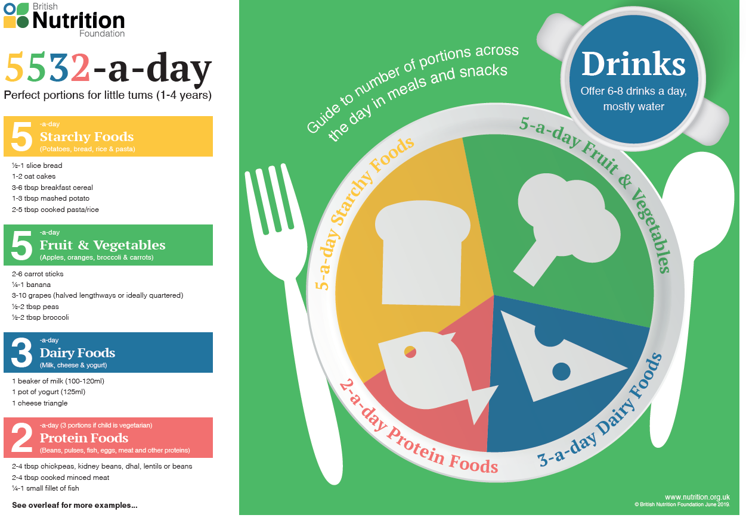
Getting the Balance – Energy Balance
It is important to explain to families about energy balance
WHAT ARE CALORIES?
Calories are energy in a foods and drink
Foods and drinks give your body energy to function and grow
Energy is used for breathing, keeping your heart beating, growing, and to do physical activities like walking, jumping, and running
CALORIES FROM FOOD AND DRINKS = ENERGY IN
The energy you need every day depend on:
Your age (increases with age)
Your gender (Boys need more than girls)
How active you are
ACTIVITY = ENERGY OUT
To use enough energy:
  Children should be active for at least 60minutes per day
  Adults should be active for 150minutes per week
  Energy dense foods are harder to burn off
  Follow this link for activity ideas for all the family
ACHIEVING THE RIGHT BALANCE
Eat a balanced and varied diet
Build activity into your normal day e.g. walking to school or work
Limit high sugar drinks
Foods high in fat and/or calories in small amounts

Slide 6
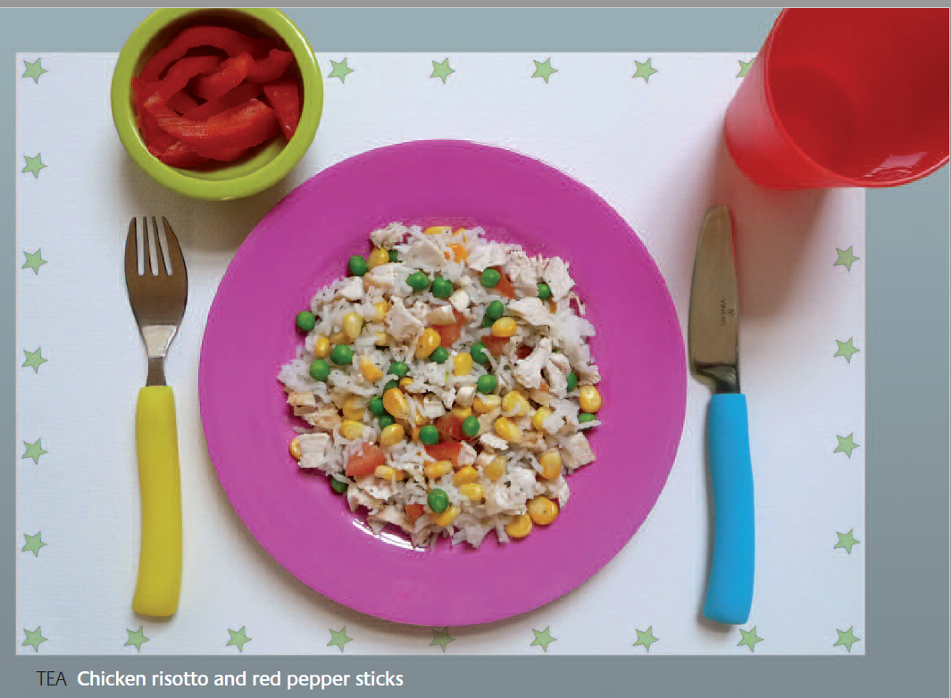
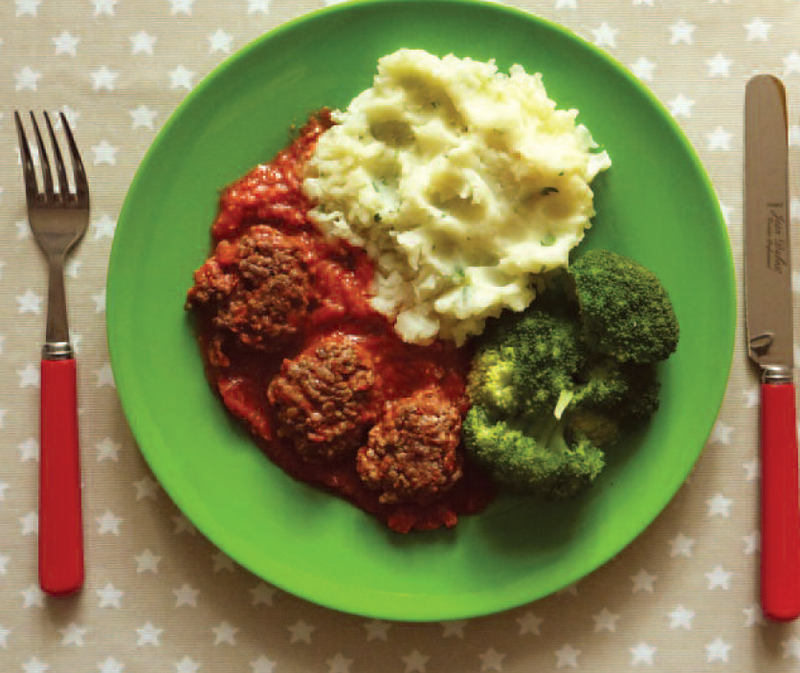
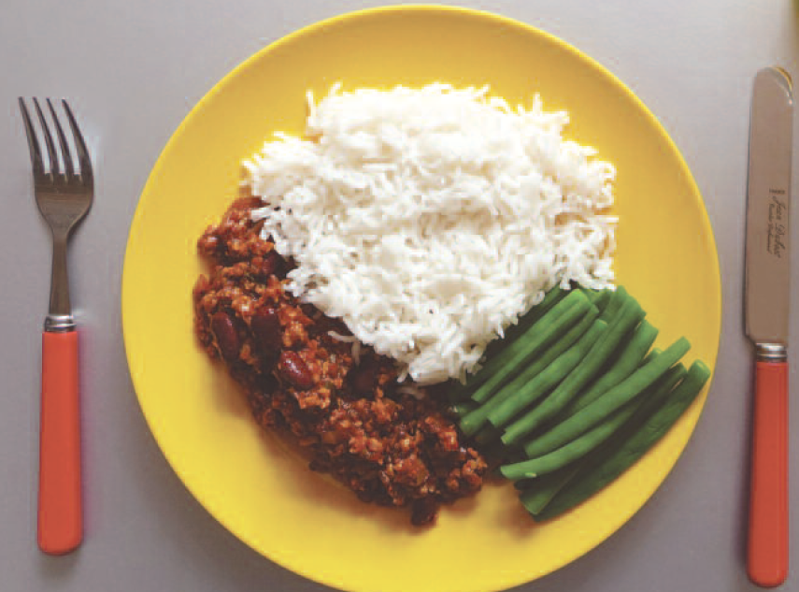
Getting the Balance – portion Sizes
Dietitians will tell you often it's not that people are eating too much food but eating
too little of some foods such as fruit, vegetable and wholegrains
too much processed, simple carbohydrates and processed meats
Portion Sizes
Following a healthy lifestyle is about getting the right balance of food and drinks in amounts that are suitable for our bodies and lifestyle
Follow this link to visualise portions for toddlers and 4-year-olds from the Infant and Toddler Forum
first steps nutrition has meal ideas and lots of great guidance
Follow this link for The British Heart foundation has a guide portion size guide for adolescents and adults.

Slide 7
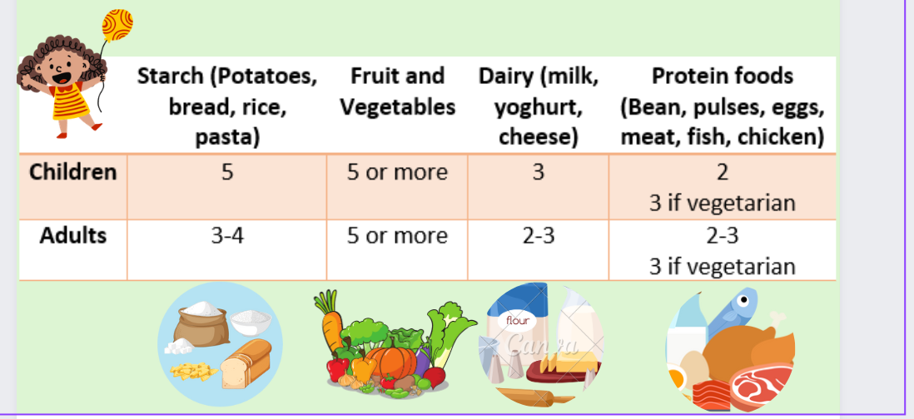
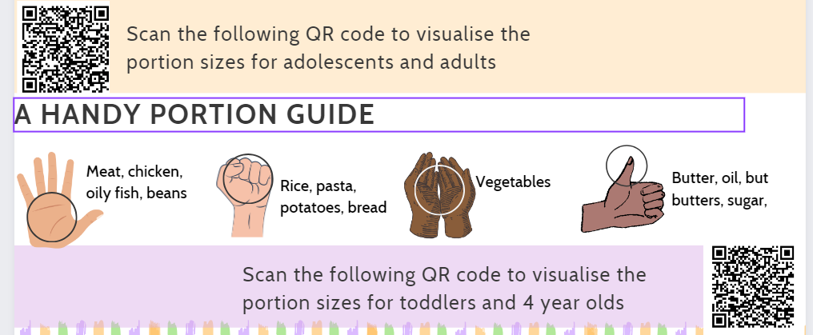
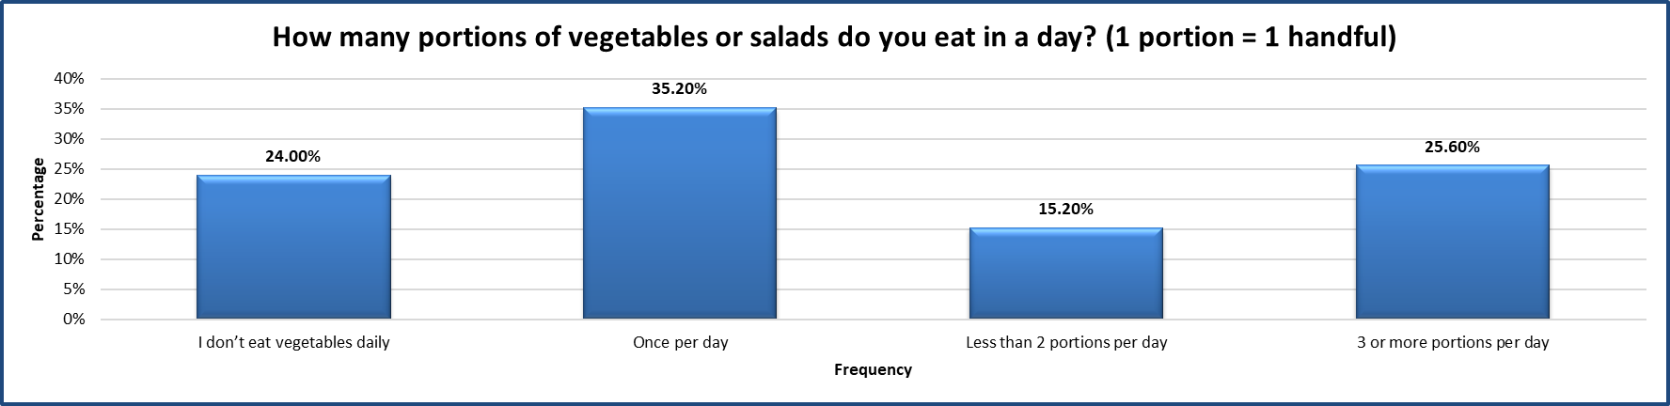
Getting the Balance – Portion Sizes: Veg
The Health lifestyles group asked patients with the diabetes services across the UK to answer questions about diet and lifestyle. Link to questionnaire available: South East Coast & London and North West Health Promotion Project - National Network (cypdiabetesnetwork.nhs.uk)
The next few slides show some of the responses
Your service can use this questionniare and ask for your own results back
Notes:
Does eat veg daily – 25.96%
Veg once per day – 35%
Less than 2 portions per day – 13%
3 or more portions – 25%
6 or more portions – 0%

Slide 8
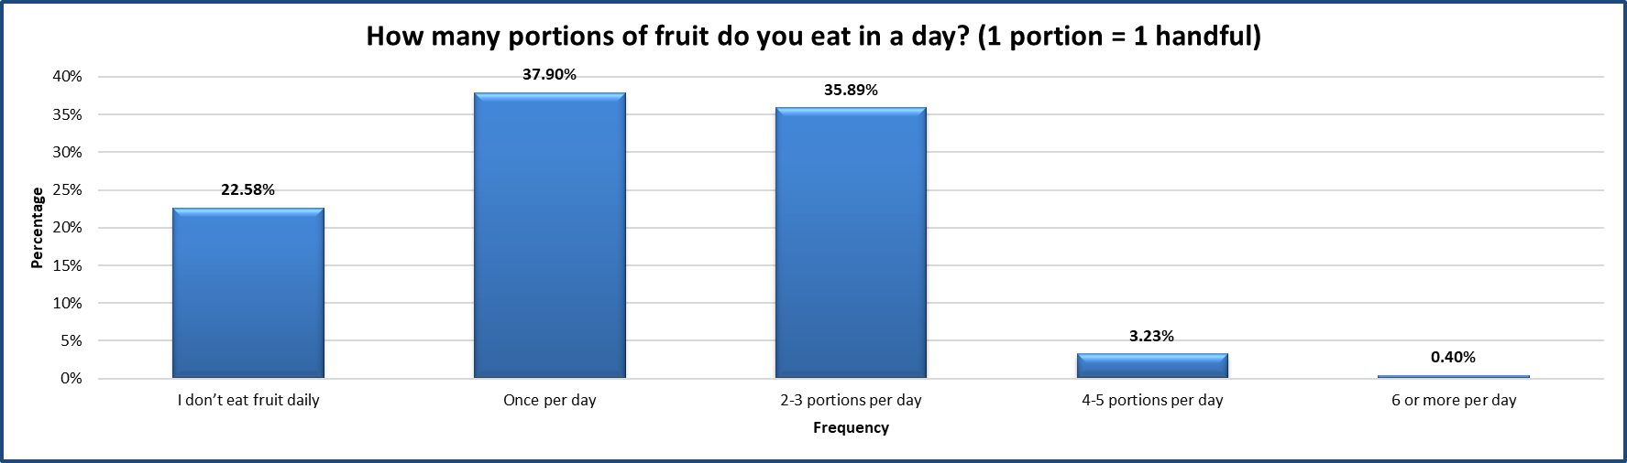
Getting the Balance – portion Size: Fruit
Notes:
Does eat fruit daily – 21%
fruit once per day – 41.26%
2-3 – 33%
4-5 – 3%
6 or more portions – 0.97%

Slide 9
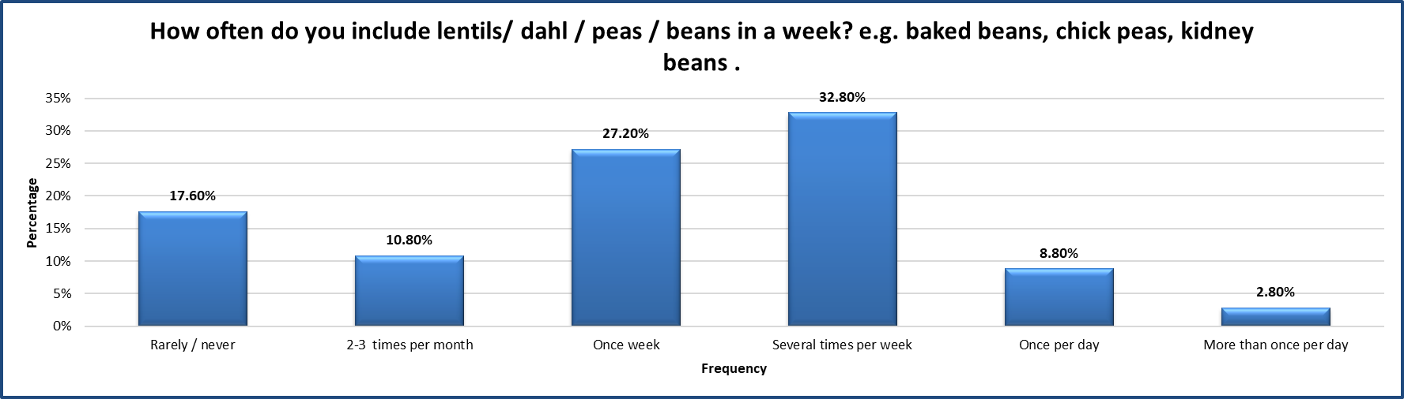
Getting the Balance – portion Sizes: pulses
Notes:
Pulses more than once per day – 3.37%
Once per day – 8.56%
Several times per week – 34.62%
Once week – 27.88%
2-3 times per week – 11%
Rarely / never – 14%

Slide 10
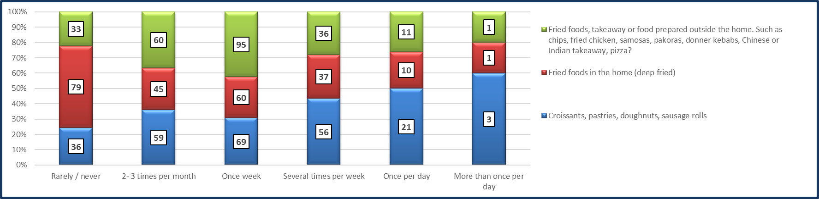
Getting the Balance: Portion s: High Fat Food
Interestingly in general there has been a large decrease in frying at home, possibly changing for air frying but also being replaced by fried food from outside the home over the last decade.
We should be trying to reduce most of these foods and not eating them regularly

Slide 11
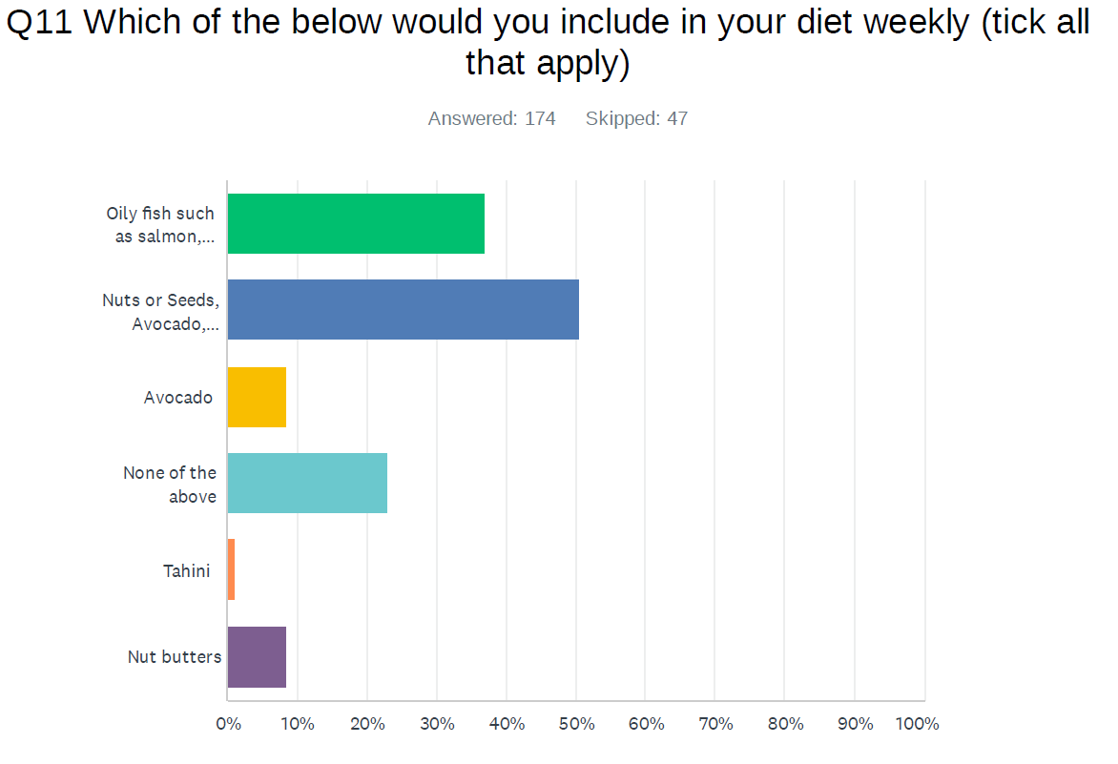
Getting the Balance: Portion s: Healthy Fats
Notes:
Oily fish – 36% each weekly
Nuts, seeds, avocado, tahini, nut butters – 50%
Avocado – 8.62%
Tahini – 1%
Nut butters – 8%
Non of the above – 22%

Slide 12
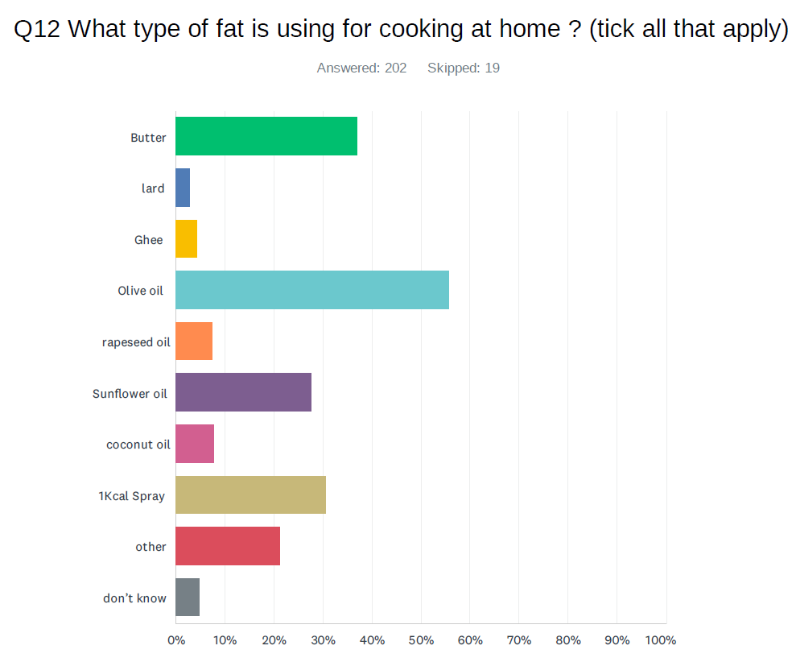
Getting the Balance: Portion s: Fats
Notes:
Butter – 37%
Lard – 3%
Ghee – 4.46%
Olive oil - 55%
Rapeseed oil – 7.43%
Sunflower oil - 27%
Coconut oil – 7.9%
1kcal spray – 30%
Other 21%
Don’t know 5%

Slide 13
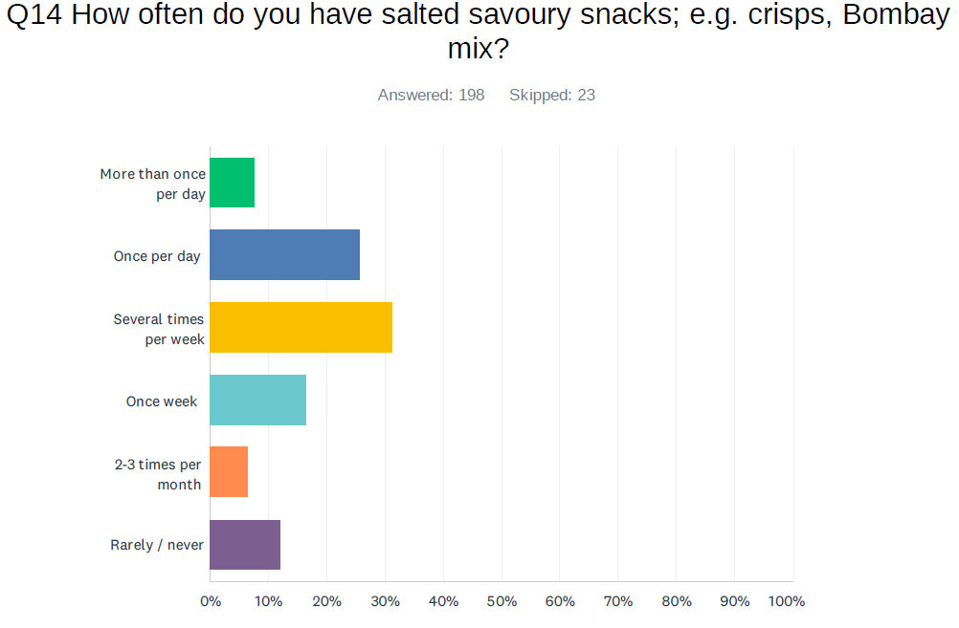
Getting the Balance: Portions: savoury snacks
Notes:
More than once per day – 7.58%
Once per day – 25%
Several times per week – 31%
Once per week – 16%
2-3 times per month – 6.57%
Rarely / never – 12%

Slide 14
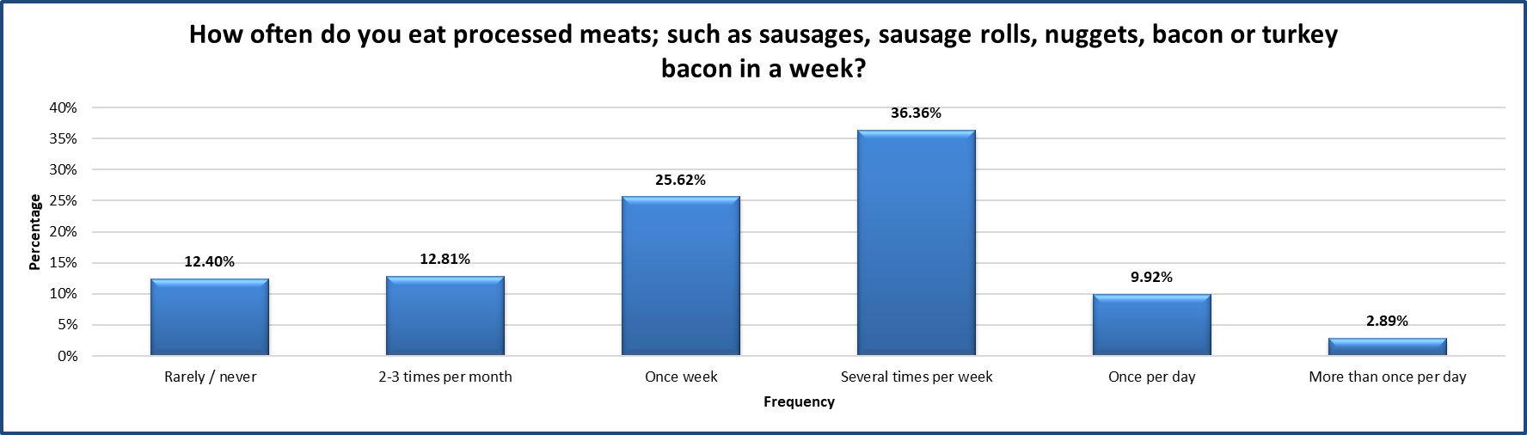
Getting the Balance: Processed meats
Notes:
More than once per day –3%
Once per day – 8.5%
Several times per week – 31%
Once per week – 27%
2-3 times per month – 15%
Rarely / never – 14%

Slide 15
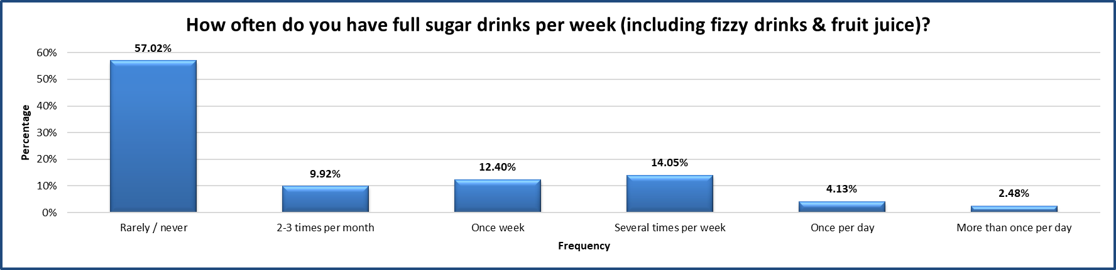
Getting the Balance: Sugary drinks
Notes:
More than once per day –2.54%
Once per day – 4.57%
Several times per week – 15%
Once per week – 12%
2-3 times per month – 11%
Rarely / never – 53%

Slide 16
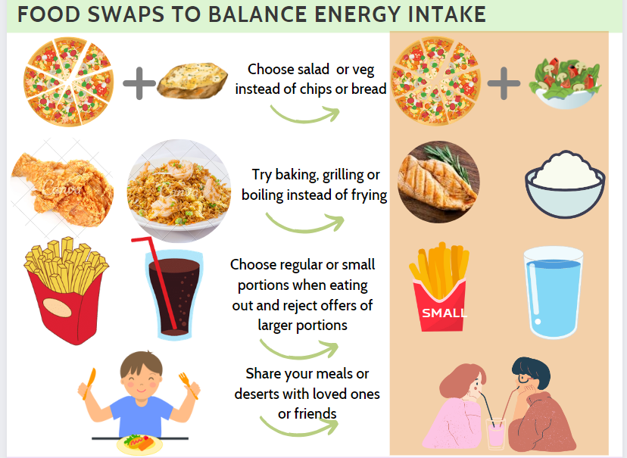
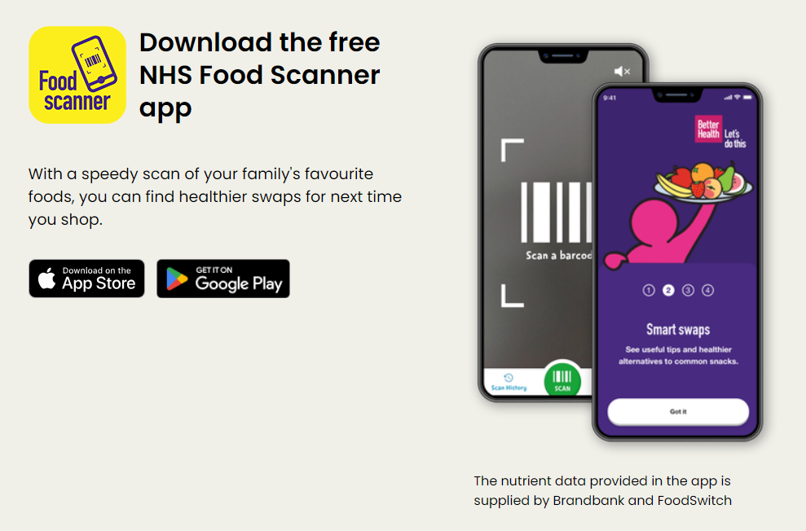
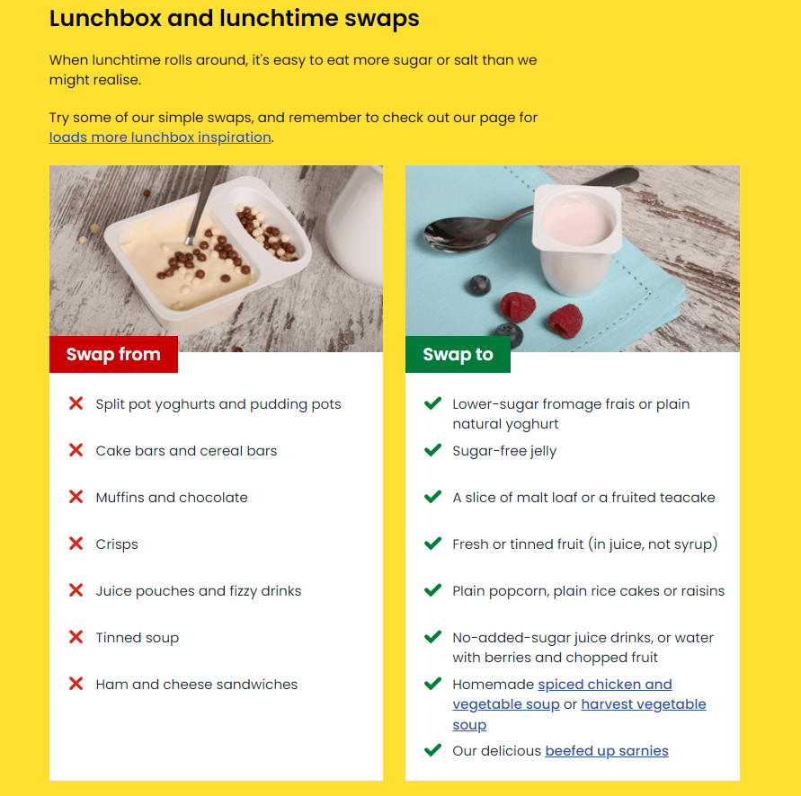
Getting the Balance – Food Swaps
Simple swaps can make a big difference, for more food swaps follow this link
Click for the NHS food scanner App which canfind healthier choices for next time you shop

Slide 17
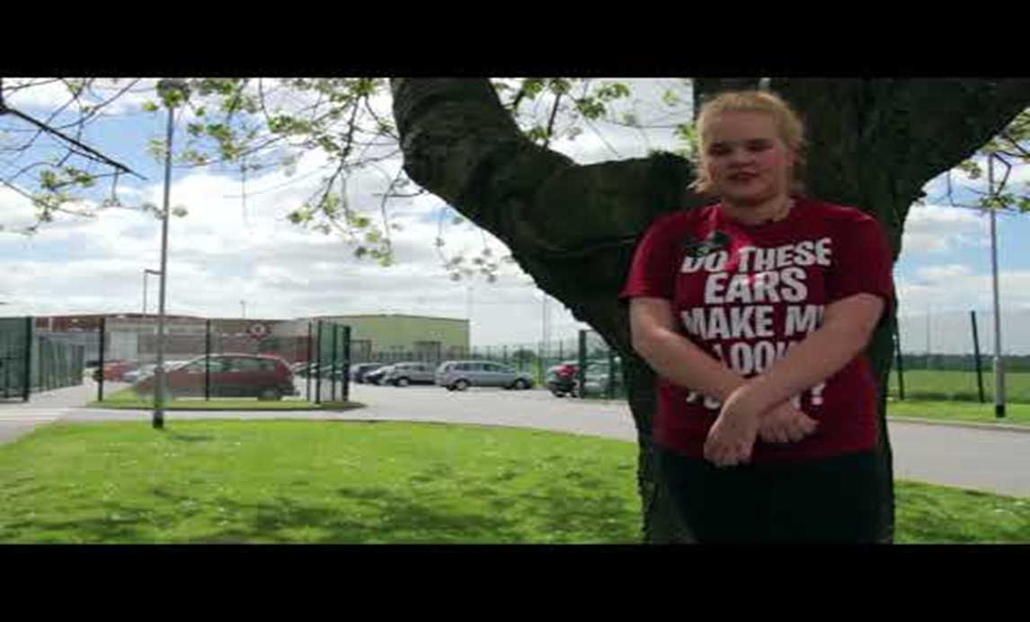
How do we make CYP living with excess weight feel?

Slide 18
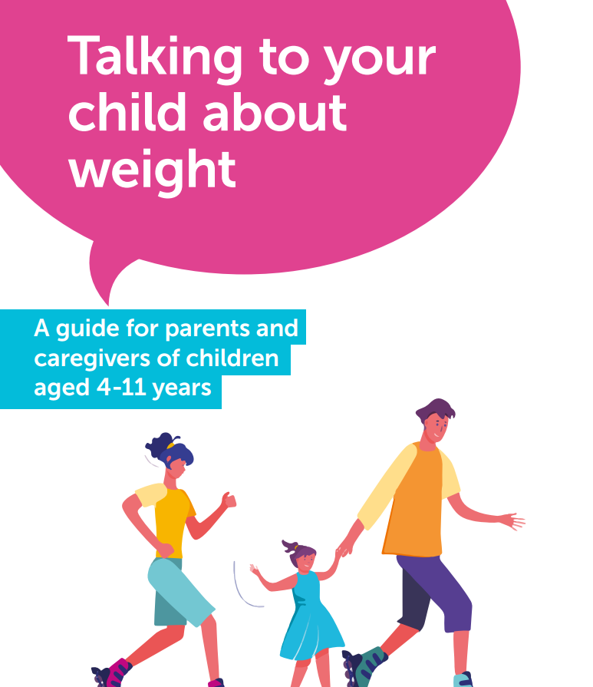
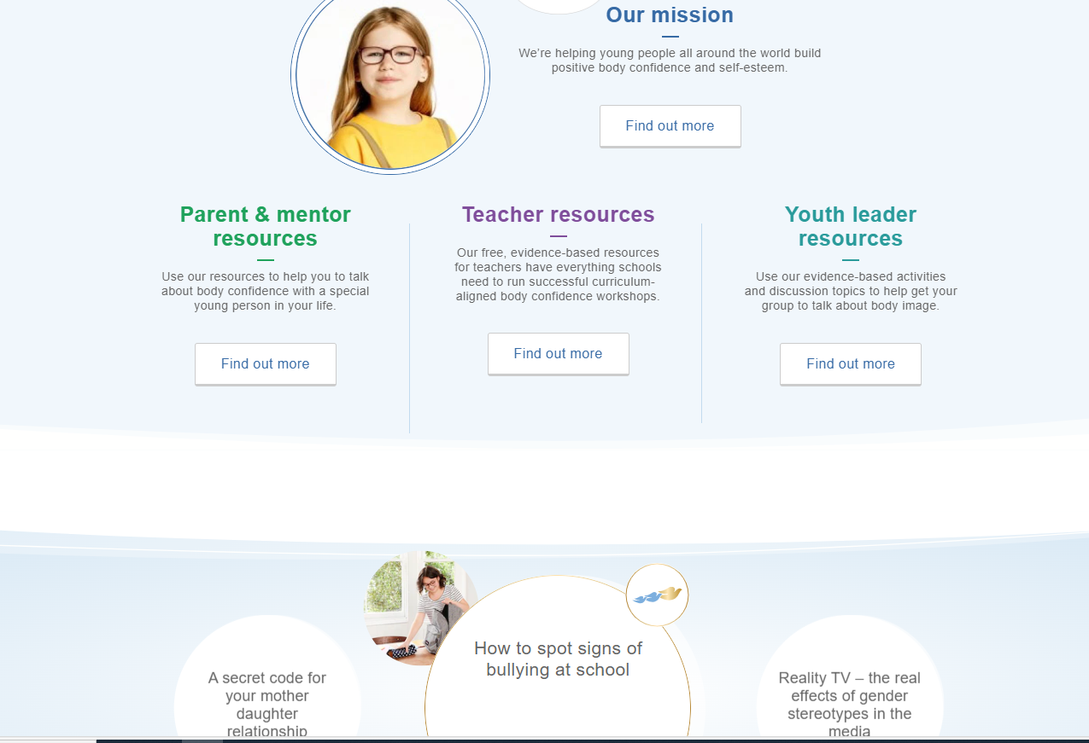
Getting the Balance – Talk
Getting the balance when talking about food and weight
There’s plenty of evidence that language influences our emotions and there is also evidence that associating foods with guilt can harm our relationship with food.
Avoid dieting talk
Healthy bodies can be different shapes and sizes
Food is not "good" or "bad", try saying "everyday" or "sometimes" foods
Try: ‘satisfying’, ‘pleasurable’, or ‘delicious’
Suggest to families that if food is a hard topic for you and meals are no longer fun or are becoming stressful, speak to your health care team for support
University of Bath and BDA - talking to your child about weight, follow this link
The Dove Self-esteem project The Dove Self-Esteem Project | Dove
Food Language
Why Food Language Matters – Dietetically Speaking
Positive Food Language for a Healthy Relationship with Food - Yumlish

Slide 19
Getting the Balance – resources and links
British Health and nutrition Survery: NDNS: results from years 9 to 11 (2016 to 2017 and 2018 to 2019) - GOV.UK (www.gov.uk)
Calorie reduction: the scope and ambition for action - GOV.UK (www.gov.uk)
Eastimating the cost of Obesity (2022)
Portion sizes and food groups - GOV.UK (www.gov.uk)
Eating well early years — First Steps Nutrition Trust
Food portions - Heart Matters magazine - BHF
How to Measure Portion Sizes with your Hands (Infographic) | Eufic
handy-portion-guide.pdf (diabetes.ca)
Understanding calories - NHS (www.nhs.uk)
Calorie counting - Better Health - NHS (www.nhs.uk)
Healthy food swaps : Healthier food swaps - Food facts - Healthier Families - NHS (www.nhs.uk)
NHS Healthier Families, 6 ways to help your child with their weight: Children's weight - Healthier Families - NHS (www.nhs.uk)
  NHS Food Scanner app
  NHS Weight Loss Plan app
  Better Health: losing weight
  Better Health: healthier families
  British Dietetic Association website factsheets
Food talk:
Mindful Eating (livelifebetterderbyshire.org.uk)
Why Food Language Matters – Dietetically Speaking
Positive Food Language for a Healthy Relationship with Food - Yumlish
Weight:
University of Bath and BDA - talking to your child about weight, follow this link
The Dove Self esteem project The Dove Self-Esteem Project | Dove

