Slide 1











HEALTH PROMOTION PROJECT
South East Coast & London + North West Dietitian Network
Emotional Health– Social Media

Slide 2
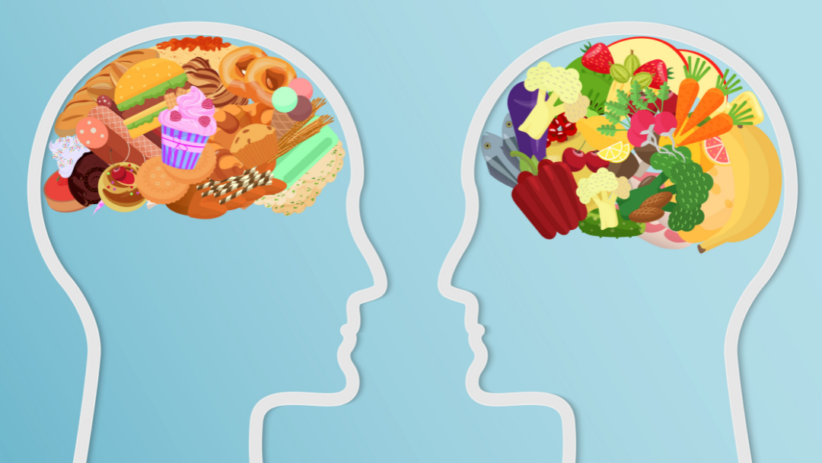
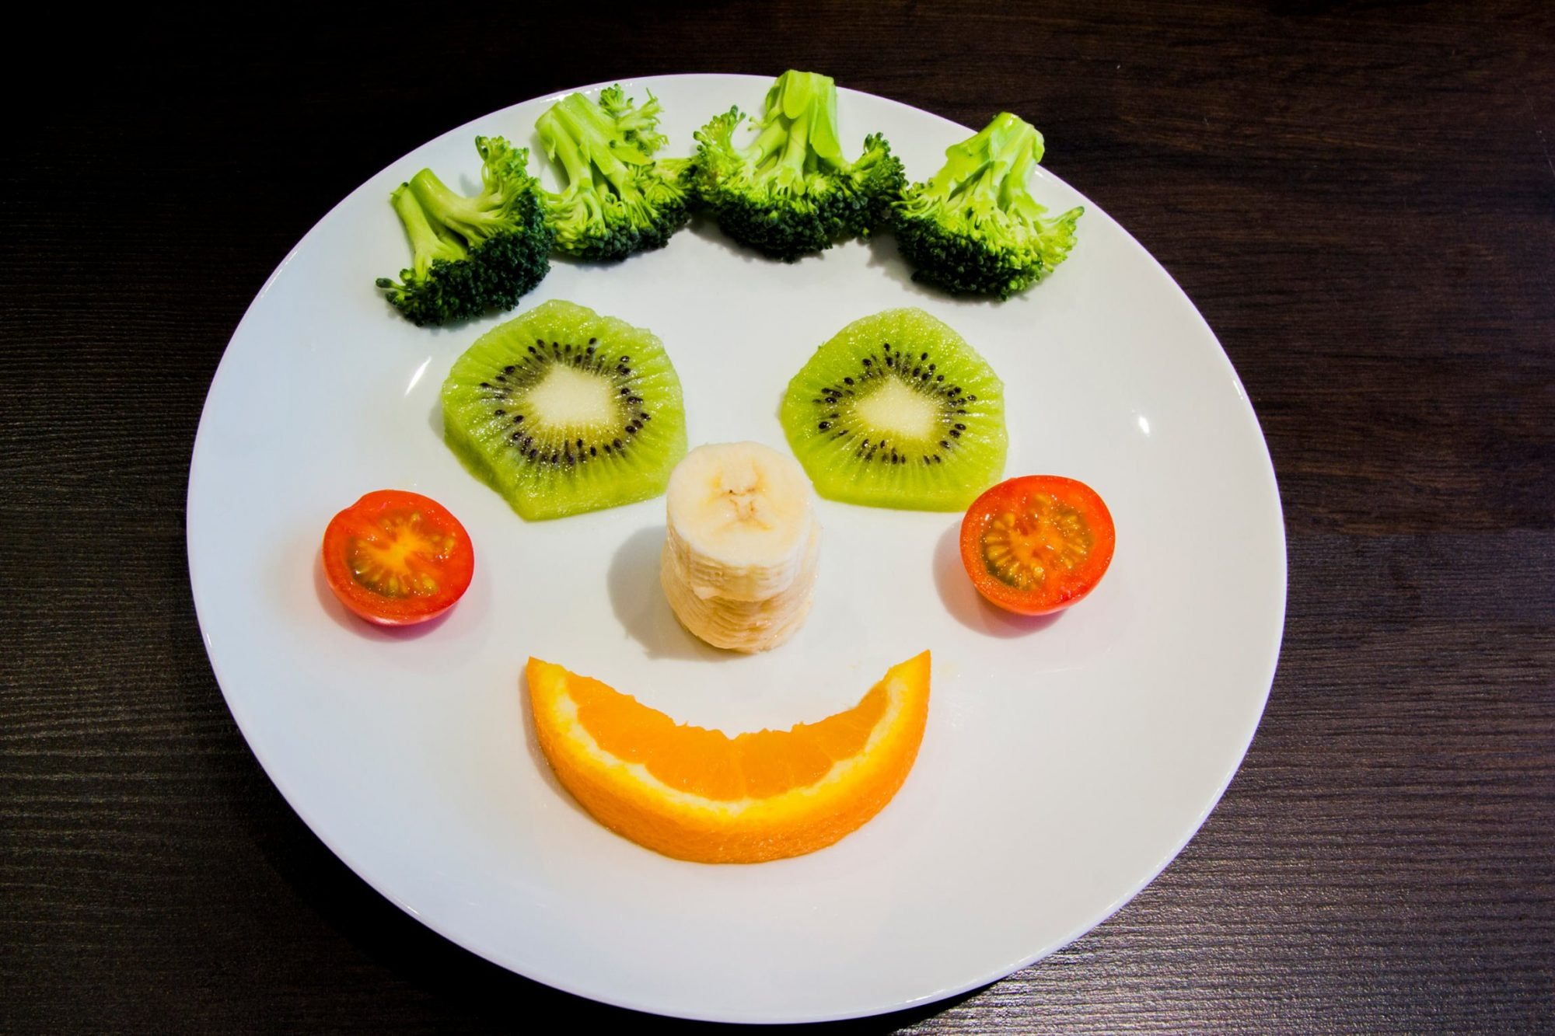
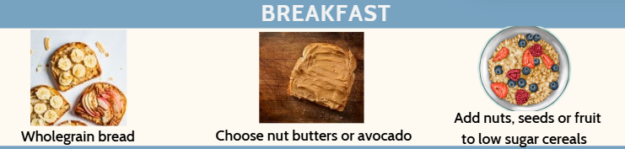
Digibete/Social media month 1
Below are 3 posts for the health promotion Topic of movement. Each newsletter has a picture for the list image and an image for the content Below are instructions for Digibete, These should be posted to Digibete in month intervals. Link to Digibete app: https://app.digibete.org/login You can do these all at the same time and schedule a time for them to be posted. If not using Digibete the app the content and images here can be used for any social media.
Post Image 1
News Title:
Emotional Health - Healthy Lifestyles Campaign
List Image
Right Click on the image opposite, save picture. Go to the Image location and drag into the list image box.
Content: (click add text and copy and paste below)
For the next 3 months we are focusing on emotional health and how food affects your mood
Does food affect your mood?
Some foods lead to low energy levels and poor mood such as
  Fizzy drinks with caffeine and sugar
  Too many processed foods
Some foods can make you feel happier and have more energy
They can improve your concentration and memory, these are:
  Fruit and vegetables
  Healthy fats (oily fish, nuts, seeds, avocado)
Click here for recipes with ingredients that can improve mood
Post Image:
- Click add image
Right Click on the second image opposite, save picture. Go to the Image location on your drive and drag into the list image box on the digibete post page.
Attachments or further reading: (Additional Files or links)
- Download Newsletter one from the CYP Diabetes Network page
- Click Add File, Name: Emotional health t Newsletter 1
- Drag and drop the file from the location you saved it on your drive
List Image
Post Image 2
Notes:
Childhood obesity strategy

Slide 3

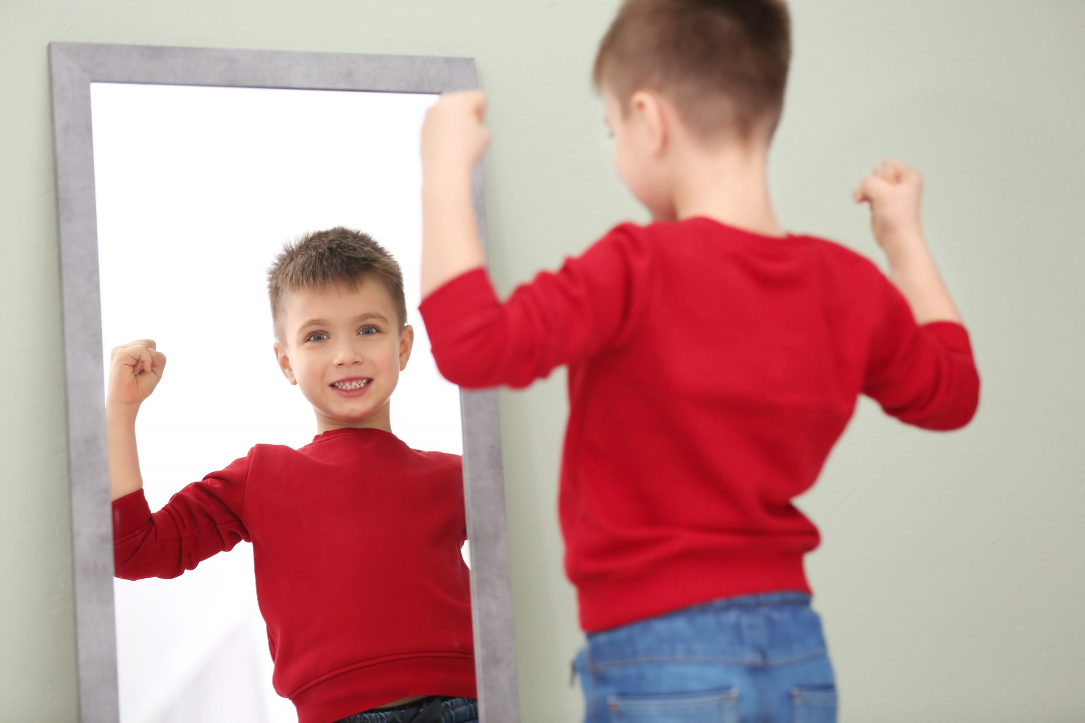
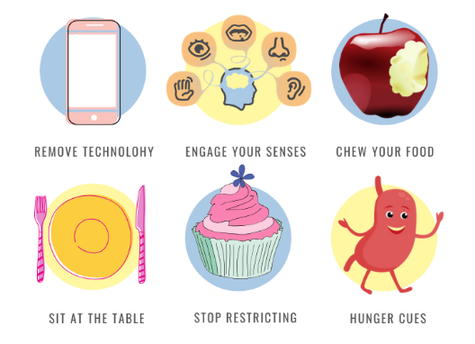
Digibete/Social media month 2
Below are 3 posts for the health promotion Topic of "Emotional Health". Each newsletter has a picture for the list image and an image for the content Below are instructions for digibete, These should be posted to Digibete in month intervals. Link to digibete app: https://app.digibete.org/login You can do these all at the same time and schedule a time for them to be posted. If not using digibete the app the content and images here can be used for any social media.
Post Image 1
News Title:
Eating behaviours - Healthy Lifestyles Campaign
List Image
Right Click on the image opposite, save picture. Go to the Image location and drag into the list image box.
Content: (click add text and copy and paste below)
For the next 3 months we are emotional health and how food affects our mood
Types of hunger
Non physical hunger:
Comes on suddenly
May not be at meal times
May not go away after eating
Can be when we are bored, sad, happy or stressed
Occasions like birthdays and festivals
Physical hunger
Goes away after eating
Builds up before a meal
Signs include stomach growling, feeling empty or low energy levels
Mindful eating
Mindful eating helps us to relax and enjoy our meals. Try thinking about the taste, texture, smell and flavour of each mouthful and avoid screens during mealtimes.
Click on this link to learn more about body image and food language
Click on this link to learn more about mindful eating
Post Image:
- Click add image
Right Click on the second image opposite, save picture. Go to the Image location on your drive and drag into the list image box on the digibete post page.
Attachments or further reading: (Additional Files or links)
- Download Newsletter two from the CYP Diabetes Network page
- Click Add File, Name: Emotional Health Newsletter 2
- Drag and drop the file from the location you saved it on your drive
List Image
Post Image 2
Notes:
Childhood obesity strategy

Slide 4
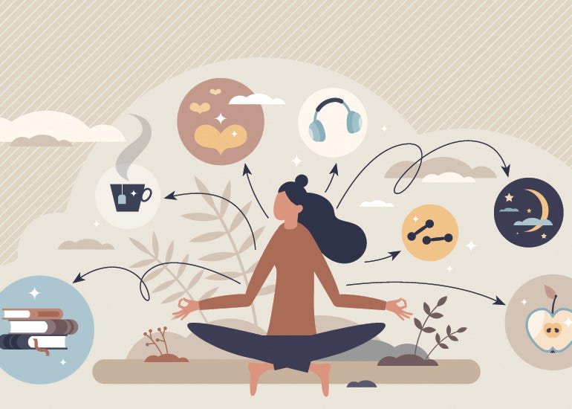
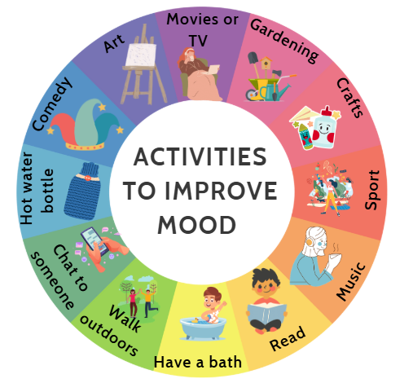
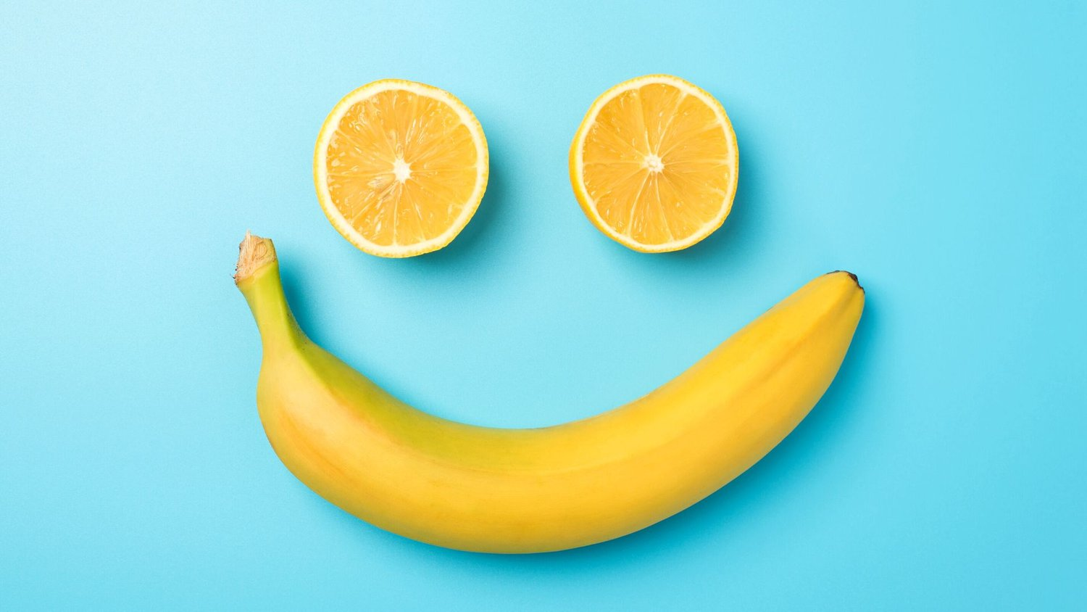
Digibete/Social media month 3
Below are 3 posts for the health promotion Topic of "Emotional Health". Each newsletter has a picture for the list image and an image for the content Below are instructions for digibete, These should be posted to Digibete in month intervals. Link to digibete app: https://app.digibete.org/login You can do these all at the same time and schedule a time for them to be posted. If not using digibete the app the content and images here can be used for any social media.
Post Image 1
News Title:
Activities that can improve your mood - Healthy Lifestyles Campaign
List Image
Right Click on the image opposite, save picture. Go to the Image location and drag into the list image box.
Content: (click add text and copy and paste below)
For the next 3 months we are focusing on emotional health and how food affects our mood
Activities that can improve your mood
Improving what we eat and being active can improve our mood
Doing the things we love also makes us feel good
Some activities stimulate us and others are soothing. Try to have some of both!
Click on this link for ideas of self care activities
Click on this link for NHS Mental Health resources
Post Image:
- Click add image
Right Click on the second image opposite, save picture. Go to the Image location on your drive and drag into the list image box on the digibete post page.
Attachments or further reading: (Additional Files or links)
- Download Newsletter three from the CYP Diabetes Network page
- Click Add File, Name: Emotional Health Newsletter 3
- Drag and drop the file from the location you saved it on your drive
List Image
Post Image 2
Notes:
Childhood obesity strategy

