Slide 1












HEALTH PROMOTION
CAMPAIGN
Southeast Coast & London + Northwest Dietitian Network
Endorsed by:
Notes:
We started the project at the end of 2020 in SEC&L network, when I moved to Manchester we continued the project and so pulled in the NW network
As with lots of things as more people got involved, we needed to jump through more hoops and so the project grew and developed.

Slide 2

WHY-Objectives
Improve the knowledge about diet and lifestyle habits that can reduce CV risk of the children and young people with type 1 diabetes Improve the access of educational material to dietitians and diabetes teams to speak about lifestyle, diet and healthy habits. (Everything in the same place)
South Coast and East London Dietitian Network

Slide 3
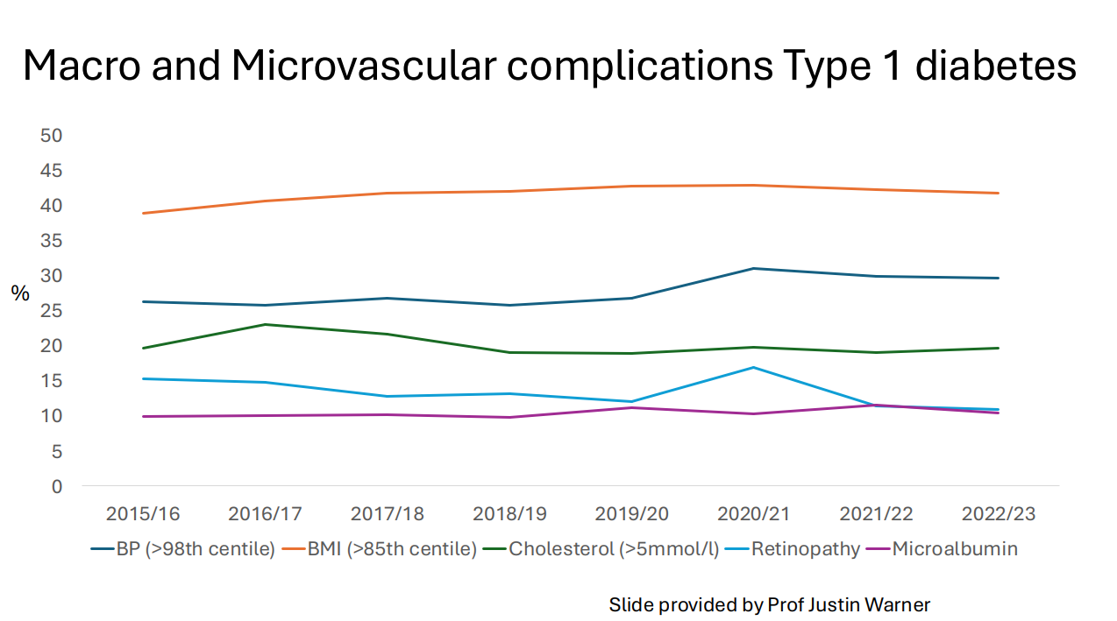
WHY-Cardiovascular disease
"The seeds of cardiovascular disease are sown in childhood.
Nutrition in early life is a critical part of CVD risk reduction"
American Heart Association 2021
Notes:
Slide is with thanks to Fransecsa annan and Justin Warner.
We know that NPDA shows improvement in HbA1c overtime but the cardiovasulcar risk has not improved despite this .
Diet and lifestyle in childhood influenced risk of heart disease and we need to aim to reduce this risk early on and promote healthy habits

Slide 4

WHY A CAMPAIGN
A JOINT TEAM APPOACH
A WHOLE FAMILY APPROACH
Notes:
We know that there is a lack of knowledge and confidence amongst health professionals in delivering healthy lifestyle advice (Mathews, 2017, BMC Health Serv Res.)
We want to encourage healthy habits for whole families as its more likely to stick
- Chenget al; 2014. Physical activity of father influences sons, and mother influence daughters. Physical activity of friends was directly associated with activity of adolescents
Dietetic consultations mainly focus on carb counting techniques, assessments of glucose response to food and insulin timings. Dietitians felt that they did not have the time to also deliver healthy eating messages consistently with update to date resources easily found
Advice is more likely be followed if:
- It is consistent,
- If a whole team of professionals is giving the same guidance
- Its practical
- Simple to understand
- There are lots of reminders (mini – interventions)

Slide 5
















WHAT-Topics to cover
Year 1
Salt
Fibre: Wholegrains, pulse, fruit and vegetables
Lifestyle behaviours:
  Sleep
  Meal times
  Sedentary behaviour
Dietary fat
Year 2
Energy balance / Portion sizes
Movement
Emotional health
Plant friendly eating

Slide 6
HOW-Work plan
Eating habits questionnaire before and after the project
3 months per campaign topic
1 team educational session to kick off each topic
Newsletter / digibete post each month
1 poster per topic
Powerpoint for clinic / GP screens
YEAR 1
YEAR 2

Slide 7

HOW-Work plan
Eating and lifestyle habits questionnaire (Survey Monkey) at the beginning and at the end of the project to evaluate the impact
Vegetable and fruit frequency of consumption
Wholegrains & pulses consumption
Processed meats consumption
High sugar and fat foods
Snacks and mealtimes
Exercise, sleep and screen times
Link to the questionnaire can be found on South East Coast & London and North West Health Promotion Project - National Network (cypdiabetesnetwork.nhs.uk)

Slide 8
Questionnaire: Results 2021 - 2024
 | All | NW4 | S1 | NW1 | NW2 | NW3
Total | 224 | 19 | 34 | 39 | 114 | 37
Male / female | 119 (54%) / 101 (45%) | 5 (26%) / 10 (52%) | 16 (47%) /18 (52%) | 18 (49%) / 19 (51%) | 63 (56%) / 49 (44%) | 22 (59%) /15 (40%)
age:
0-4 | 12 | 1 | 1 | 2 | 5 | 4
5 to 9 years | 39 | 5 | 1 | 13 | 15 | 10
10 to 14 years | 93 | 4 | 13 | 17 | 48 | 15
15 to 19 years | 77 | 5 | 19 | 6 | 44 | 8
Not answered | 3 | 4 |  | 1 | 2
Ethic group
White | 103 | 7 | 11 | 31 | 27 | 34
Asian | 12 | 5 | 6 | 5 | 1
Black | 7 | 1 | 5 | 0 | 2
mix | 10 |  | 5 | 1 | 1 | 3
Not answered / unknown | 92 | 6 | 7 | 0 | 83
11 hospitals had responded;
4 Hospitals have been included here
Ealing (n=34) – S1
Wythenshawe (n=39) – NW1
Salford (n=114) – NW2
Arrow Park (n=37) – NW3
RMCH (n=19) - NW4
Notes:
Results
A survey monkey questionnaire was developed, piloted and then shared between August 2021-August 2024.
11 UK hospitals responded with 4 units having >30 responses which are included in this analysis so that there was enough data to be able to make reasonable comparisons.
A total of 224 responded, 1 unit in south and 3 units in the northwest.
Whilst we asked about ethnicity and age we could not collect post codes to look at deprivation due to GDPR but comparing these units to the NPDA showed that all had a greater percentage of the cohort in the mot deprived quintile. NW2 and NW3 having 50% in this quintile, twice the national average.
The group is evenly split between male and females.
There is a larger representation of those over 10 years old. Those numbers of those of non-white ethnicity are too small to make significant conclusions. NW2 had over 72% not respond re-ethnicity, the National Paediatric Diabetes Audit data for this unit are >90% white.

Slide 9
Questionnaire: Fibre
Notes:
Significant:
Around 1/3 eat wholegrains daily and this was consistent across the units, except for RMCH where only 16% ate wholegrains daily
There was greater variety (10-29%) in those who did not eat wholegrains at all.
NW3 had the highest daily percentage of wholegrains eaten daily but also had the highest portion of families who ate no wholegrains at all.
SW1 only had 11% reporting not to eat wholegrains at all
61% of the families who responded eat pulses once – several times per week and this was consistent across the units (range 52-65%). There was much wider variation (range 23-50%) in those that eat pulses monthly / rarely or never – half in NW3 and ¼ at other units. NW3 also had 0% who had more than 1 portion of pulses per day compare with 11-13% in the other units.
RMCH highest intake once – several times per week
Knowing this data may make you plan different interventions – You might do more to recommend how / where to introduce wholegrains for those areas where there is little or no intake vs how to increase intake in other locations. This data may also raise more questions to ask – why are families not eating wholegrains and pulses; is it lack of knowledge or cooking skill, costs or a taste preference?

Slide 10
Questionnaire: Sugary drinks
Full Sugar Drinks | Asian | Black | Mixed | White
Rare / never / 2-3 x month | 40% | 29% | 80% | 78%
Weekly or more | 60% | 72% | 20% | 21%
Ethnicity
Full Sugar Drinks | NW3 | S1 | NW2 | NW1 | Rmch
Rare / never / 2-3 x month | 79% | 41% | 73% | 71% | 63%
Weekly or more | 21% | 58% | 27% | 28% | 37%
Full Sugar Drinks | ALL Units | 0-4 | 5-9 yrs | 10-14 yrs | 15- 19 yrs
Rare / never / 2-3 x month | 69% | 75% | 97% | 66% | 60%
once per week or more | 31% | 25% | 3% | 34% | 40%
Age
Notes:
All the north west units had lower sugary drinks intakes compared with the Ealing unit.
Further looking into this data those from Asian, black and older age groups had higher intakes
This allows health promotion to be focus on specific groups or ages

Slide 11
Questionnaire: Sleep
Notes:
62% sleep >8 hours a night (Range 48%S1-79%NW3).
We saw links between age and the number of hours sleep with the older age groups much more likely to get less than 8 hours sleep
This was the opposite for those 15-19 years where 68% had LESS than hours sleep
Outside school / work; 57% where spending more than 3 hours at a screen (range 44-66%),
1 fifth were spending more than >5 hours per day in front of a screen. Range (9% NW1-28%S1). This rose to 85% of those 15–19-year-olds (n=77) spending over 5 hours a day at a screen.
Graph on the right shows we saw that those who had more screen time where more likely to get fewer hours sleep

Slide 12
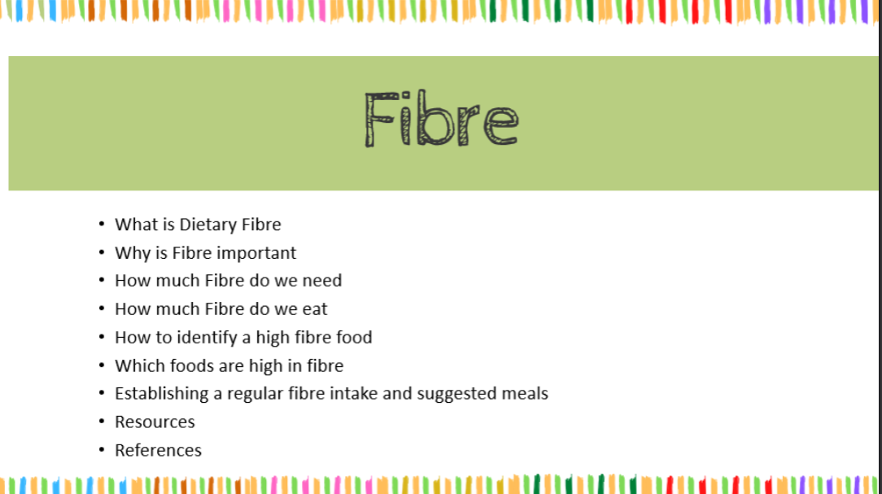
Team Educational Presentation
Slides to present to Diabetes MDT before every topic of the campaign
This helps to educate our colleagues and for them to be in line with what we are sharing
Reference, resources and how to use the pack will also be included in this document
Notes:
A unique element to this campaign is the involvement of the MDT.
The each topics includes a slide deck that can be presented to the team at the beginning of each project. Ideally everyone will learn something and it means health lifestyle messages will be consistently given.

Slide 13
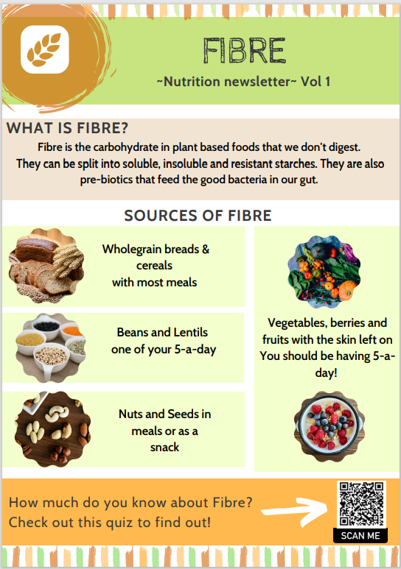
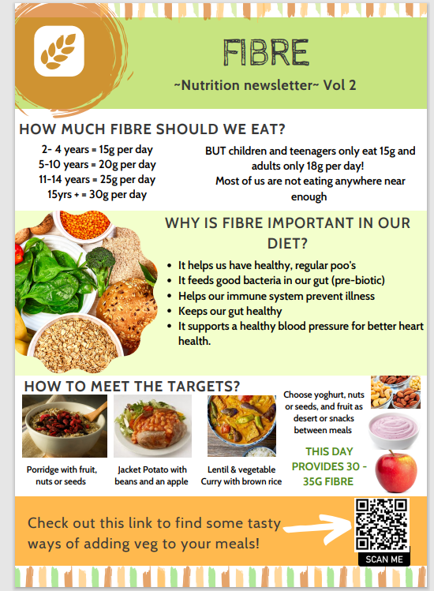
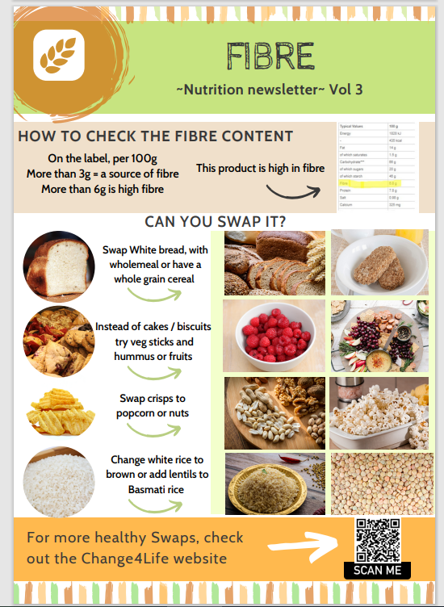
Newsletters
Notes:
Newsletter can be sent via email, whatsapp, digibete or social media.
We recommend send one out a month
They can also be printed and used as posters in clinic or as dietetic resources.
All include QR codes that link for further information.

Slide 14
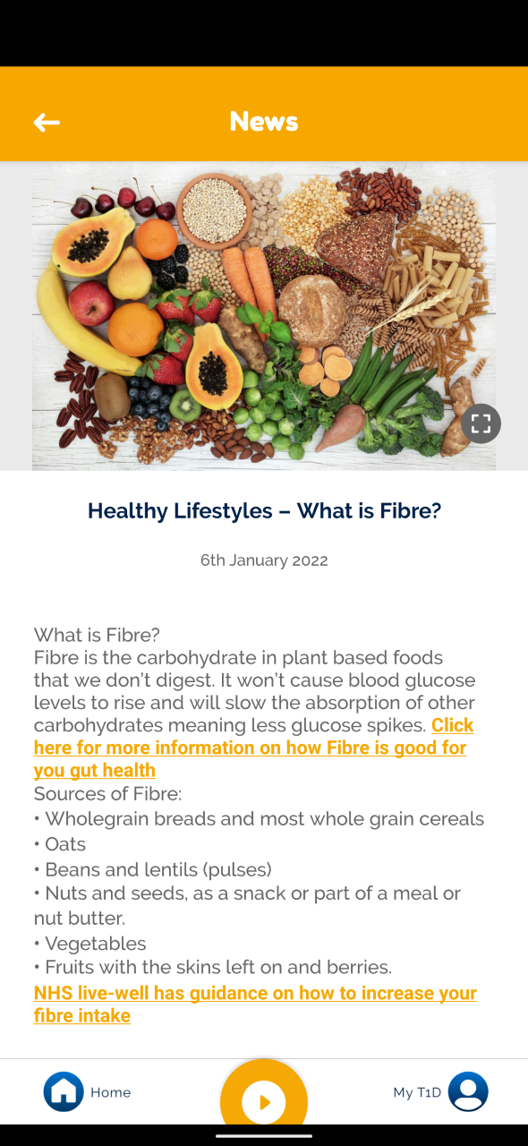
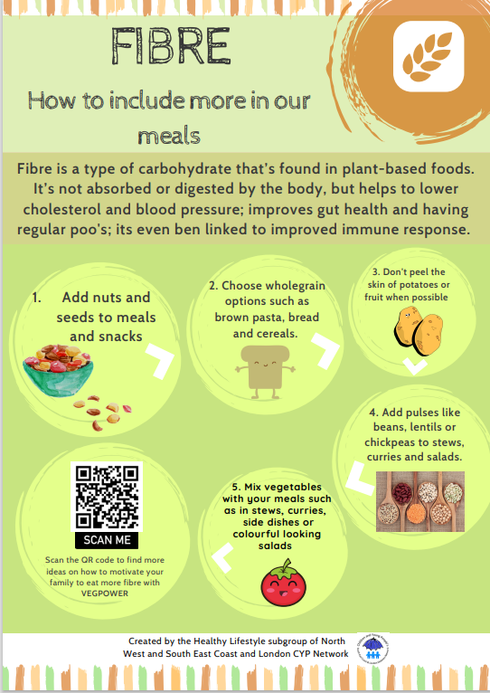
Virtual Resources
Digibete post draft
Digital poster to put in screens or to have available in clinics
Notes:
There are slides decks call 'social media; slides which guide you on how to upload the newsletter to digibete and have them sent out to your clinic.
There are also TV slides which can be uploaded to clinic hospital TV screens.

Slide 15
Links to more Guidance
Waiting room presentations for services that have screens
The use of QR codes to signpost to other resources
Notes:
All the resources have QR codes and links to further information

Slide 16
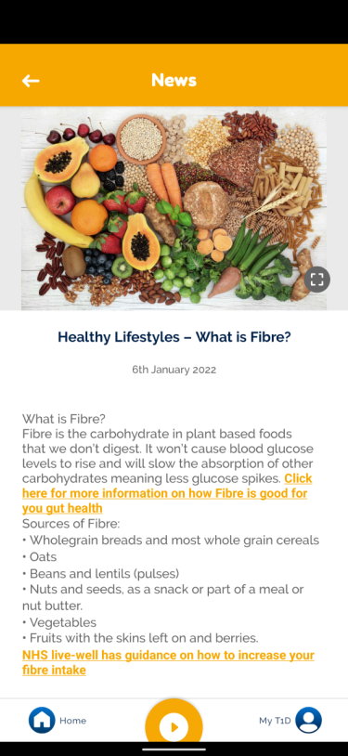
Ways of using the toolkit
3 months per topic. 1 post in Digibete/social media 1 and newsletter per month
Health Promotion Campaign 2 years
Present the concept to your MDT and apply the questionnaire
Display poster
1)
Notes:
Ideally you would use the tool kit as a campaign
So each quarter using a new topic, presenting to your MDT , displaying the posters and sending the newsletter our virtually

Slide 17
Ways of using the toolkit
Use resources to educate families in case you spot specific needs of education in areas of general healthy living.
2)
Notes:
They can of course be used opportunistically when needed. I.e if a child is constipated using the fiber sheets or the movement resources when trying to encouraged increased activity.
- The resources don’t mention diabetes, they can therefore be used with many different cohorts of patients

Slide 18
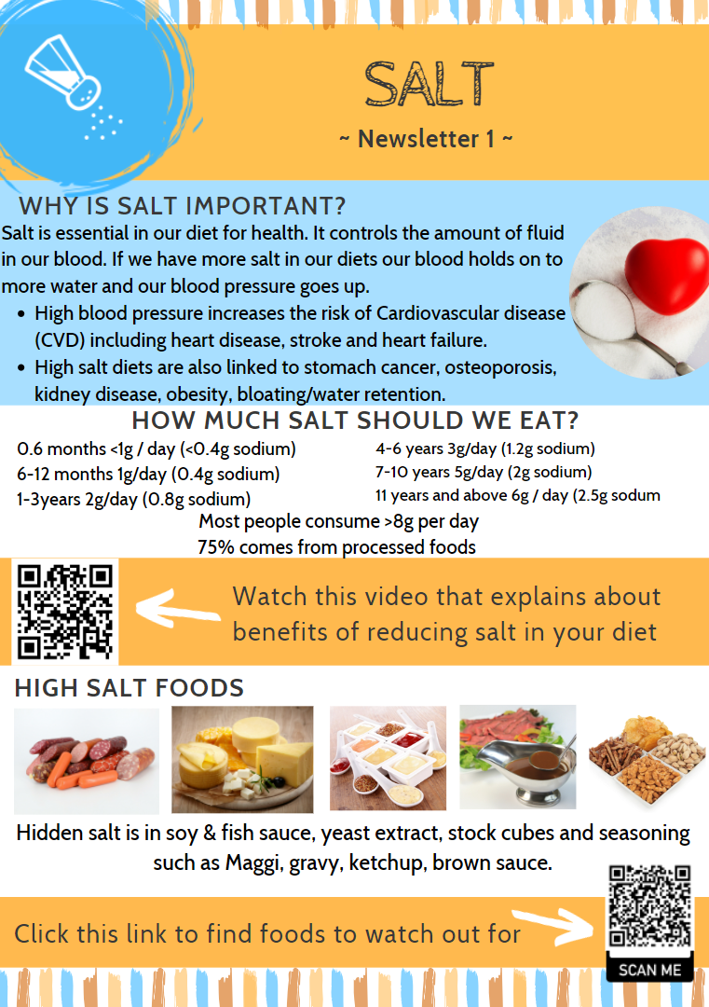
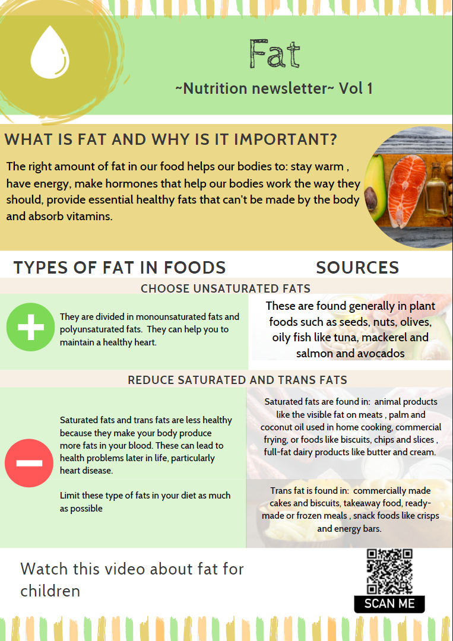
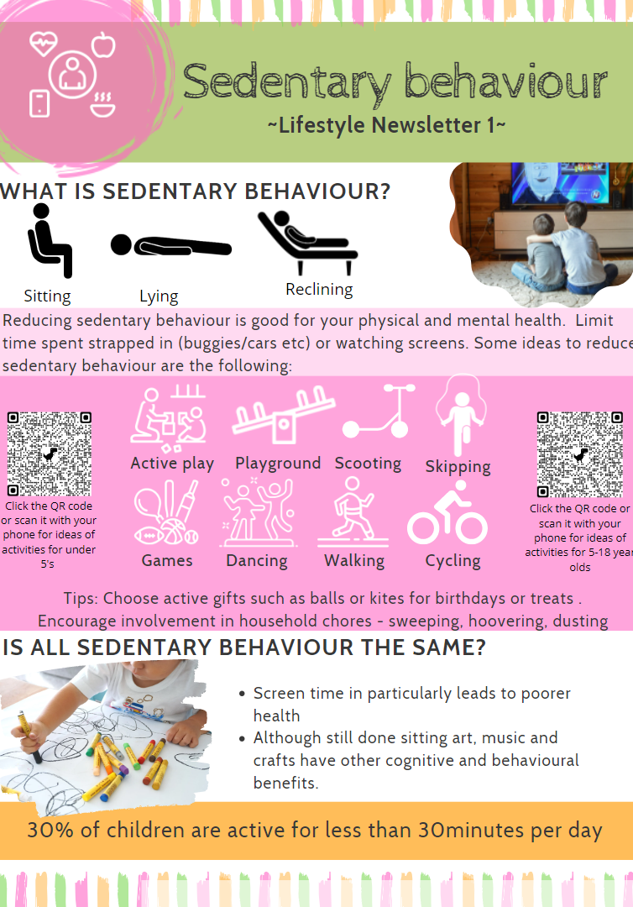
Year 1 content
Notes:
The year 1 content includes fibre, salt and fat
And lifestyle behaviour sheets

Slide 19
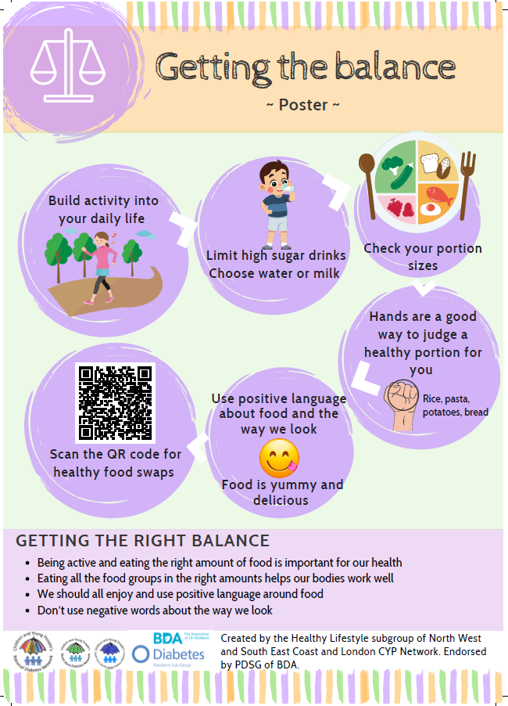
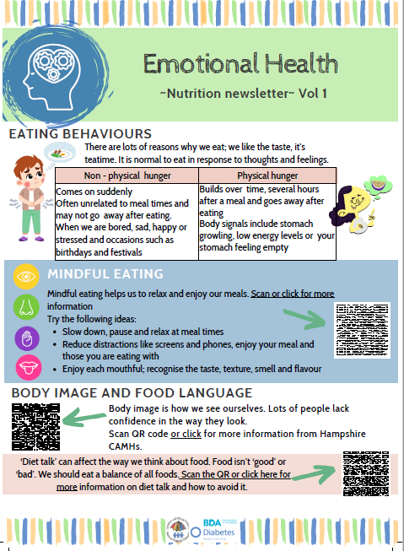
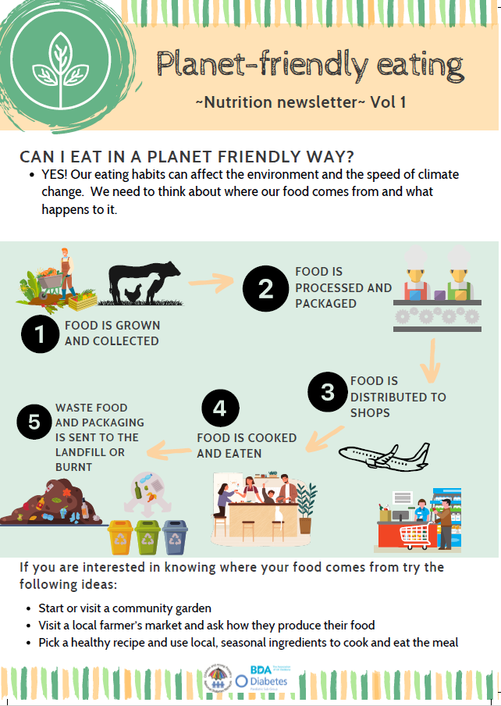
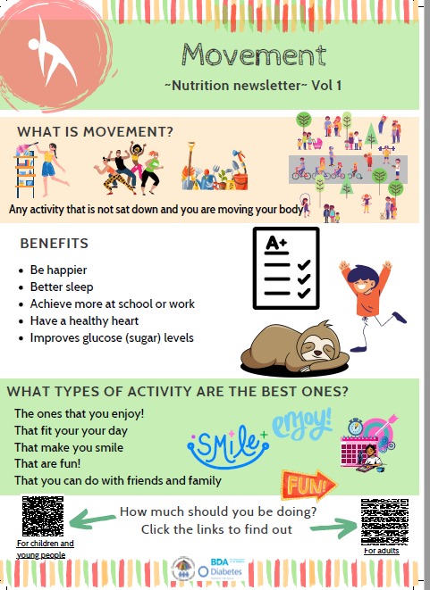
Year 2 content
Notes:
Year 2 content has been signed off in OCtober 2025 by the national diabetes network and is to be uploaded onto the CYP diabetes network website

Slide 20
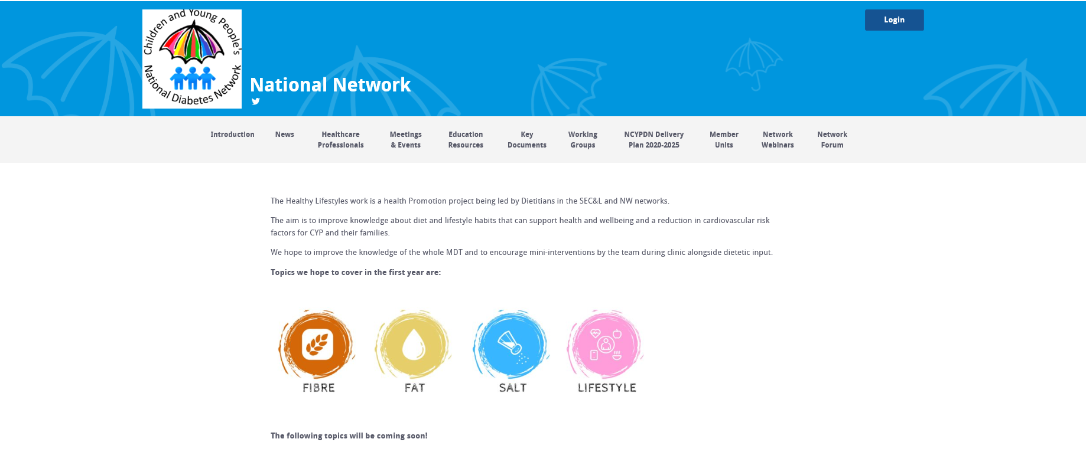
Where to find the resources
Website: South East Coast & London and North West Health Promotion Project - National Network (cypdiabetesnetwork.nhs.uk)
Notes:
Here is the website where all the resources can be found

Slide 21
WORKING GROUP
Contacts:
Kate Henson
kate.henson@mft.nhs.uk
Paula Chinchilla
paula.chinchilla@nhs.net
Jonathan Maiden
jonathan.maiden@nhs.net
Usha Parkash
Usha.parkash@nhs.net
Paediatric Diabetes Dietitians from:
Barts Health NHS Trust
London North West University NHS Trust
North Middlesex University NHS Trust
Manchester Foundation NHS Trust
Salford Royal Foundation NHS Trust
Stockport NHS Foundation Trust
Dartford and Gravesham NHS Trust
Royal Alexandra Hospital
St Mary's Hospital, Imperial College Healthcare NHS Trust
Medway NHS Foundation trust
Royal Wolverhampton NHS Trust
Notes:
The resources have been created and supported by paediatric dietitians from many different units across the UK.
The groups is chaired by Kate Henson and Paula Chinchilla
Usha Parkash has supported the project from it inception
Jonathan Maiden has been supporting us with the meetings, has created the survey monkey, has created a data tool to collate the questionnaire data and can support team with gaining access to their questionnaire data

Slide 22
Endorsement & Thanks
Readability checks and testing (Thanks to Lynn Burney)
Proofread (Thanks to Tracey Wiggham @ Cardiff and Vale)
Youth / peer review (Thanks to Adele Swart)
Data collected and
Reviewed and endorsed by
  National CYP diabetes network lead dietitians
  Paediatric specialist diabetes group of the BDA (Thanks to Jenny Brown)
Notes:
We would like to thanks everyone for their contributions to making these resources happen,

