Slide 1
HEALTH PROMOTION - SALT
Brought to you by: South East Coast & London, North West Dietitian Network

Slide 2
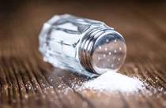
Salt
What is Dietary salt
Why is salt important
How much salt do we need
How much salt do we eat
How to identify a high salt foods
How to reduce salt in our diet
Establishing a regular intake, suggested meals
Resources
References
Before we start, lets see how much you know about salt:
SALT QUIZ

Slide 3
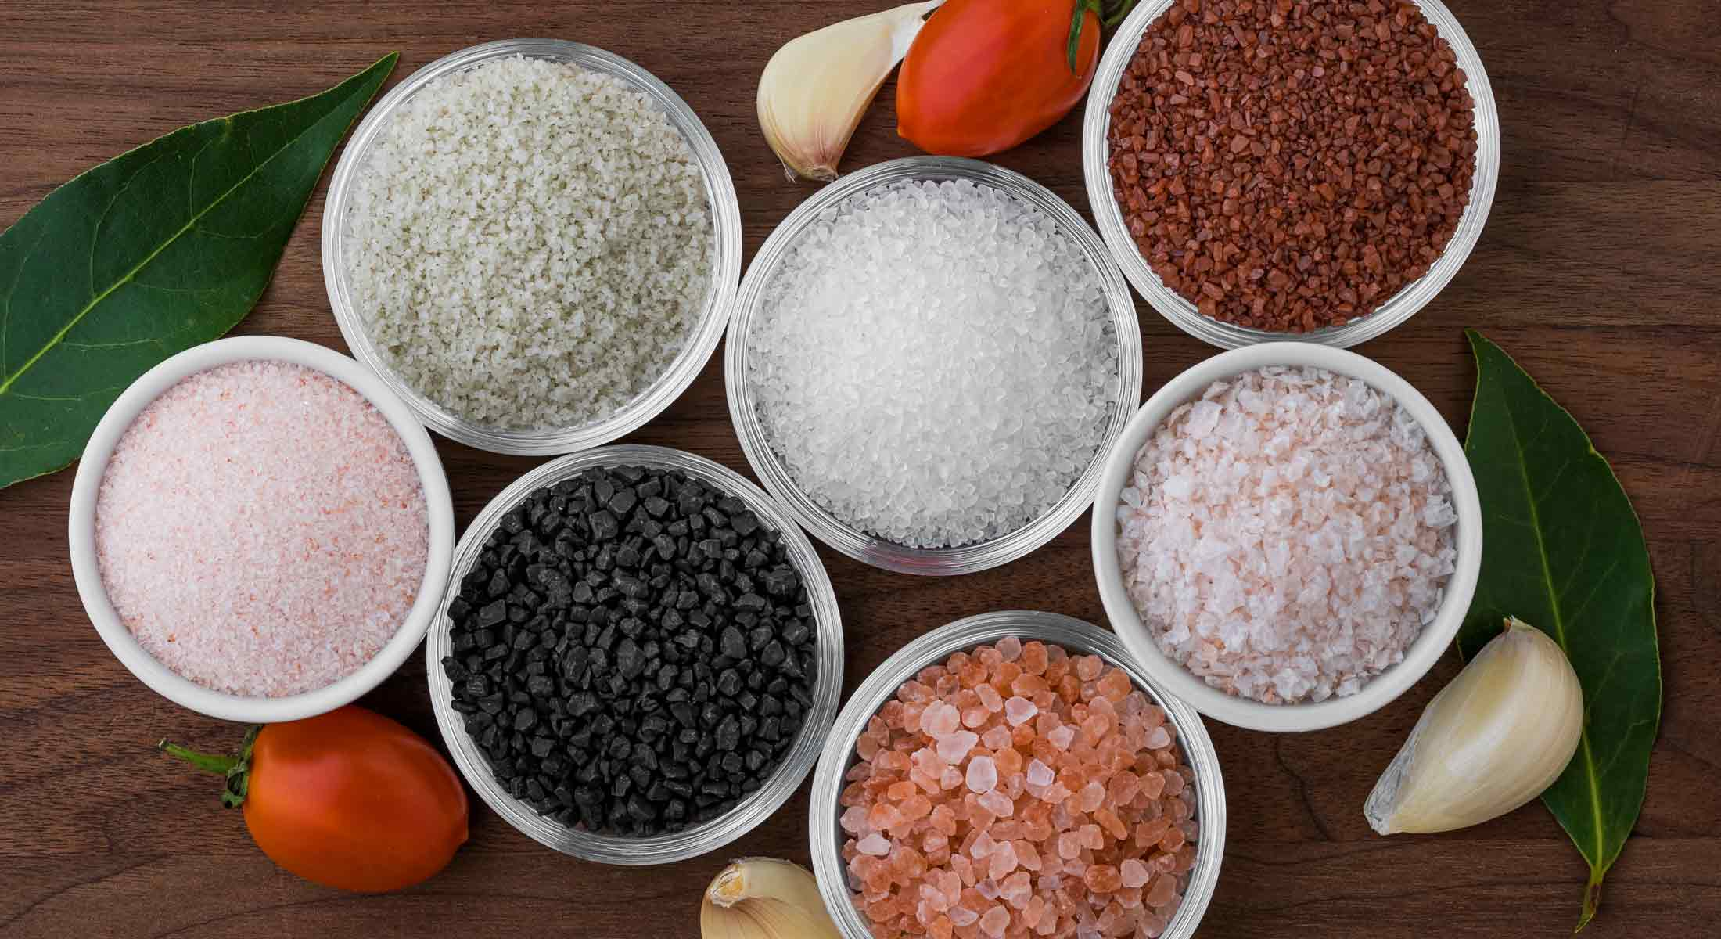
What is Dietary Salt ?
The salt we use to season our food is called table salt or sodium chloride
Salt is listed as sodium on food labels
Other types of salt (Less process, equal amount of sodium & nutrients as table salt)
Pink salt
Black salt
Rock salt
Crystal salt
Salt flakes

Slide 4
Why is Salt Important?
The kidneys uses some sodium to control the amount of water in our blood
Regularly eating too much sodium, causes water to be pulled back into the blood stream
Too much water in the blood vessel causes the blood pressure to increase
Too much salt in our diets increases risks for developing:
High blood pressure & may increase the risk of developing heart & circulatory diseases, such as heart attack, heart failure, stroke & vascular dementia in adults
High blood pressure, Osteoporosis & indirectly obesity in children
Notes:
https://www.bhf.org.uk/informationsupport/heart-matters-magazine/nutrition/sugar-salt-and-fat/hold-the-salt

Slide 5
HOW much Salt do we need ?
Age | Maximum salt per day | Maximum Sodium per day
0-6 months | <1g | <0.4g
6-12 months | 1g | 0.4g
1-3 years | 2g | 0.8g
4-6 years | 3g | 1.2g
7-10 years | 5g | 2g
11 years and older | 6g | 2.5g
Adults | 6g | 2.5g

Slide 6
How much salt do we eat ?
The average adult in the UK is thought to eat around 8.1g salt a day
The average salt consumption for adults had reduced by 0.9grams/day between 2005 & 2014
A cross sectional study in 2014 of 340 CYP from South London:
5 & 6 year olds consumed 25% too much
8 & 9 year olds consume 34% too much
13-17 year olds consumed 25% too much
Boys tended to consume more salt than girls
Main sources of dietary salt in this study came from breakfast cereals (36%, including bread 15%), meat products( 19%), milk & milk products (11%)
Reducing salt intake by around 2.5g/day can reduce the risk of having a stroke or heart attack later in life by a quarter
Notes:
A cross sectional study in 2014 of 340 CYP from South London:
5 & 6 year olds consumed 3.75 g of salt each day
8 & 9 year olds consumed 4.71 g of salt each day (1.7g too much)
13-17 year olds consumed 7.55 g of salt each day
Boys tended to consume more salt than girls
Boys had about 1 g more of salt per day in 5-6 year olds & 2.5 g
per day more in 13-17 year olds
Main sources of dietary salt in this study came from breakfast cereals (36%, including bread 15%), meat products( 19%), milk & milk products (11%)

Slide 7
How much salt do we eat ?

Slide 8
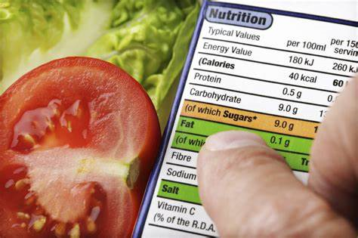
Food labels
What should I look for on the label?
You may see ‘sodium' listed rather than salt → to convert sodium into salt, multiply the amount on the label by 2.5.
There can be a really big difference between different types & brands
Some products also have colour coding on the front & tells you at a glance if the food has low, medium or high amounts of salt
** add food scanner app **

Slide 9
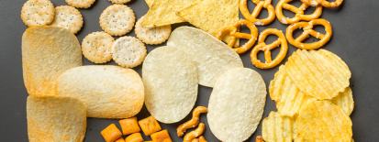
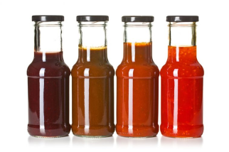
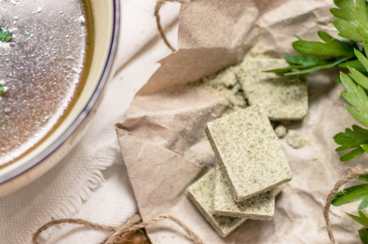
Food High In Salt
Some high salt foods
Salt can be hidden in store cupboard ingredients
Cheese
Breakfast cereals
Canned & packet soups
Bread, pastries & pizzas
Biscuits, cookies, chocolate & cakes
Salted snacks like crisps, nuts, biscuits & popcorn
Processed meats, sausages, bacon & ham pate or salami
Tinned food with added salt
Smoked & cured meat & fish, prawns & anchovies
Even if the food we eat doesn’t taste salty, it might still be high in salt
Soy sauce
Fish sauce
Yeast extracts
Pasta sauce
Stock cubes & seasonings (Maggi seasoning)
Ready-mixed dry seasonings, rubs & sauces
Gravy
Ketchup
Brown sauce
Mustard
Mayonnaise
Pickles
Processed foods & ready meals

Slide 10
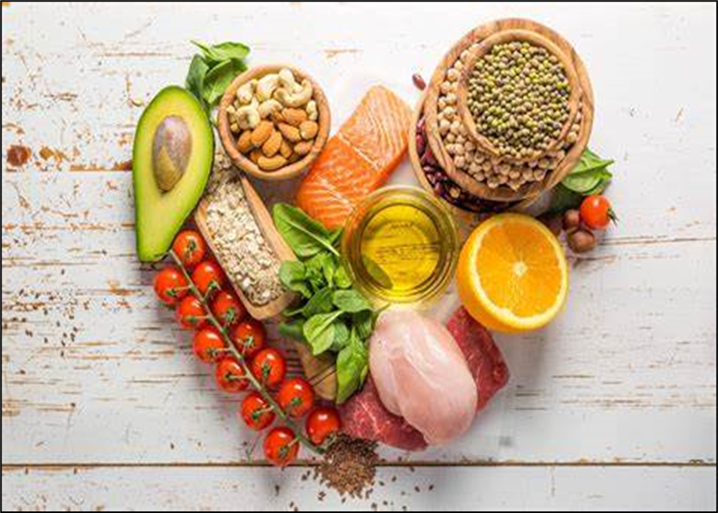
Low salt Foods
Most unprocessed, natural foods are low in salt & sodium

Slide 11
Tips for Eating Less Salt
There are lots of things you can do to make sure your food is still exciting & easy to prepare whilst reducing your salt intake
Gradually add less salt when you’re cooking
You will quickly get used to it
If you’re a salt lover, suddenly going cold turkey could be a shock, so reduce levels gradually
Ditch the table salt most of us eat enough hidden salt without topping up levels further
Don't add salt to your food automatically
Taste it first
Even better leave from your shopping list!
Sauces and stocks - Use them sparingly & go for reduced-salt versions wherever possible
Limit takeaways - Fast foods like pepperoni pizzas & donor kebabs are often high in salt as are many Chinese & Indian takeaways

Slide 12
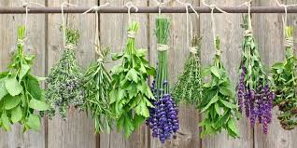
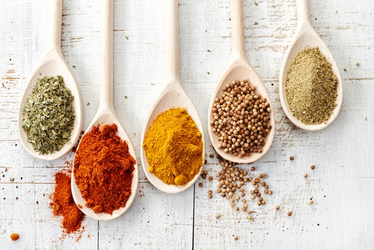
Tips for Eating Less Salt
There are lots of things you can do to make sure your food is still exciting & easy to prepare whilst reducing your salt intake
Cooking techniques
Swap high salt meals, ready-made or processed snacks, sandwich fillers for healthier, home-made options
Try baking or roasting vegetables such as red peppers, tomatoes, courgettes, fennel, parsnips & squash to bring out their flavour
Make sauces using ripe tomatoes & garlic
Try new herbs & spices
Make your own stock & gravy instead of using cubes or granules

Slide 13
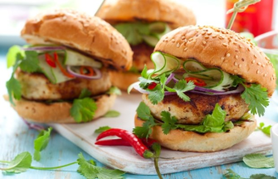
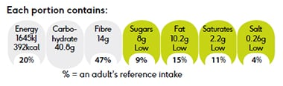
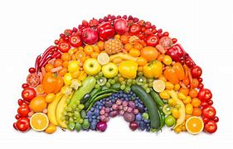
Low Salt Meal Ideas
Breakfast
Lunch
Evening Meal
Cinnamon & Fruit Toast
Turkey Burger
Spanish Style Lentils & Eggs
Tip: use cinnamon, nutmeg & other spices as a flavouring rather than salt
Tip: swop processed meats such as ham and sausage for turkey, chicken. Use Tomatoes, onions & salsa to add flavour
Tip: use roasted tomatoes, peppers & paprika to give flavour here rather than salt
Snacks: Fresh, tinned of frozen fruit chopped/sliced veggie sticks e.g. celery, cucumber, carrots, unsalted nuts, yoghurt

Slide 14
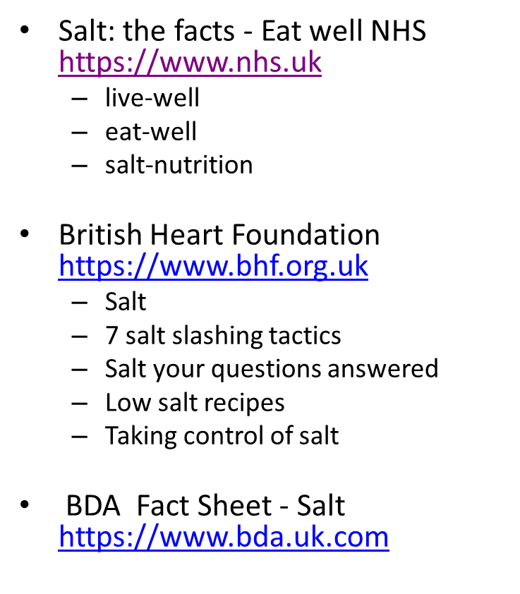
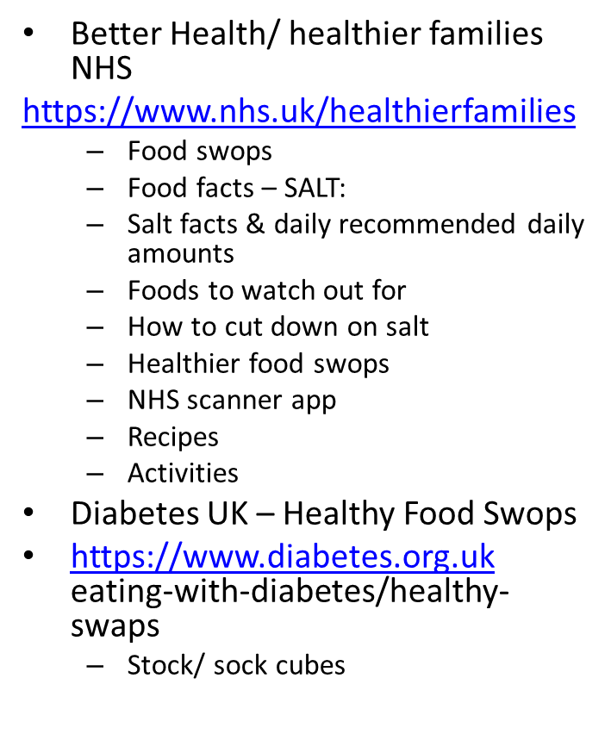
Resources
There are lots of things you can do to make sure food is still exciting & easy to prepare whilst reducing salt intake

Slide 15
References
British heart foundation
https://www.bhf.org.uk/informationsupport/support/healthy-living/healthy-eating/salt
PHE data on salt consumption levels
https://www.gov.uk/government/statistics/national-diet-and-nutrition-survey-assessment-of-dietary-sodium-in-adults-in-england-2014
NHS healthier families –food facts: salt
https://www.nhs.uk/healthier-families/food-facts/salt/
Salt Intake of children and Adolescents in South London
https://doi.org/10.1161/HYPERTENSIONAHA.113.02264

