Slide 1
HEALTH PROMOTION – Fibre
South East Coast & London + North West Dietitian Network

Slide 2
Fibre
MDT training Slides
What is Dietary Fibre
Why is Fibre important
How much Fibre do we need
How much Fibre do we eat
How to identify a high fibre food
Which foods are high in fibre
Establishing a regular fibre intake and suggested meals
Resources
References

Slide 3
Fibre
MDT training Slides
How much do you know about Fibre Quiz:
https://www.bhf.org.uk/informationsupport/heart-matters-magazine/nutrition/fibre/fibre-quiz

Slide 4
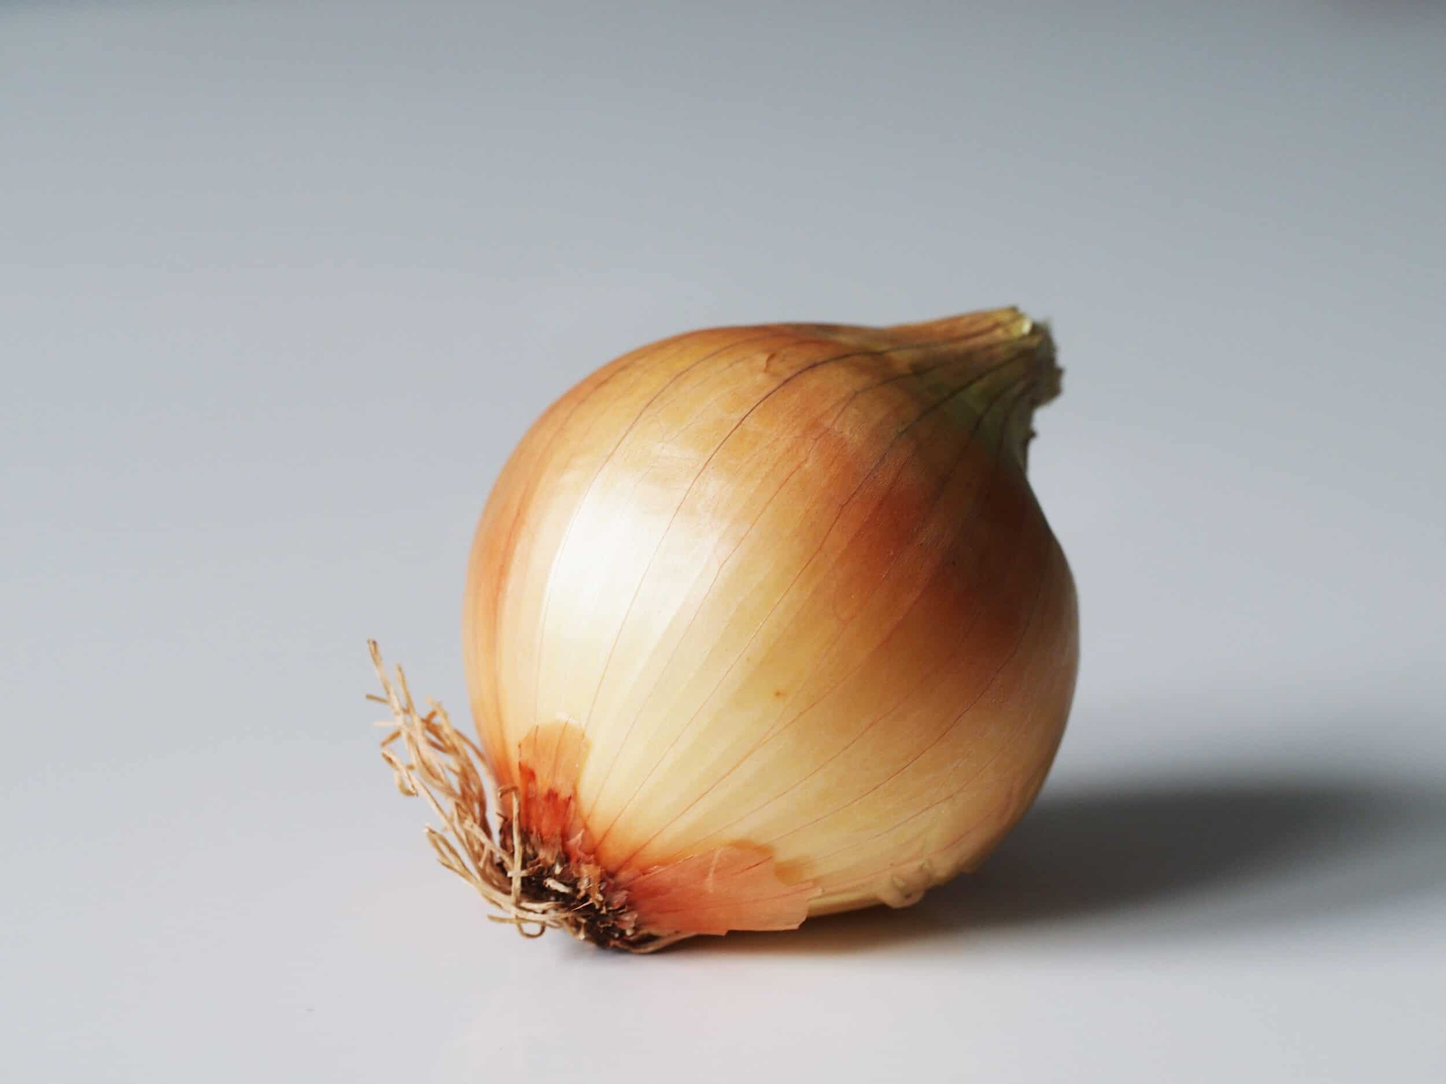
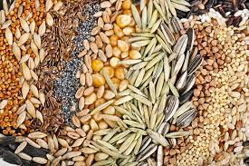
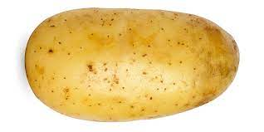
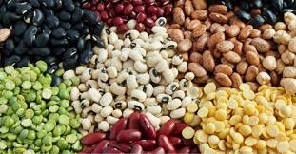
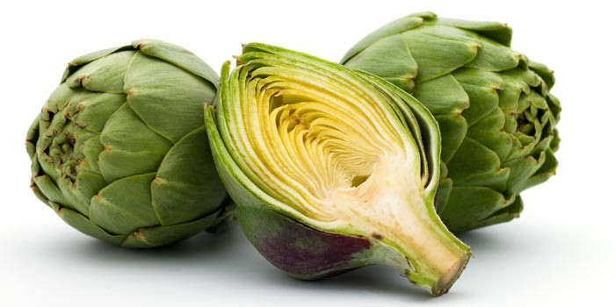
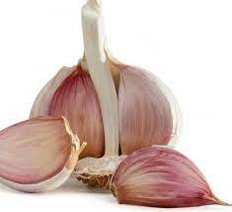
What is Dietary Fibre?
All carbs that are neither digested nor absorbed by the small intestine. They can be broken down or fermented in your large intestines.
Soluble Fibre
attracts water, softens stools
found in fruit, vegetables, nuts, pulses, oats & barley
Insoluble fibre (usually viscous)
bulking agent to soften and enlarge stools and reduce transit time
Found in wheat bran, seeds, grains and nuts
Resistant Starch(RS) and the products of starch digestion
soluble fibres that are fermentable by ‘good’ bacteria in the large intestine to produce short chain fatty acids (SCFA) and increase faecal mass
Bananas, cereal grains, seeds and pulses, cooked and cooled starchy foods such as potato
Prebiotics: Carbohydrate that gut bacteria feed upon
Found in onions, garlic, asparagus, bananas, artichoke
Notes:
Originally it was thought that dietary fibre was completely indigestible and did not provide any energy. It is now known that some types of fibre can be fermented in the large intestine by gut bacteria (collectively known as the gut microbiota), producing short-chain fatty acids and gases (methane, hydrogen and carbon dioxide). The fatty acids are absorbed into the blood stream and provide a small amount of energy which can be used by the cells lining the colon and are thought to strengthen gut barrier function. The amount of gas produced depends on the type of fibre eaten and the gut bacteria present.

Slide 5
Why is Fibre important?
Improve the diversity of your gut microbiota
Reduces constipation
Enhance immunity
Reduce inflammation in your gut
Reduced blood pressure & cholesterol
Strong evidence that diets high in fibre are associated with a lower risk of cardiovascular diseases, type 2 diabetes and bowel cancer.
Notes:
Dietary Fibre is essential for our gut to work normally. It increases the beneficial bacteria in the gut and improves your immune system
From British Nutrition Foundation summary
Fibre and digestive health
Sources of less fermentable fibre can act as bulking (laxative) agents and help prevent constipation. For fibre to have the best effect on preventing constipation, an increase in fibre intake should be accompanied by an increase in fluid intake. Some oligosaccharides (a type of fibre with a shorter carbon chain length) can be fermented by gut bacteria and may have a beneficial effect on the gut microbiota.
Eating a diet low in fibre is associated with diverticulitis (where the bowel wall becomes inflamed and ultimately damaged) and colorectal cancer. Evidence suggests a protective effect of eating a diet rich in dietary fibre on diverticulitis (particularly fruit and cereal fibre) and colorectal cancer.
Fibre and heart health
Some fermentable fibres eaten in large amounts can help reduce blood cholesterol levels. Diets rich in fermentable fibre, such as fruits and grains, and in particular oats, have been shown to reduce low density lipoprotein (LDL)-cholesterol.
Fibre and type 2 diabetes
Dietary fibre has been shown to improve glycaemic control and has an important role in managing diabetes.
Studies suggest that a high intake of dietary fibre reduces the risk of developing type 2 diabetes. There is also evidence specifically for higher intakes of cereal fibre and higher wholegrain consumption and lower incidence of type 2 diabetes.
Fibre, energy balance and bodyweight
The SACN carbohydrates report concluded that there was no evidence from randomised trials to show that dietary fibre intake influences bodyweight changes or energy intake. They said that there was limited evidence from trials that a higher intake of wholegrains may decrease total dietary energy intake, but that more evidence is needed to confirm this. A systematic review published in 2020 did not find evidence that wholegrains had an effect on body weight.
Studies looking at the effect of fibres and fibre-rich foods on appetite, energy intake and body weight have had inconsistent results. However, a systematic review and meta-analysis of randomised controlled trials published in 2020 found that intake of viscous fibres such as beta-glucan, psyllium or guar gum can result in modest reductions in body weight, BMI and waist circumference. It was suggested that viscous fibres could affect energy intake as they increase the viscosity of the gut contents, promote gastric distention and slow gastric emptying as well as potential effects on satiety hormones.
Fibre and the gut microbiome
The human gut microbiota (the community of microorganisms in the gut) is estimated to number approximately 100 trillion organisms – mainly bacteria but also viruses, fungi and other micro-organisms. The gut microbiota has important roles in immunity, digesting food, gut hormone and neurological signalling, the metabolism of drugs and elimination of toxins. There has been growing interest in the potential impact of the bacteria in our gut on health and disease, and how our diet could modulate this.
The gut microbiota develops from birth and early childhood and then tends to remain relatively stable from later childhood to adulthood. The balance of different bacterial species in the gut varies between individuals and can be affected by factors including mode of birth (vaginal or caesarean section), infant feeding, lifestyle, medications, and genetics. There is currently no agreed definition of exactly what makes a ‘healthy’ gut microbiota but having a greater diversity of species is associated with positive effects and certain bacterial strains produce compounds that are associated with health benefits.
A plant-rich diet can provide fermentable fibres such as inulins and galacto-oligosaccharides which are ‘pre-biotic’, that is, they provide food for beneficial bacteria species such as Bifidobacterium and Lactobacillus, selectively increasing their numbers in the gut. When such species ferment fibres, they produce the short-chain fatty acids acetate, butyrate and proprionate. These compounds provide an energy source for the cells in the gut as well as having potential roles in in modulating hormones such as peptide YY (PYY) and glucagon-like peptide 1 (GLP-1), that are involved in appetite control and glucose metabolism. Fermentation of prebiotic fibres also promotes the protective layer of mucus on the gut wall, providing a strong barrier function that is important for maintaining a healthy gut. Conversely, diets high in animal fats and protein and low in fibre may promote ‘dysbiosis’, an unfavourable imbalance of bacteria in the gut, resulting in lower production of short-chain fatty acids, a leaky gut mucosa and intestinal and systemic inflammation.
The evidence on fibre and health
The 2015 SACN report on Carbohydrates and Health reviewed the wealth of available evidence for the links between fibre and health outcomes. SACN concluded that there is strong evidence from prospective cohort studies that diets rich in fibre, particularly cereal fibre and wholegrains, are associated with a lower risk of cardiovascular disease, coronary events, stroke, type 2 diabetes and colorectal cancer. The randomised controlled trials included in the report did not show an effect of dietary fibre intake on type 2 diabetes or cardiovascular risk factors such as fasting blood lipids, glucose or insulin, but did support the role of fibre in bowel function (decreased intestinal transit times and increased faecal mass). Find out more about the report from SACN's website.
Most of the evidence for the wide range of health benefits of fibre comes from studies where the exposure reflects dietary fibre intakes achieved through a variety of foods where it is present as a naturally integrated component. Therefore, it is recommended that fibre intakes should be achieved through a variety of food sources.
A low fibre intake is associated with constipation and gut diseases such as diverticulitis and bowel cancer.

Slide 6
How much Fibre do we eat?
< 2yrs no recommendations, however, to gradually increase diversity in the diet, including wholegrains, pulses, fruit and vegetables.
Along with fibre it is important to have adequate drinks of 6-8 drinks water per day
Age | SACN 2015 (recommendations) | Nutrition & Diet survey 2020
2-4years | 15g/day | 10.4g/day: 12% met recommendation
5-10years | 20g/day | 14.3g/day: 14% met recommendation
11-14years 15 years + | 25g/day 30g/day | 16g/day: 4% met recommendation 19.7g / day. 9% of adults met recommendation
Notes:
In the UK average intake in adults is 20g, children less. Socio-economic disparities exist with lower intakes in the lowest income quintile compared to the highest, in all age groups and in both sexes.
In the UK, most dietary fibre in the average adult’s diet comes from vegetables, pasta and rice, white bread, fruit and chips and other potato products. In children (aged 4-10 years) and teenagers, the biggest contributors to fibre intake are fruit, vegetables, white bread, pasta and rice and high-fibre breakfast cereals.
https://www.gov.uk/government/collections/national-diet-and-nutrition-survey

Slide 7
How to meet the Targets
- Here are some example high fibre meals.
- Eating these 3 meals and 3 snacks would meet adult fibre recommendations
Notes:
Wider points to consider;
As well as educating parents what are schools doing? Can we involve them
National School fruit and vegetable scheme- all 4-6 year olds in state funded infant, primary and secondary schools will receive a free piece of fruit or veg every day. Nhs.uk/live-well/eat-well/school-fruit-and-vegetable-scheme
School food standards- voluntary, no statutory monitoring.
School food plan website- http://www.schoolfoodplan.com/Children in reception,
Year 1 and Year 2 receive free school meals https://www.gov.uk/government/news/free-school-lunch-for-every-child-in-infant-school

Slide 8
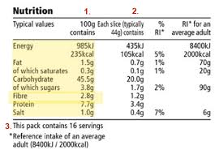
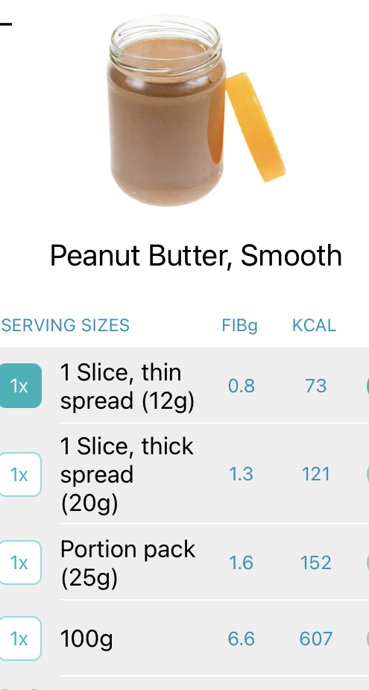
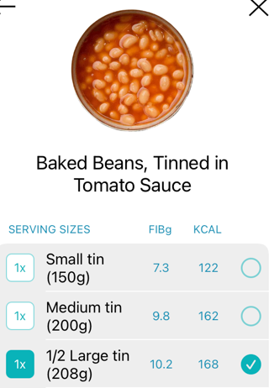
Food labels- how to identify a food high in fibre
Voluntary for fibre information to be displayed
Fibre content per 100g of the food
A ‘source of’ fibre: 3g per 100g
‘high in’ fibre: 6g per 100g
You may also see ‘source of fibre’ or ‘high in fibre’ on the front of food packets
Available on Carbs&Cals App
Notes:
Fibre is a source of energy providing on average 2kcal per gram.

Slide 9
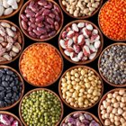
Fibre rich foods
Cereals and Carbohydrates per 100g
Shredded whole wheat or bran cereals 13- 24.5g
Rolled oats 9g
Popcorn 8.5g
Wholemeal/ multigrain bread 7g
Wholemeal pitta 5.8g
Barley 4.5g
Wholemeal spaghetti (boiled) 4.2g
Baked potato with skin 2.6g
Fruit and Vegetables
Figs 6.9g
Parsnip (boiled) 4.7g
Strawberries 3.8g
Swede 3g
Broccoli (boiled) 2.8g
Nuts and seeds per 100g
Almonds 7.4g
Peanuts 7.6g
Sesame 7.9g
Sunflower seeds 6.0g
Peanut butter 6.6g
Peas and beans
Lentils 6.3-7.4g
Chickpeas 7.1g
Kidney Beans 6.8g
Soya /Edamme beans 6.3g
Peas (boiled) 5.6g
Baked beans (in tomato sauce) 4.9g
Green beans (boiled) 4.1g
Notes:
Consider;
Fibre
Processing such as cooking, drying, chopping or blending of fruits and vegetables can lead to significant changes in dietary fibre content in terms of amounts and functionality

Slide 10
Establishing a regular fibre intake
Wholegrain bread and cereals with each meal
Beans and lentils = one of your 5-a-day
Nuts and seeds added to meals or as a snack
Fruit & Vegetables at each meal and as snacks - offer 3 servings of each per day
Notes:
Toddlers- fibre load from wholegrain maybe too high for some toddlers restricting energy/too filling/phytate levels can decrease absorption of some nutrients and exacerbate loose stools
Remember portions are small- Henry/Infant & toddler forum/Caroline Walker trust
Wider points to consider;
Healthy Start Vouchers- exchange for cows milk/formula/fruit and vegetables
Sure start- cook and eat sessions?

Slide 11
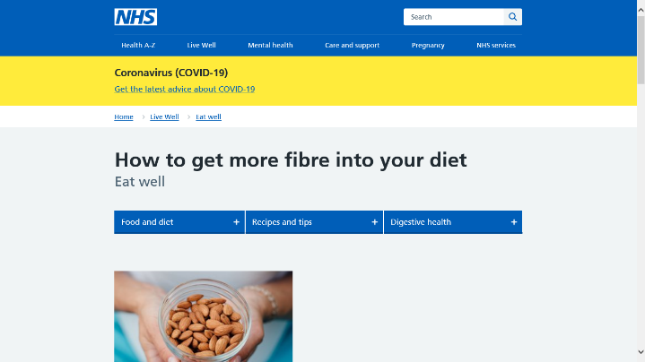
Resources- How are we getting the message across
Eating habits questionnaire
Education of MDT team
Health promotion poster
Resources
Newsletter
Digibete
Repeat Eating habits questionnaire after 1 year
Notes:
Quizzes, information, recipes

Slide 12
References
Fibre- Report on carbohydrates SACN 2015
https://www.gov.uk/government/publications/sacn-carbohydrates-and-health-report
National Diet and Nutrition Survey: Diet Nutrition and physical activity in 2020. A follow up study during covid
https://www.gov.uk/government/collections/national-diet-and-nutrition-survey
Clinical Paediatric Dietetics 5th Edition 2020
British Dietetic Association Food Facts Fibre 2021
https://www.bda.uk.com/resource/fibre.html
British Nutrition Foundation
https://www.nutrition.org.uk/healthy-sustainable-diets/starchy-foods-sugar-and-fibre/fibre/
Notes:
Childhood obesity strategy

