Slide 1
FAT - HEALTH PROMOTION PROJECT
South East Coast and London Dietitian Network

Slide 2
Contents
Macronutrients
Why is Fat important
Sources of fat and its role
How to identify a high fat food
How much fat do we need
How much fat do we eat
Which foods are high in fat
Establishing an appropriate fat intake
Summary
References
South Coast and East London Dietitian Network

Slide 3
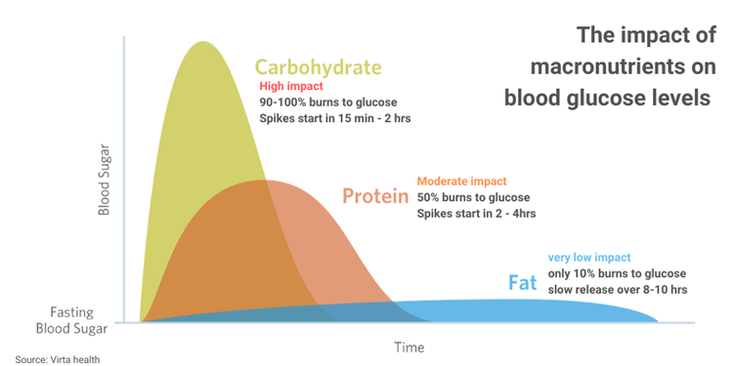
Macronutrients
Carbohydrates (4kcal/g)
Protein (4kcal/g)
Fat (9kcal/g)
South Coast and East London Dietitian Network

Slide 4
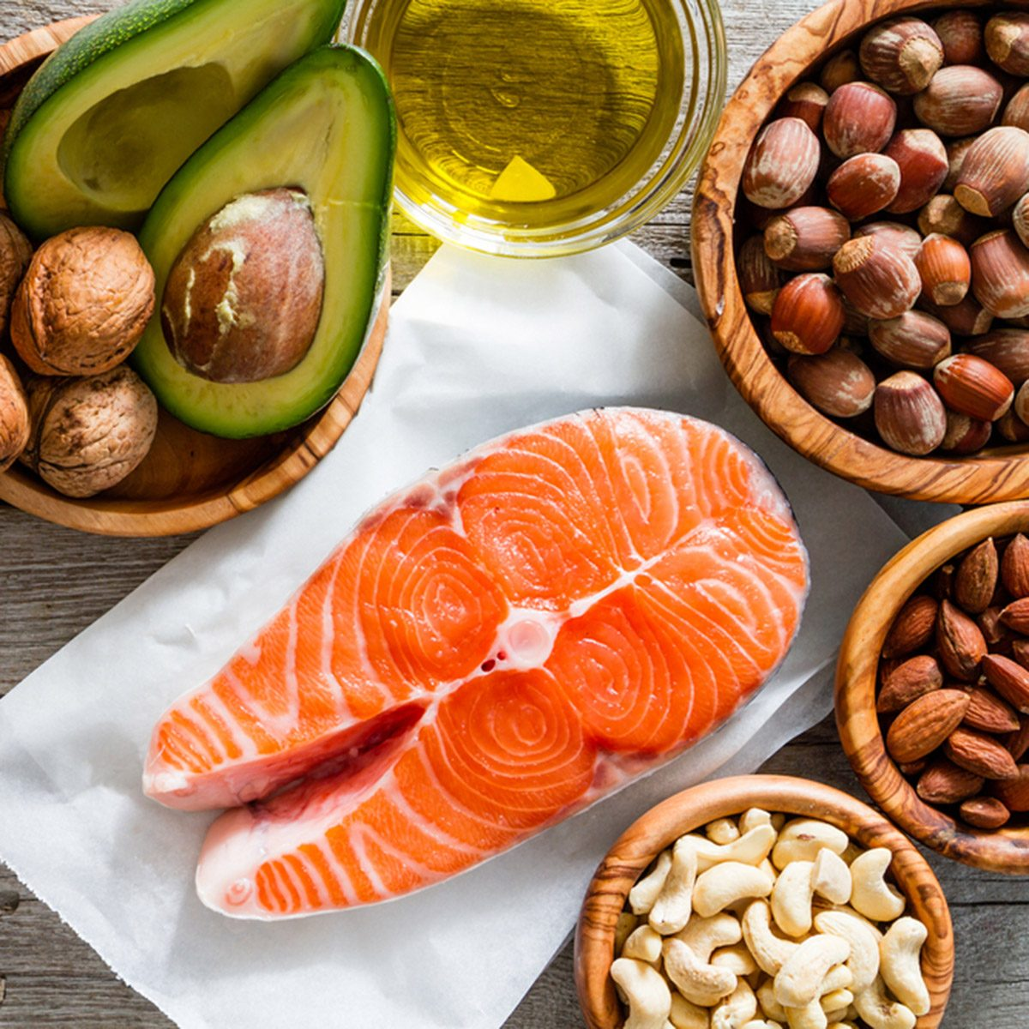
Why is Fat Important
Important structural component of cell membrane, ‘lipid membrane’
Warmth – prevents heat loss
Energy storage
Chemical signals - hormone like functions
Fat soluble vitamins (A, D, E and K)
Satiety
Fat carries flavour and adds creamy texture to foods
South Coast and East London Dietitian Network

Slide 5
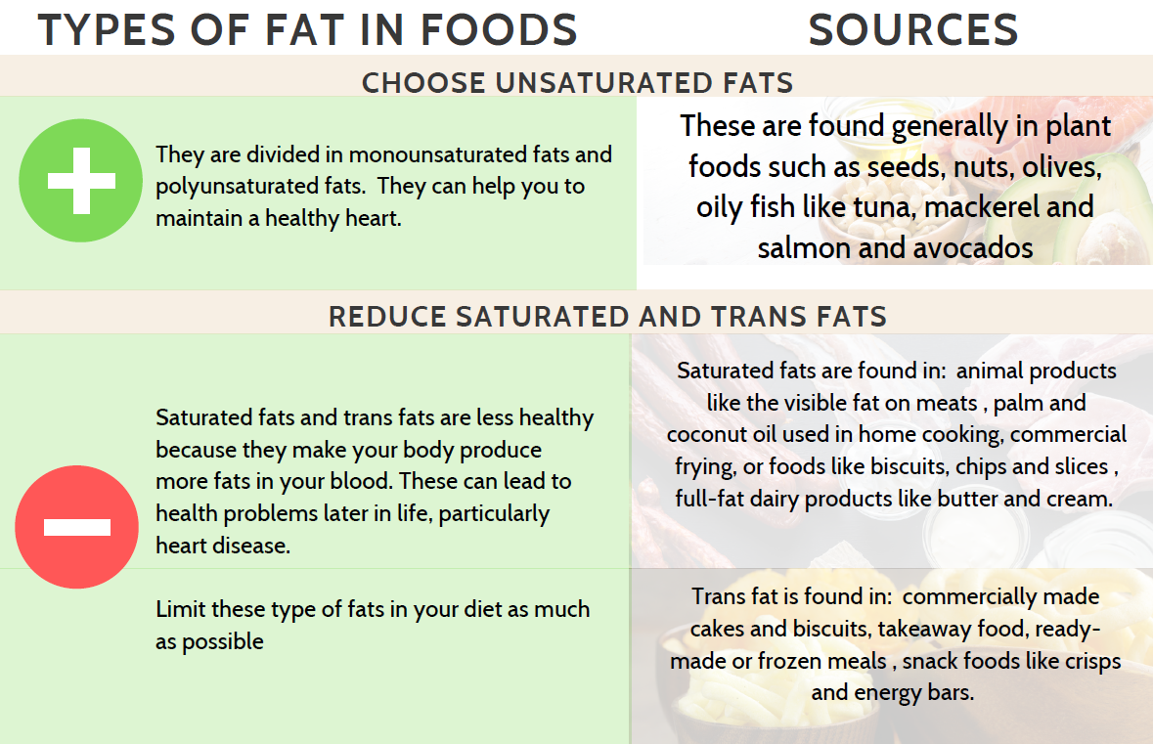
Types of Fat
South Coast and East London Dietitian Network
Notes:
Unsaturated = one or more double bonds causing a bent structure. Generally liquid at room temperature.
Saturated = no double bond, straight structure, solid at room temperature

Slide 6
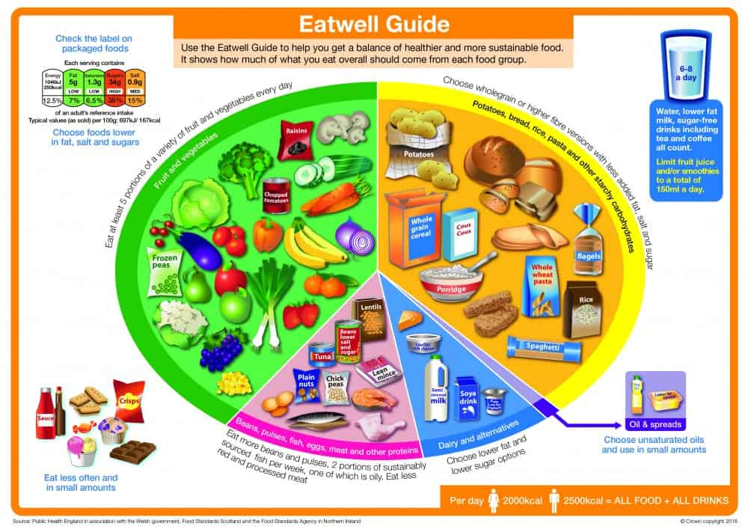
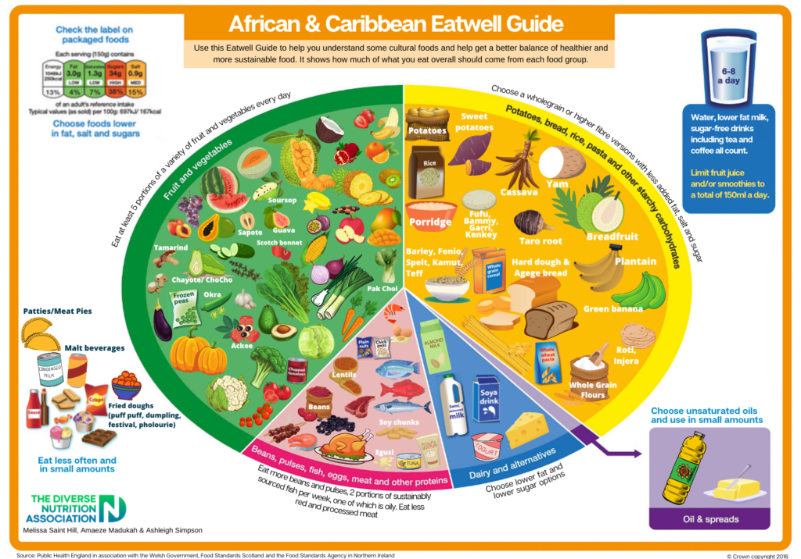
Fat in the Eatwell Guide
South Coast and East London Dietitian Network
Note that the Eatwell Guide has a section for oils and spreads, not fats
Reflects fat content to be observed across food groups – fat in nuts, avocados, protein, calcium sources and carbohydrate

Slide 7
How to Identify Fat Content
Always read per 100g on labelling when comparing foods. Then look at per portion. Be realistic about portion.
Dietary cholesterol translates poorly to blood cholesterol
REDUCED FAT/ LIGHT/ LITE: the reduction in content is at least 30% compared to a similar product.
South Coast and East London Dietitian Network

Slide 8
How Much Fat Do We Need
Total fat – 33% of total calories | Female adult 70g | Male adult 90g
Of which no more than 10% saturated | 20g | 30g
Unsaturated
Trans fats no more than 2% | 5g
Most fat in diet should be unsaturated
Note that saturated and trans fats are not a target but rather an upper limit.
2 portions fish a week, one oily – EFA’s Network

Slide 9
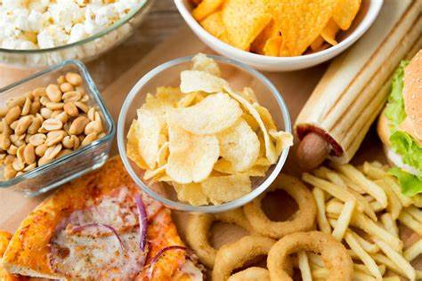
How Much Fat Do We Eat
Total Fat (33% rec)
Age | Mean intake
4 – 10 years | 34.2%
11-18 years | 34.1%
19 – 64 years | 34.1%
65 – 74 years | 34.3%
75 years + | 34.6%
Saturated Fat (no more than 10% rec)
Age | Mean intake
4 – 10 years | 13.1
11-18 years | 12.6
19 – 64 years | 12.3
65 – 74 years | 12.8
75 years + | 14.1
South Coast and East London Dietitian Network

Slide 10
Establishing an Appropriate Fat Intake
Portion size
Cooking method
Reduced frequency eating out/ takeaway
Reduced frequency ready meals
Being realistic
Gradual change – chicken shop x2 a week instead of 4, grilled chicken instead of fried, no mayo, smaller chips
School lunch / packed lunch options
Snack options
Other convenient options
South Coast and East London Dietitian Network

Slide 11
Summary
Fat in the diet is important
We don’t eat too much fat, we eat too much saturated fat
Focus on identifying foods that are high in fat and saturated fat and making realistic changes to reduce intake
South Coast and East London Dietitian Network

Slide 12
Resources
NHS: https://www.nhs.uk/live-well/eat-well/different-fats-nutrition/
Caroline Walker Trust: https://www.cwt.org.uk/publications/
British Dietetic Association: https://www.bda.uk.com/resource/fat.html
First Steps Nutrition Trust (balanced eating for under 5’s, not fat specific): https://www.firststepsnutrition.org/eating-well-resources
British Heart Foundation: https://www.bhf.org.uk/informationsupport/conditions
South Coast and East London Dietitian Network

Slide 13
References
McKee, T. and McKee, J., 2009. Biochemistry. Oxford: Oxford University Press.
Assets.publishing.service.gov.uk. 2022. [online] Available at: <https://assets.publishing.service.gov.uk/government/uploads/system/uploads/attachment_data/file/528193/Eatwell_guide_colour.pdf> [Accessed 12 May 2022].
Diverse Nutrition Association. 2011. [online] Available at: https://www.diversenutritionassociation.com/new-page-1 [Accessed 12 May 2022].
British Dietetic Association, 2021. Fats. [online] Available at: Fat (bda.uk.com)
European Commission. [online] Available at: Nutrition claims (europa.eu) .
First Steps Nutrition Trust, 2021. Good food choices and portion sizes for 1-4 year olds. London: First Steps Nutrition Trust.
Public Health England. 2020. NDNS: results from years 9 to 11 (combined) – statistical summary. [online] Available at: NDNS: results from years 9 to 11 (combined) – statistical summary - GOV.UK (www.gov.uk) .
Committee on Medical Aspects of Food Policy, 2019. Dietary Reference Values. London: The Stationery Office Ltd.
South Coast and East London Dietitian Network

