Slide 1
HEALTH PROMOTION CAMPAIGN
Lifestyle Behaviours
Brought to you by:
South East Coast & London and Northwest Dietitian Network

Slide 2
What is a healthy lifestyle?
The most important behaviours associated with children’s and adolescents’ health status are
Daily physical activity
Spending less than two hours in screen-based sedentary time
Having a healthy diet
Abstaining from alcohol and tobacco consumption
https://www.ncbi.nlm.nih.gov/pmc/articles/PMC6765801/
One of the theories of behaviour change (self-determination theory) encourages the following aspects to achieve behaviour change:
Competence: feel skilled/able to follow a task and being recognised when they achieve
Autonomy: feel that they have control of their lives (letting them decide how best to work around their goals according to their schedules and lifestyle)
Relatedness (impacted by the relationship between HCP and patients)
Significant individuals (e.g., teachers or parents) take on a primary role in supporting children’s and adolescents’ psychological needs, contributing to their motivation for various activities. This maybe their diabetes team as well

Slide 3
What is a healthy lifestyle?
Findings from studies have shown that when engaging in activities for autonomous reasons (i.e., enjoying it or view as important), individuals achieve better results and manifest higher wellbeing.
When tasks are taken on for less autonomous reasons (e.g., to please others or avoid punishment), they have been shown to produce lower achievement and wellbeing
Healthy Lifestyle in Children and Adolescents and Its Association with Subjective Health Complaints: Findings from 37 Countries and Regions from the HBSC Study
https://www.ncbi.nlm.nih.gov/pmc/articles/PMC6765801/#:~:text=The%20most%20important%20behaviors%20associated,consumption%20%5B12%2C13%5D.

Slide 4
What is a healthy lifestyle?
Healthy lifestyles or habits cannot be just be advised. HCP should apply principles of behaviour change to work together with families towards change and be able to maintain that change
Self-monitoring of behaviour,
Support families to track and monitor goals and changes, make use of non-digital and digital approaches
Restructuring the physical environment,
Encouraging families to modify their living environment to maximise behaviour change, for example increase access to healthier food and drink items and moving less healthier items out of sight
coping strategies
supports families on managing challenging situations that can trigger less healthy behaviours
Reward systems:
point charts or family activities (for example fun days out). Using food and drinks as a reward should be avoided
Changing behaviour in families Behaviour change techniques for healthy weight services to support families with children aged 4-11 years
https://assets.publishing.service.gov.uk/government/uploads/system/uploads/attachment_data/file/873555/PHE_Family_Behaviour_Change_Guide__1_.pdf

Slide 5
Why promoting healthy lifestyles is important?
Consuming healthful foods and beverages, doing regular physical activity, getting adequate sleep, and other factors may help children to
Grow
Learn
Build strong bones and muscles
Maintain a healthy weight
Feel good about themselves
Literature has shown that engaging in physical activity and spending less time in screen-based sedentary behaviours are related to fewer health complaints.
Notes:
https://www.bhf.org.uk/informationsupport/heart-matters-magazine/nutrition/sugar-salt-and-fat/hold-the-salt

Slide 6
Sedentary Behaviours
Common sedentary behaviours include TV viewing, video game playing, computer use (collective termed “screen time”), driving the car, and reading.
According to an estimated global average, children accumulate 8 h/day of sedentary time, which represents approximately 50% of the waking day.
30% of children are active for less than 30 minutes per day

Slide 7
Sedentary Behaviours
The link between illness and sitting first emerged in the 1950s, when researchers found double decker bus drivers were twice as likely to have heart attacks as their bus conductor colleagues. The drivers sat for 90 per cent of their shifts, the conductors climbed about 600 stairs each working day.
It is still not clear how much is too much
In Australia they recommend limiting screen time to 1-2 hours per day
Studies have linked being inactive to being overweight, obese, type 2 diabetes, some cancers and early death
Sitting for long periods slows the metabolism, effecting blood sugar, blood pressure and the break down of body fat.

Slide 8
Sedentary Behaviours

Slide 9
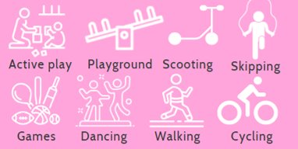
Sedentary Behaviours-advice
Encourage more active play
Discourage sedentary behaviours
Break up long periods of sitting with activity for 1-2 minutes
Reduce the amount of time they spend sitting in cars or strapped into buggies
Choose active gifts such as balls or kites
Involve children in household chores, cooking, gardening, cleaning

Slide 10
Sleep
Quality sleep is essential for growth and development
Children who sleep well do better at school, react more quickly, more developed memory, learn more effectively
Less susceptible to cold, ailments, less irritable and better behaved
It helps improve attention span, memory, learning and growth.
11 to 14 hours sleep including naps
1-2 years
12 to 16 hours sleep including naps
10 to 13 hours sleep including naps
4-12 months
3 to 5 years old
9 to 12 hours
8 to 10 hours
6 to 12 years old
12-18 years old

Slide 11
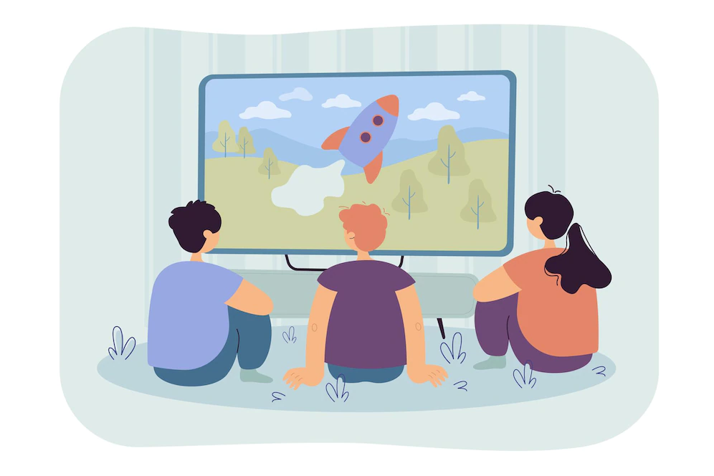
Sleep-advice
A consistent bedtime routine helps to ensure enough sleep in the long term
Think about the environment
Relaxing
no screens, dimmed lights
18 degrees is ideal
Activities such as jigsaws or colouring pictures or breathing exercises can help relaxation
Exercise is good for sleep (not too close to bedtime)
End the day on a positive note by sharing 5 great things that have happened during the day
Avoid caffeine (tea, coffee, cola), large meals, and sugary treats before bedtime, opting for a healthy bedtime snack if necessary

Slide 12
Mealtime routines
Having mealtime routines where the family eats together and distractions are minimal and allowing children some autonomy in terms of food choice and intake have shown to impact positively in fussiness.
Everyone learns by example. Encouraging parents to also have good Your good food choices and eating habits will encourage children to try new foods and enjoy eating.
Have meal times at a similar time every day.
Leave at least 2 hours but ideally 3-4 hours between meals
Avoid grazing
Make meal times happy, relaxed and sociable. Encourage families to chat about their day; what did they learn at school? Give examples of some ice breaker activities

Slide 13
Mealtimes – Fussy eaters
Encourage preparing meals as a family – BDA-Let’s get cooking resource
Motivate parents to involve everyone in meal time decisions. Giving each family member their choice of meal one per week
Praise should be given for trying new things but don't pressure to finish everything
Ignore fussy eating as much as possible
If a meal is refused, avoid offering fatty, sugary or salty foods. This can lead to fussier eating because the young person knows they will have another option

Slide 14
Resources & references
Resources
Mealtime routines
https://www.bda.uk.com/food-health/lets-get-cooking/cooking-at-home.html
Fussy eating Webinar: https://youtu.be/5XkbqPybn1Q
https://www.nhs.uk/conditions/baby/weaning-and-feeding/fussy-eaters/
https://www.cdc.gov/nutrition/infantandtoddlernutrition/mealtime/mealtime-routines-and-tips.html
Sleep
Children: Children - The Sleep Charity
Adults: Sleep and tiredness - NHS (www.nhs.uk)
Sleep well: Sleeping well | Royal College of Psychiatrists (rcpsych.ac.uk)
Sedentary Behaviour
https://www.nhs.uk/live-well/exercise/why-sitting-too-much-is-bad-for-us/
NHS: https://www.nhs.uk/live-well/exercise/exercise-health-benefits/
https://movingmedicine.ac.uk/consultation-guides/patient-info-finder/

