Slide 1
HEALTH PROMOTION
CAMPAIGN
South East Coast & London + North West Dietitian Network

Slide 2
WHY-Objectives
Improve the knowledge about diet and lifestyle habits that can reduce CV risk of the children and young people with type 1 diabetes Improve the access of educational material to dietitians and diabetes teams to speak about lifestyle, diet and healthy habits. (Everything in the same place)
South Coast and East London Dietitian Network

Slide 3
WHY A CAMPAGIN
We know that there is a lack of knowledge and confidence amongst health professionals in delivering healthy lifestyle advice (Mathews, 2017, BMC Health Serv Res.)
We want to encourage healthy habits for whole families as its more likely to stick
- Chenget al; 2014. Physical activity of father influences sons, and mother influence daughters. Physical activity of friends was directly associated with activity of adolescents
Dietetic consultations mainly focus on carb counting techniques, assessments of glucose response to food and insulin timings. Dietitians felt that they did not have the time to also deliver healthy eating messages consistently with update to date resources easily found
Advice is more likely be followed if:
- It is consistent,
- If a whole team of professionals is giving the same guidance
- Its practical
- Simple to understand
- There are lots of reminders (mini – interventions)

Slide 4
WHAT-Topics to cover
Salt
Fibre/ Whole grains and vegetables
Lifestyle
Dietary fat
Energy balance/ Portion sizes
Exercise
Sugar and carbs
Emotional health

Slide 5
HOW-Work plan
Eating habits questionnaire before and after the project
3 months per campaign topic
1 team educational session to kick off each topic
Newsletter / digibete post each month
1 poster per topic
Powerpoint for clinic / GP screens
YEAR 1
YEAR 2

Slide 6
HOW-Work plan
Eating habits questionnaire to be applied via Survey Monkey at the beginning and at the end of the project to evaluate the impact
Vegetable and fruit frequency of consumption
Fibre consumption
Salt and processed meats consumption
High sugar and fat foods
Snacks and meal times
Exercise, sleep and screen times
Link to the questionnaire can be found on South East Coast & London and North West Health Promotion Project - National Network (cypdiabetesnetwork.nhs.uk)

Slide 7
Eating Habits Questionnaire
Results can be presented to the Diabetes MDT to highlight specific lifestyle change needs
Results from the questionnaire have helped to tailor the project to the local population
London North-West – 73% use saturated fat in cooking Vs South Manchester – 37%
London North west – 77% add salt at the table, this behaviour was only reported by 25% in South Manchester
South Manchester 25% ate wholegrains daily, vs 70% reporting to eat daily in north-west London
Link to the questionnaire can be found on South East Coast & London and North West Health Promotion Project - National Network (cypdiabetesnetwork.nhs.uk)

Slide 8
Team Educational Presentation
Slides to present to Diabetes MDT before every topic of the campaign
This helps to educate our colleagues and for them to be in line with what we are sharing
Reference, resources and how to use the pack will also be included in this document

Slide 9
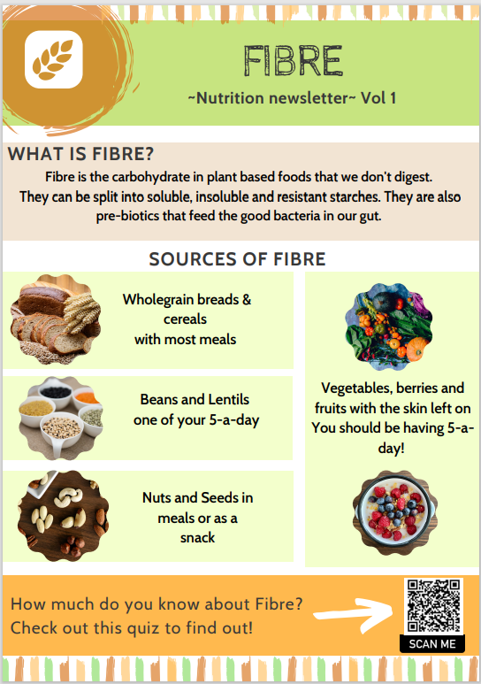
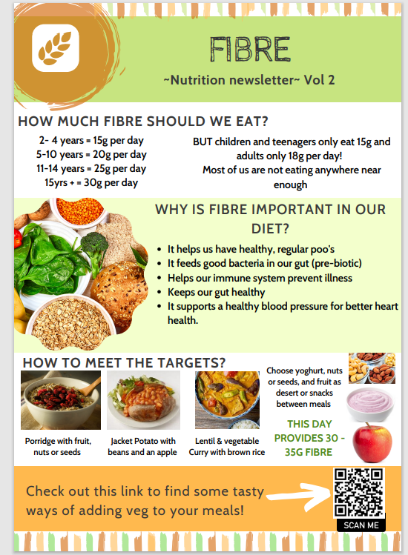
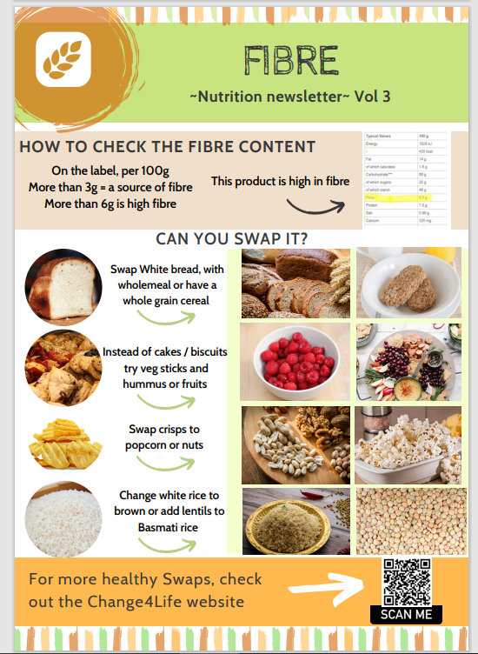
Newsletters

Slide 10
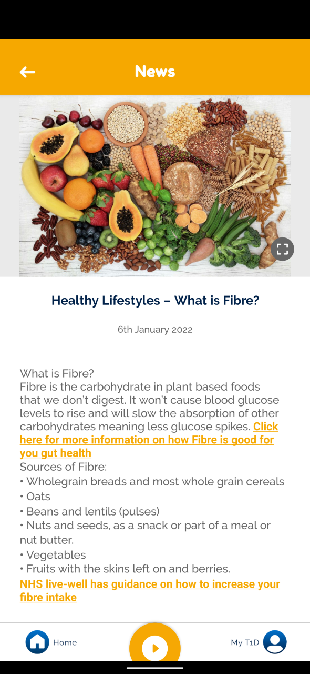
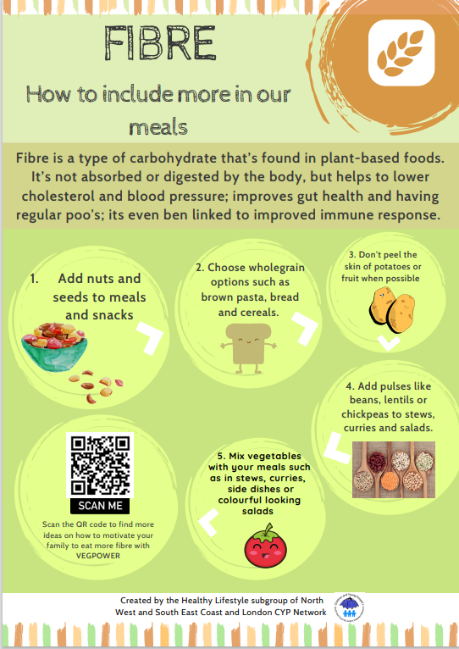
Virtual Resources
Digibete post draft
Digital poster to put in screens or to have available in clinics

Slide 11
Links to more Guidance
Waiting room presentations for services that have screens
The use of QR codes to signpost to other resources

Slide 12
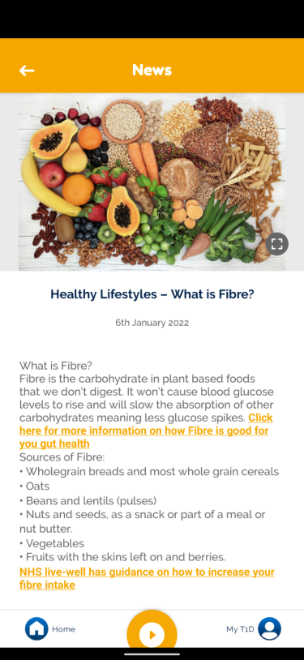
Ways of using the toolkit
3 months per topic. 1 post in Digibete/social media 1 and newsletter per month
Health Promotion Campaign 2 years
Present the concept to your MDT and apply the questionnaire
Display poster
1)

Slide 13
Ways of using the toolkit
Use resources to educate families in case you spot specific needs of education in areas of general healthy living.
2)

Slide 14
Update: Year 1 content

Slide 15
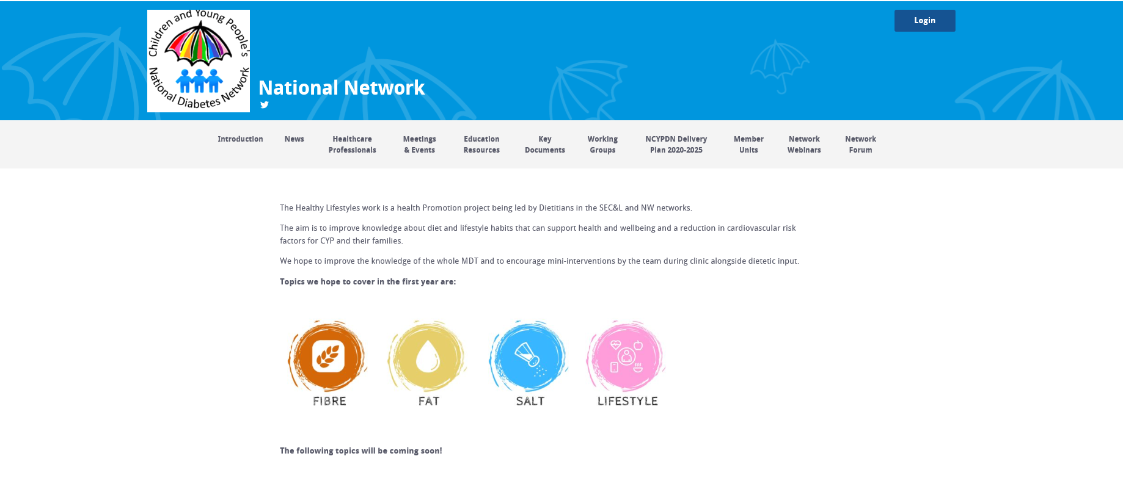
Where to find the resources
Website: South East Coast & London and North West Health Promotion Project - National Network (cypdiabetesnetwork.nhs.uk)

Slide 16
Future Opportunities
To be available on Digibete
To be translated into different languages
For the questionnaire to be validated and potentially for use in national comparison and research of lifestyle habits
Opportunities to be used outside diabetes settings, public health, obesity clinics, general dietetic clinics and GP surgeries

Slide 17
WORKING GROUP
Paediatric Diabetes Dietitians from:
Barts Health NHS Trust
London North West University NHS Trust
North Middlesex University NHS Trust
Manchester Foundation NHS Trust
Salford Royal Foundation NHS Trust
Stockport NHS Foundation Trust
Dartford and Gravesham NHS Trust
Royal Alexandra Hospital
St Mary's Hospital, Imperial College Healthcare NHS Trust
Medway NHS Foundation trust
Royal Wolverhampton NHS Trust
Contacts:
Kate Henson
kate.henson@mft.nhs.uk
Paula Chinchilla
paula.chinchilla@nhs.net
Usha Parkash
Usha.parkash@nhs.net

